Slide 1
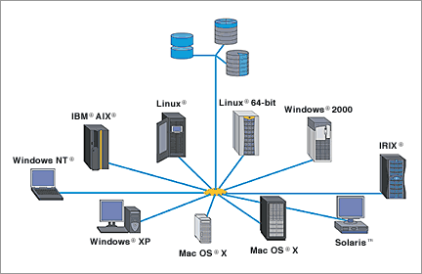
Unix Training

Slide 2
Unix
Goals
Unix Architecture
System Bootup
Login Management
Directories and Files
Unix File Management
Standard Unix Streams
Unix Directories

Slide 3
Unix
Goals
File Permissions
Unix Environment Commands
Java Basic Utilities
Unix Pipes and Filters
Grep Command
Unix Process Management
Ping, FTP utility

Slide 4
Unix
Goals
Vi Editor
Shell Commands
Shell Scripting

Slide 5
What is Unix
UNIX once referred to a specific operating system.
However, today it is not a single operating system, but rather a large family of closely related operating systems.
These different operating systems are sometimes known as UNIX variants, or UNIX-like operating systems.
All these operating systems are built using a collection of enabling technologies that were originally developed in the 1970s at AT&T Bell Laboratories and at the University of California, Berkeley They have much in common and share a set of utilities and programs.

Slide 6
What is Unix
The Unix system is a multi-user, multi tasking operating system which means that it allows a single or multiprocessor computer to simultaneously execute several programs by one or several users.
It has one or several command interpreters (shell) as well as a great number of commands and many utilities (assembler, compilers for many languages, text processing, email, etc.).

Slide 7
What is Unix
Furthermore, it is highly portable, which means that it is possible to implement a Unix system on almost all hardware platforms.
Currently, Unix systems have a strong foothold in professional and university environments thanks to their stability, their increased level of security and observance of standards, notably in terms of networks.

Slide 8
Why Is UNIX Important
During the past 35 years, the operating system known as UNIX has evolved into a powerful, flexible, and versatile operating system.
The different variants of UNIX conform to a variety of standards and are closely related.
To understand how to use any or all of them, you need to only understand the basic conceptual model upon which UNIX is built.
Once this conceptual model is understood, it is straightforward to learn the peculiarities of a variant of UNIX or to learn how to use a new variant of UNIX if you already know how to use another.

Slide 9
Why Is UNIX Important
UNIX, as it is implemented in its many variants, serves as the operating system for all types of computers, including personal computers and engineering workstations, multiuser microcomputers, minicomputers, mainframes, and supercomputers, as well as special-purpose devices.
The number of computers running a variant of UNIX has grown explosively with more than 40 million computers now running a variant of UNIX and more than 300 million people using these systems.
This rapid growth, especially for computers running Linux, is expected to continue, according to most computer industry experts.
The success of UNIX is due to many factors, including its portability to a wide range of machines, its adaptability and simplicity, the wide range of tasks that it can perform, its multiuser and multitasking nature, and its suitability for networking, which has become increasingly important as the Internet has blossomed.

Slide 10
Why Is UNIX Important
Open Source Code
Cooperative Tools and Utilities
Multiuser and Multitasking Abilities
Excellent Networking Environment(excellent platform for web servers)
Portability(people using the desktop environment of Mac OS X without knowing that it is built on UNIX)
less work is needed to adapt it to run on a new hardware platform.

Slide 11
Why Is UNIX Important
Security
Background Processing (Many jobs/tasks are executed in bg without human intervention).
Pipes (chain od commands)
Redirection tools
Software Development Tools (any language which has interpreter and compiler).
Communication

Slide 12
Why Is UNIX Important
Hierarchical File System
Shells

Slide 13
The Structure of the UNIX Operating System

Slide 14
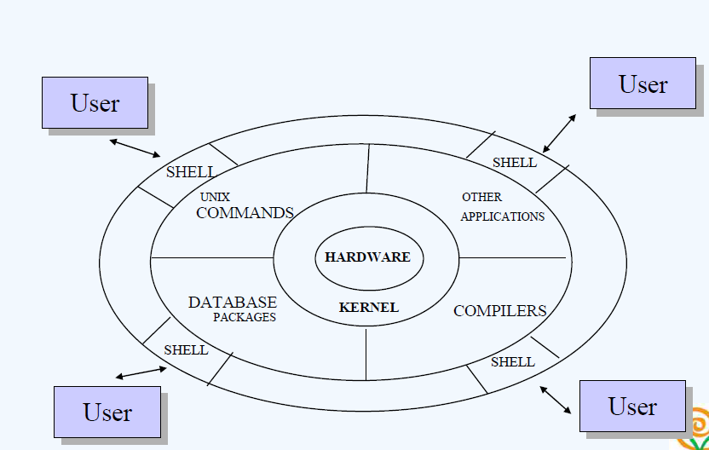
The Structure of the UNIX Operating System

Slide 15
The Structure of the UNIX Operating System
The UNIX operating system is made up of several major components.
These components include the kernel, the shell, the file system, and the commands (or user programs ).

Slide 16
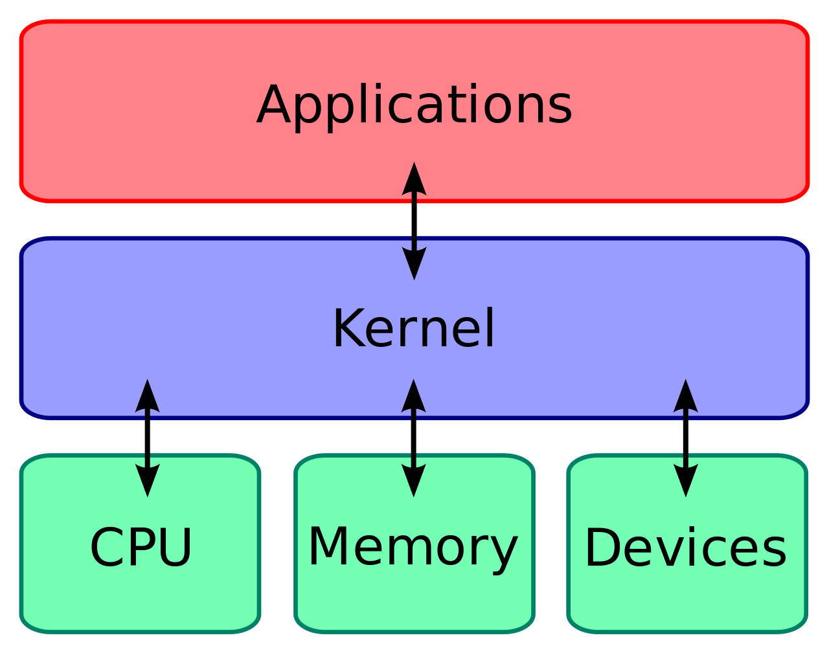
Kernel

Slide 17
Kernel
The kernel is the part of the operating system that interacts directly with the hardware of a computer, through device drivers that are built into the kernel.
It provides sets of services that can be used by programs, insulating these programs from the underlying hardware.
The major functions of the kernel are to
manage computer memory
control access to the computer
maintain the file system

Slide 18
Kernel
handle interrupts (signals to terminate execution)
handle errors
perform input and output services (which allow computers to interact with terminals, storage devices, and printers)
allocate the resources of the computer (such as the CPU or input/output devices) among users.

Slide 19
Kernel
Programs interact with the kernel through system calls.
System calls tell the kernel to carry out various tasks for the program, such as
Opening a file, writing to a file, obtaining information about a file, executing a program, terminating a process, changing the priority of a process.
Getting the time of day Different implementations of a variant of the UNIX system may have compatible system calls, with each call having the same functionality.
However, the internals, programs that perform the functions of system calls (usually written in the C language), and the system architecture in two different UNIX variants or even two different implementations of a particular UNIX variant may bear little resemblance to one another.

Slide 20
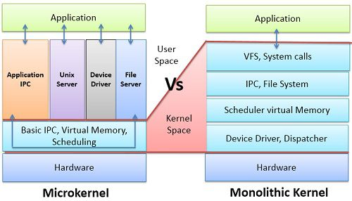
Kernel

Slide 21
Kernel
BASIS FOR COMPARISON | MICROKERNEL | MONOLITHIC KERNEL
Basic | In microkernel user services and kernel, services are kept in separate address space. | In monolithic kernel, both user services and kernel services are kept in the same address space.
Size | Microkernel are smaller in size. | Monolithic kernel is larger than microkernel.
Execution | Slow execution. | Fast execution.
Extendible | The microkernel is easily extendible. | The monolithic kernel is hard to extend.
Security | If a service crashes, it does effect on working of microkernel. | If a service crashes, the whole system crashes in monolithic kernel.
Code | To write a microkernel, more code is required. | To write a monolithic kernel, less code is required.
Example | QNX, Symbian, L4Linux, Singularity, K42, Mac OS X, Integrity, PikeOS, HURD, Minix, and Coyotos. | Linux, BSDs (FreeBSD, OpenBSD, NetBSD), Microsoft Windows (95,98,Me), Solaris, OS-9, AIX, HP-UX, DOS, OpenVMS, XTS-400 etc.

Slide 22
Utilities
The UNIX System contains several hundred utilities or user programs.
Commands are also known as tools, because they can be used separately or put together in various ways to carry out useful tasks.
You execute these utilities by invoking them by name through the shell; this is why they are called commands.
A critical difference between UNIX and earlier operating systems is the ease with which new programs can be installed-the shell need only be told where to look for commands, and this is user-definable

Slide 23
Utilities
You can perform many tasks using the standard utilities supplied with UNIX.
There are utilities for text editing and processing, for managing information, for electronic communications and networking, for performing calculations, for developing computer programs, for system administration, and for many other purposes.

Slide 24
The File System
The basic unit used to organize information in UNIX is called a file.
The UNIX file system provides a logical method for organizing, storing, retrieving, manipulating, and managing information.
Files are organized into a hierarchical file system, with files grouped together into directories.
An important simplifying feature of UNIX is the general way it treats files.
For example, physical devices are treated as files; this permits the same commands to work for ordinary files and for physical devices; for instance, printing a file (on a printer) is treated similarly to displaying it on the terminal screen.

Slide 25
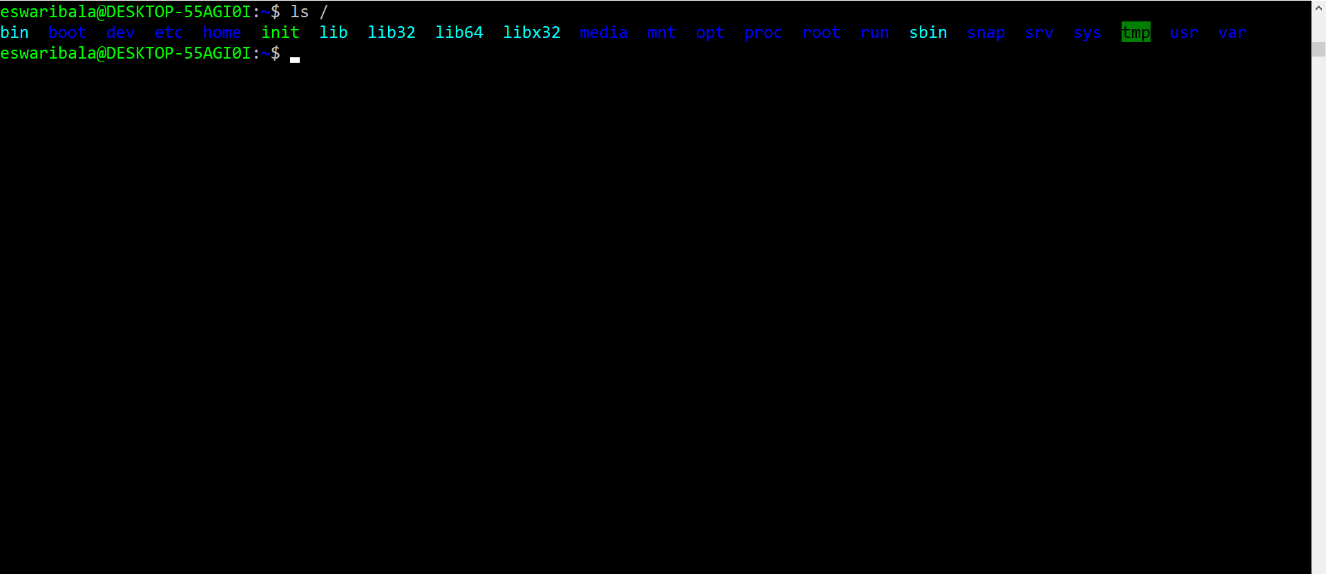
The File System

Slide 26
The Shell
The shell reads your commands and interprets them as requests to execute a program or programs, which it then arranges to have carried out.
Because the shell plays this role, it is called a command interpreter.
Besides being a command interpreter, the shell is also a programming language.
As a programming language, it permits you to control how and when commands are carried out

Slide 27
Applications
You can use applications built using UNIX commands, tools, and programs. Application programs carry out many different types of tasks.
Some perform general functions that can be used by a variety of users in government, industry, and education.
These are known as horizontal applications and include such programs as word processors, compilers, database management systems, spreadsheets, statistical analysis programs, and communications programs.
Others are industry specific and are known as vertical applications.
Examples include software packages used for managing a hotel, running a bank, and operating point-of-sale terminals.

Slide 28
Applications
Several classes of applications have experienced explosive growth in the past few years.
The first of these involves network applications, including those that let people make use of the wide range of services available on the Internet.
Chief among these are web browsers and web server applications.
Another important class of applications deals with multimedia.
Such applications let users create and view multimedia files, including audio, images, and video.

Slide 29
The Birth of the UNIX System
The history of the UNIX System dates back to the late 1960s when MIT, AT&T Bell Labs, and then computer manufacturer GE (General Electric) worked on an experimental operating system called Multics.
Multics, from Multiplexed Information and Computing System, was designed to be an interactive operating system for the GE 645 mainframe computer.
Allowed information sharing while providing security Development met with many delays, and production versions turned out to be slow and required extensive memory
For a variety of reasons, Bell Labs dropped out of the project.
However, the Multics system implemented many innovative features and produced an excellent computing environment.

Slide 30
The Birth of the UNIX System
In 1969, Ken Thompson, one of the Bell Labs researchers involved in the Multics project, wrote a game for the GE computer called Space Travel.
This game simulated the solar system and a space ship.
Thompson found that the game ran jerkily on the GE machine and was costly-approximately $75 per run! With help from Dennis Ritchie, Thompson rewrote the game to run on a spare DEC PDP-7.
This initial experience gave him the opportunity to write a new operating system on the PDP-7, using the structure of a file system Thompson, Ritchie, and Rudd Canaday had designed.
Thompson, Ritchie, and their colleagues created a multitasking operating system, including a file system, a command interpreter, and some utilities for the PDP-7.

Slide 31
The Birth of the UNIX System
Because the new multitasking operating system for the PDP-7 could support two simultaneous users, it was humorously called UNICS for the Uniplexed Information and Computing System; the first use of this name is attributed to Brian Kernighan.
The name was changed slightly to UNIX in 1970, and that has stuck ever since.

Slide 32
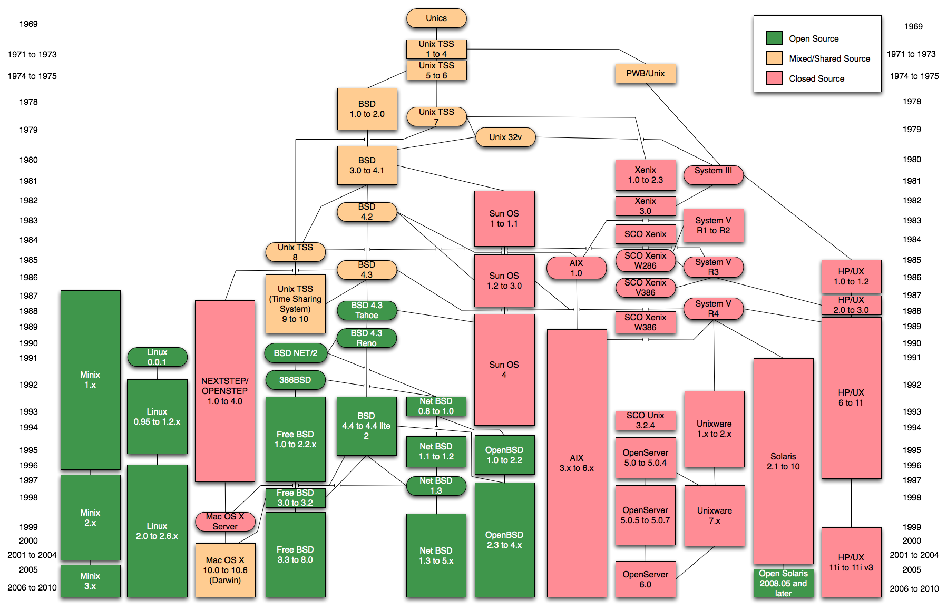
The Birth of the UNIX System

Slide 33
A UNIX System Timeline

Slide 34
A UNIX System Timeline

Slide 35
A UNIX System Timeline

Slide 36
A UNIX System Timeline

Slide 37
A UNIX System Timeline

Slide 38
A UNIX System Timeline

Slide 39
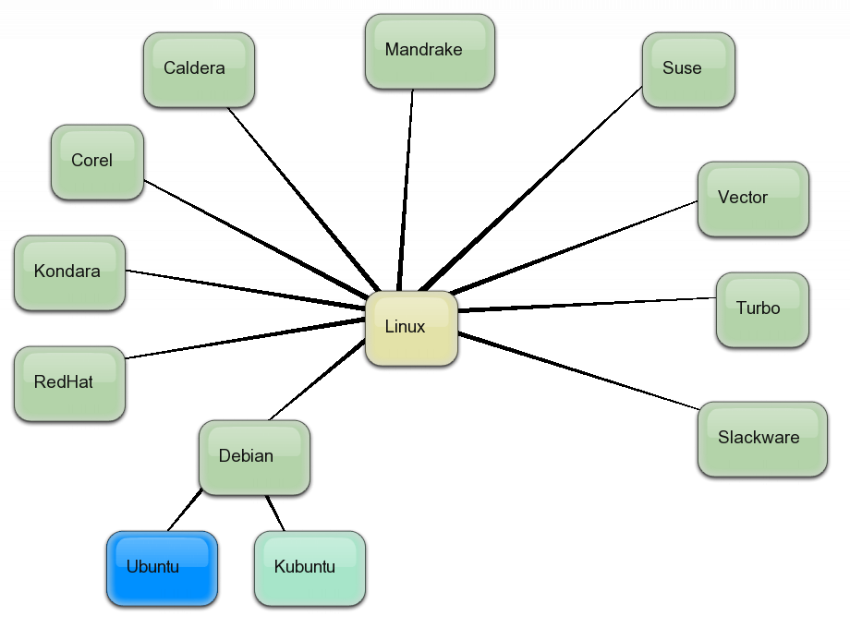
Widely Used UNIX Variants

Slide 40
UNIX Contributors

Slide 41
UNIX Contributors

Slide 42
UNIX Contributors

Slide 43
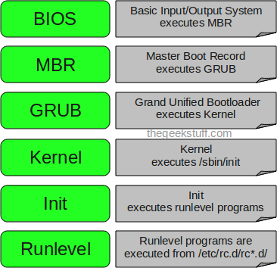
Boot up Process

Slide 44
Bios
BIOS stands for Basic Input/Output System
Performs some system integrity checks
Searches, loads, and executes the boot loader program.
It looks for boot loader in floppy, cd-rom, or hard drive. You can press a key (typically F12 of F2, but it depends on your system) during the BIOS startup to change the boot sequence.
Once the boot loader program is detected and loaded into the memory, BIOS gives the control to it.
So, in simple terms BIOS loads and executes the MBR boot loader.

Slide 45
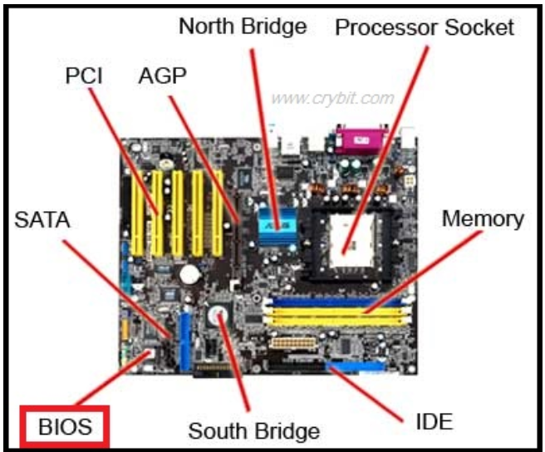
Bios

Slide 46
MBR
MBR stands for Master Boot Record.
It is located in the 1st sector of the bootable disk. Typically /dev/hda, or /dev/sda
MBR is less than 512 bytes in size. This has three components 1) primary boot loader info in 1st 446 bytes 2) partition table info in next 64 bytes 3) mbr validation check in last 2 bytes.
It contains information about GRUB (or LILO in old systems).
So, in simple terms MBR loads and executes the GRUB boot loader.

Slide 47
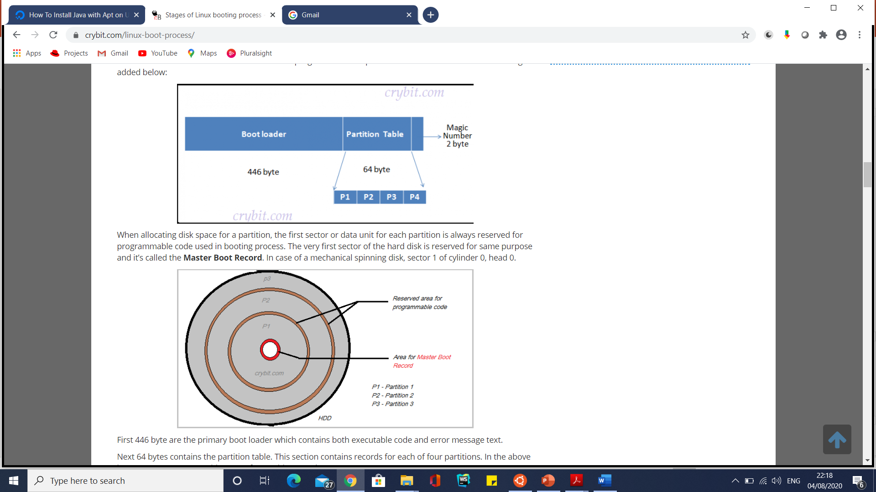
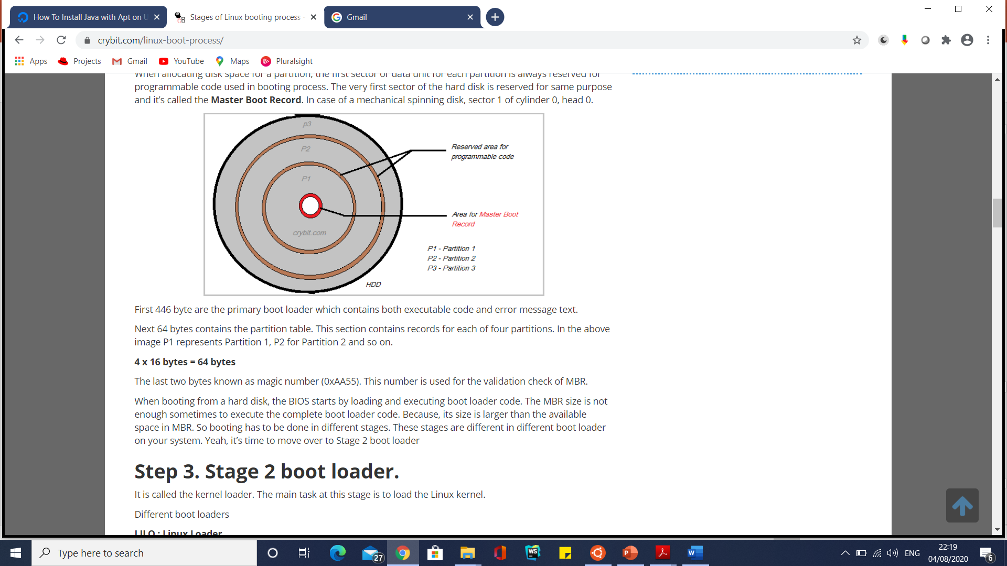
MBR

Slide 48
GRUB
GRUB stands for Grand Unified Bootloader.
If you have multiple kernel images installed on your system, you can choose which one to be executed.
GRUB displays a splash screen, waits for few seconds, if you don’t enter anything, it loads the default kernel image as specified in the grub configuration file.
GRUB has the knowledge of the filesystem (the older Linux loader LILO didn’t understand filesystem).
Grub configuration file is /boot/grub/grub.conf (/etc/default/grub.d is a link to this).

Slide 49
Kernel
Mounts the root file system as specified in the “root=” in grub.conf
Kernel executes the /sbin/init program
Since init was the 1st program to be executed by Linux Kernel, it has the process id (PID) of 1. Do a ‘ps -ef | grep init’ and check the pid.
initrd stands for Initial RAM Disk.
initrd is used by kernel as temporary root file system until kernel is booted and the real root file system is mounted. It also contains necessary drivers compiled inside, which helps it to access the hard drive partitions, and other hardware.

Slide 50
Init
Looks at the /etc/inittab file to decide the Linux run level.
Following are the available run levels
0 – halt
1 – Single user mode
2 – Multiuser, without NFS
3 – Full multiuser mode
4 – unused
5 – X11
6 – reboot
Init identifies the default initlevel from /etc/inittab and uses that to load all appropriate program.

Slide 51
Init
Execute ‘grep initdefault /etc/inittab’ on your system to identify the default run level
If you want to get into trouble, you can set the default run level to 0 or 6. Since you know what 0 and 6 means, probably you might not do that.
Typically you would set the default run level to either 3 or 5.

Slide 52
Runlevel programs
When the Linux system is booting up, you might see various services getting started. For example, it might say “starting sendmail …. OK”. Those are the runlevel programs, executed from the run level directory as defined by your run level.

Slide 53
Runlevel programs
Depending on your default init level setting, the system will execute the programs from one of the following directories.
Run level 0 – /etc/rc.d/rc0.d/
Run level 1 – /etc/rc.d/rc1.d/
Run level 2 – /etc/rc.d/rc2.d/
Run level 3 – /etc/rc.d/rc3.d/
Run level 4 – /etc/rc.d/rc4.d/
Run level 5 – /etc/rc.d/rc5.d/
Run level 6 – /etc/rc.d/rc6.d/

Slide 54
Runlevel programs
Please note that there are also symbolic links available for these directory under /etc directly. So, /etc/rc0.d is linked to /etc/rc.d/rc0.d.
Under the /etc/rc.d/rc*.d/ directories, you would see programs that start with S and K.
Programs starts with S are used during startup. S for startup.
Programs starts with K are used during shutdown. K for kill.
There are numbers right next to S and K in the program names. Those are the sequence number in which the programs should be started or killed.
For example, S12syslog is to start the syslog deamon, which has the sequence number of 12. S80sendmail is to start the sendmail daemon, which has the sequence number of 80. So, syslog program will be started before sendmail.

Slide 55
Install Ubuntu in Windows 10
https://docs.microsoft.com/en-us/windows/wsl/install-win10
In the next step, it's time to install the graphical desktop programs. You do this by running these programs from Bash:
https://www.zdnet.com/article/how-to-run-run-the-native-ubuntu-desktop-on-windows-10/
apt-get install ubuntu-desktop
apt-get install unity
apt-get install compiz-core
apt-get install compizconfig-settings-manager
export DISPLAY=localhost:0
Ccsm

Slide 56
Install Ubuntu in Windows 10
sudo apt-get install xfce4
Xfce4-session

Slide 57
How to access and log in to a UNIX system
https://cocalc.com/doc/terminal.html

Slide 58
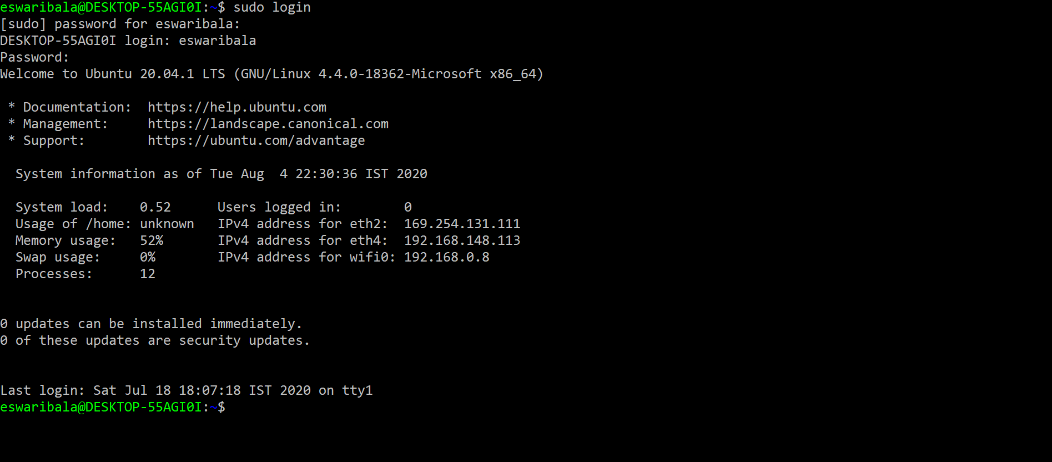
How to access and log in to a UNIX system

Slide 59
How to access and log in to a UNIX system
Every UNIX system has at least one person, called the system administrator, whose job is to maintain the system.
The system administrator is also responsible for adding new users to the system, and for setting up the initial work environment.
If you are on a multiuser system, you will have to ask the system administrator to set up a login for you.
If you are the only user on the system, you will be the system administrator.
During the installation of your UNIX variant, you will be asked to select a login name and password.

Slide 60
How to access and log in to a UNIX system
In general, your login name can be almost any combination of letters and numbers, although there are a few constraints:
Your login name must be more than two characters long.
If it is longer than eight, only the first eight characters are relevant.
It must contain only lowercase letters and numbers and must begin with a lowercase letter.
No symbols or spaces are allowed.
It cannot be the same as another login name already in use. Some login names are customarily reserved for certain uses; for example, root is often a login name for the system administrator (sometimes called the superuser ).

Slide 61
How to access and log in to a UNIX system
Choosing a Password
If you begin by installing a UNIX variant on your own system, it will ask you to choose a password when you select a login name.
If your account is on a remote system, your system administrator will probably assign you a temporary password, which you should change the first time you log in.

Slide 62
How to access and log in to a UNIX system
Passwords must have at least six characters.
Passwords must contain at least two alphabetic characters (uppercase or lowercase letters), and at least one number or symbol. Note that UNIX is sensitive to case, so WIZARD is a different password than w1zard.
Your login name with its letters reversed or shifted cannot be used as a password.
For example, if your login name is msilver, you cannot choose silverm or revlism as a password.
The passwords 3hrts&3lyonz and R0wkS+@r are both valid, but kilipuppy (no numeric or special characters) and Red1 (too short) are not.

Slide 63
UNIX System Password Security
Your first contact with security on your UNIX system is choosing a password.
Simple passwords are easily guessed. A large commercial dictionary contains about 250,000 words, which can be checked as passwords in less than two minutes of computer time.
All dictionary words spelled backward takes about another minute.
All dictionary words preceded or followed by the digits 0–99 can be checked in just a few more minutes.

Slide 64
UNIX System Password Security
Here are some guidelines:
Avoid easily guessed passwords, such as your name or the names of family members or pets.
Also avoid your address, your car’s license plate, and any other phrase that someone might associate with you.
Avoid words or names that exist in a dictionary (in any language, not just English).
Avoid trivial modifications of dictionary words. For example, normal words with replacement of certain letters with numbers: mid5umm3r, sn0wball, and so forth.

Slide 65
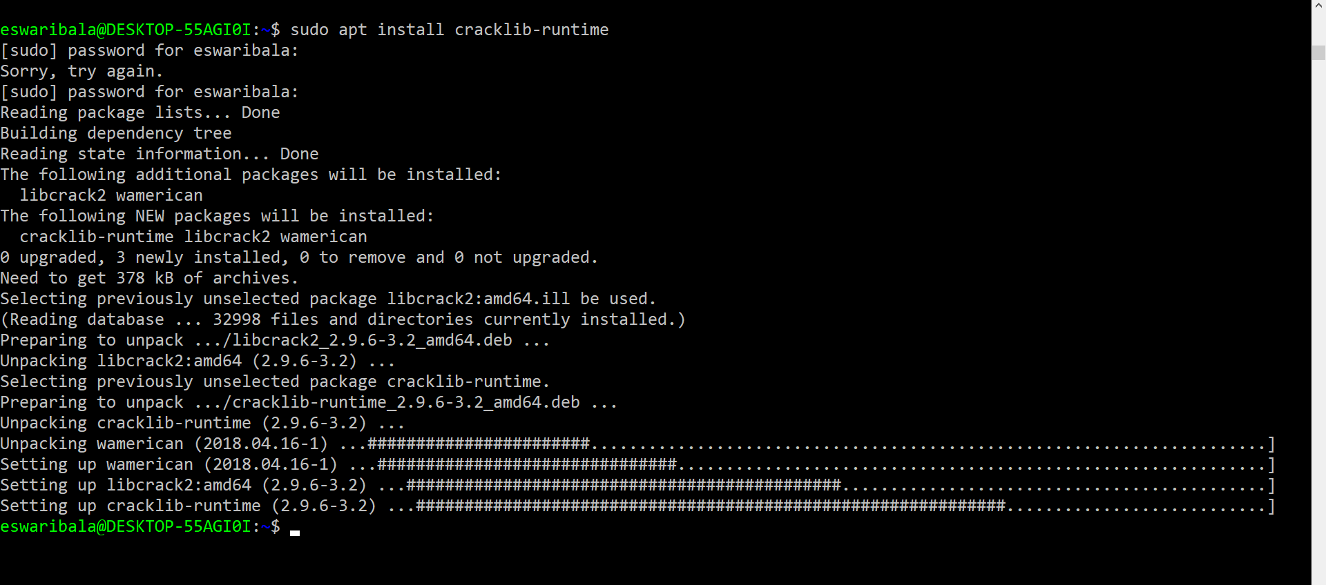
UNIX System Password Security
sudo apt install cracklib-runtime

Slide 66
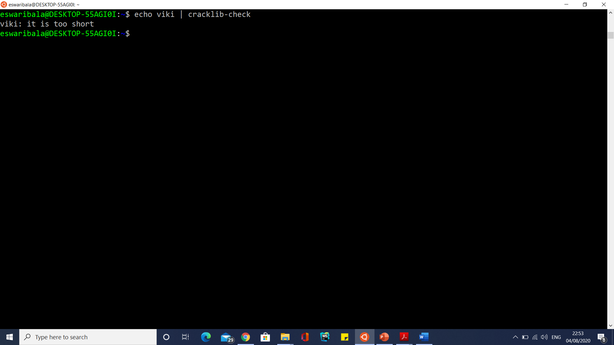
UNIX System Password Security Stength
echo viki | cracklib-check

Slide 67
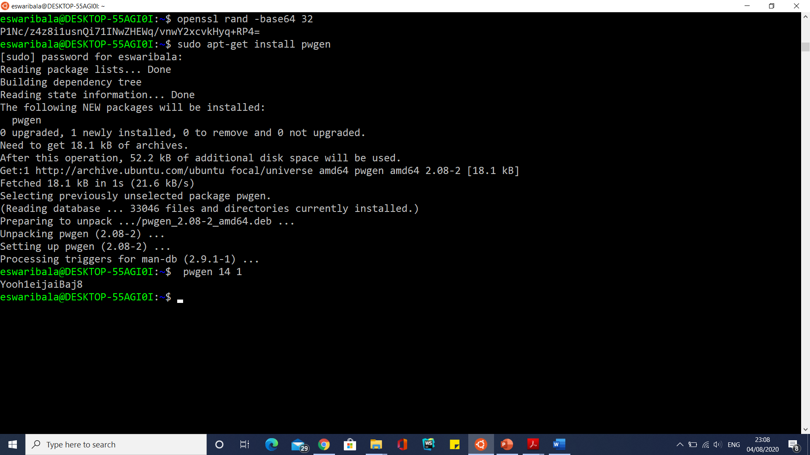
Generate Strong Passwords

Slide 68
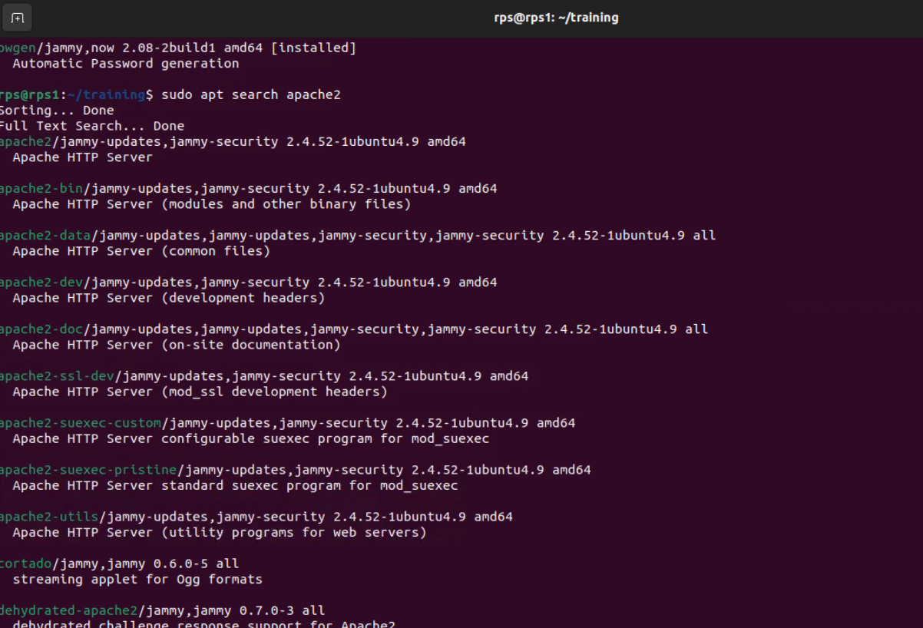
Search For Package Before Installation

Slide 69
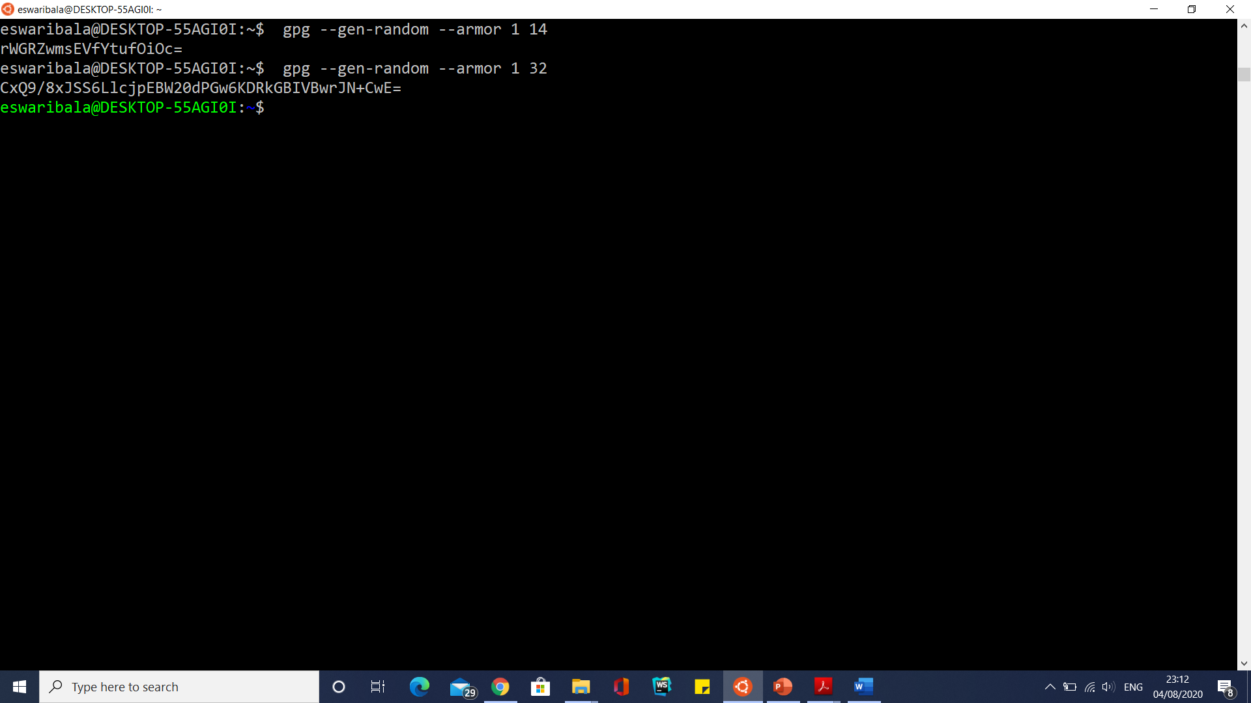
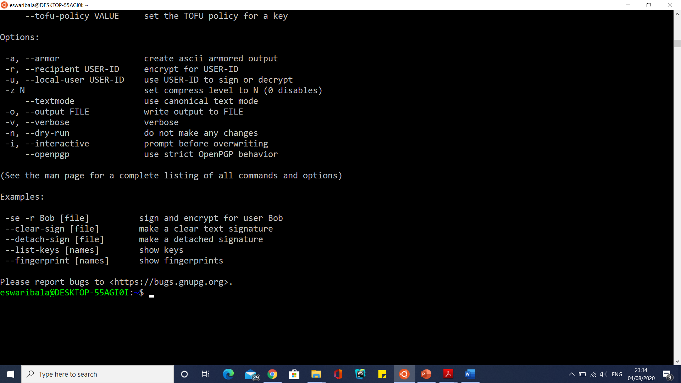
Generate Strong Passwords

Slide 70
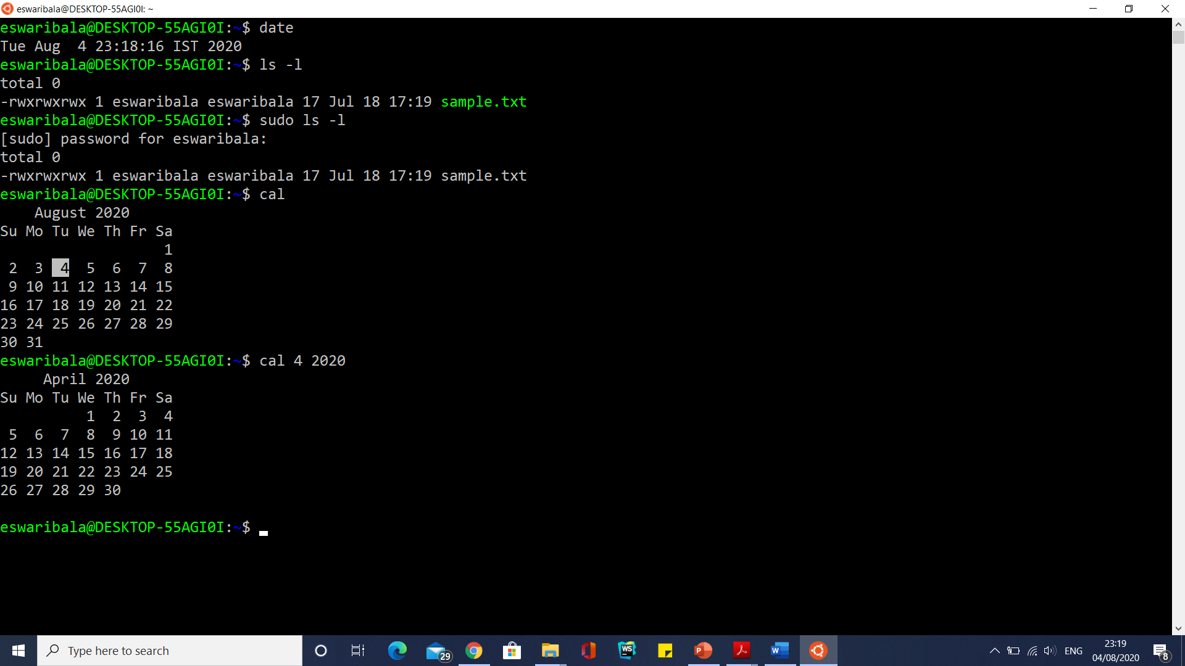
Entering Commands

Slide 71
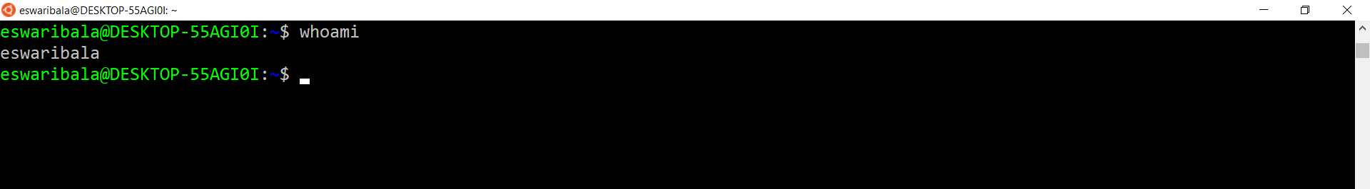
Entering Commands
Who logged in whoami

Slide 72
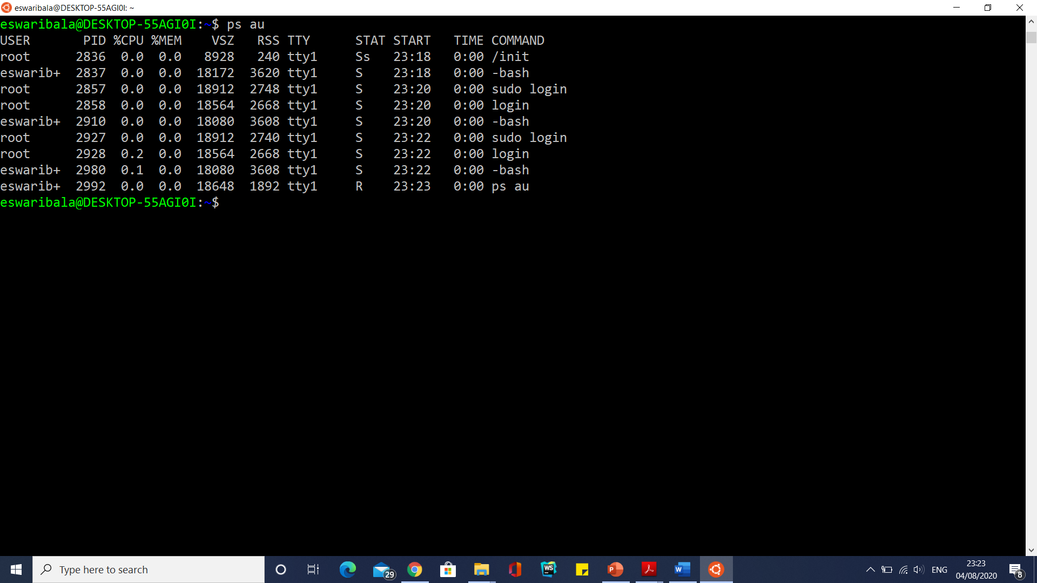
Entering Commands
Who logged in who –H, w, who –u, ps au

Slide 73
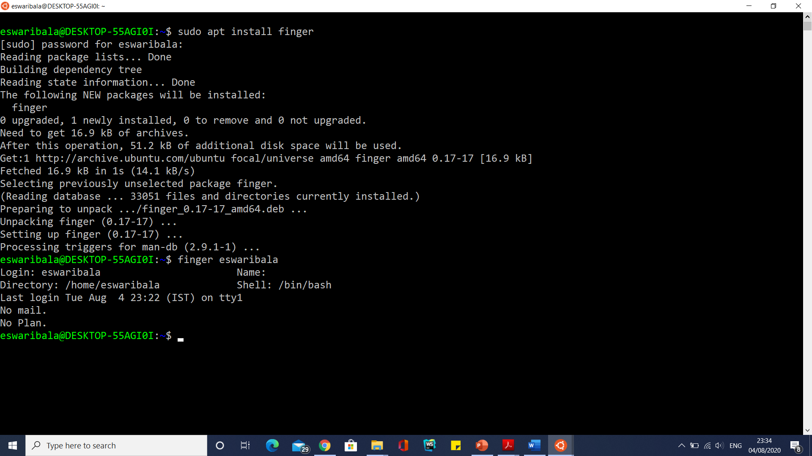
Entering Commands

Slide 74
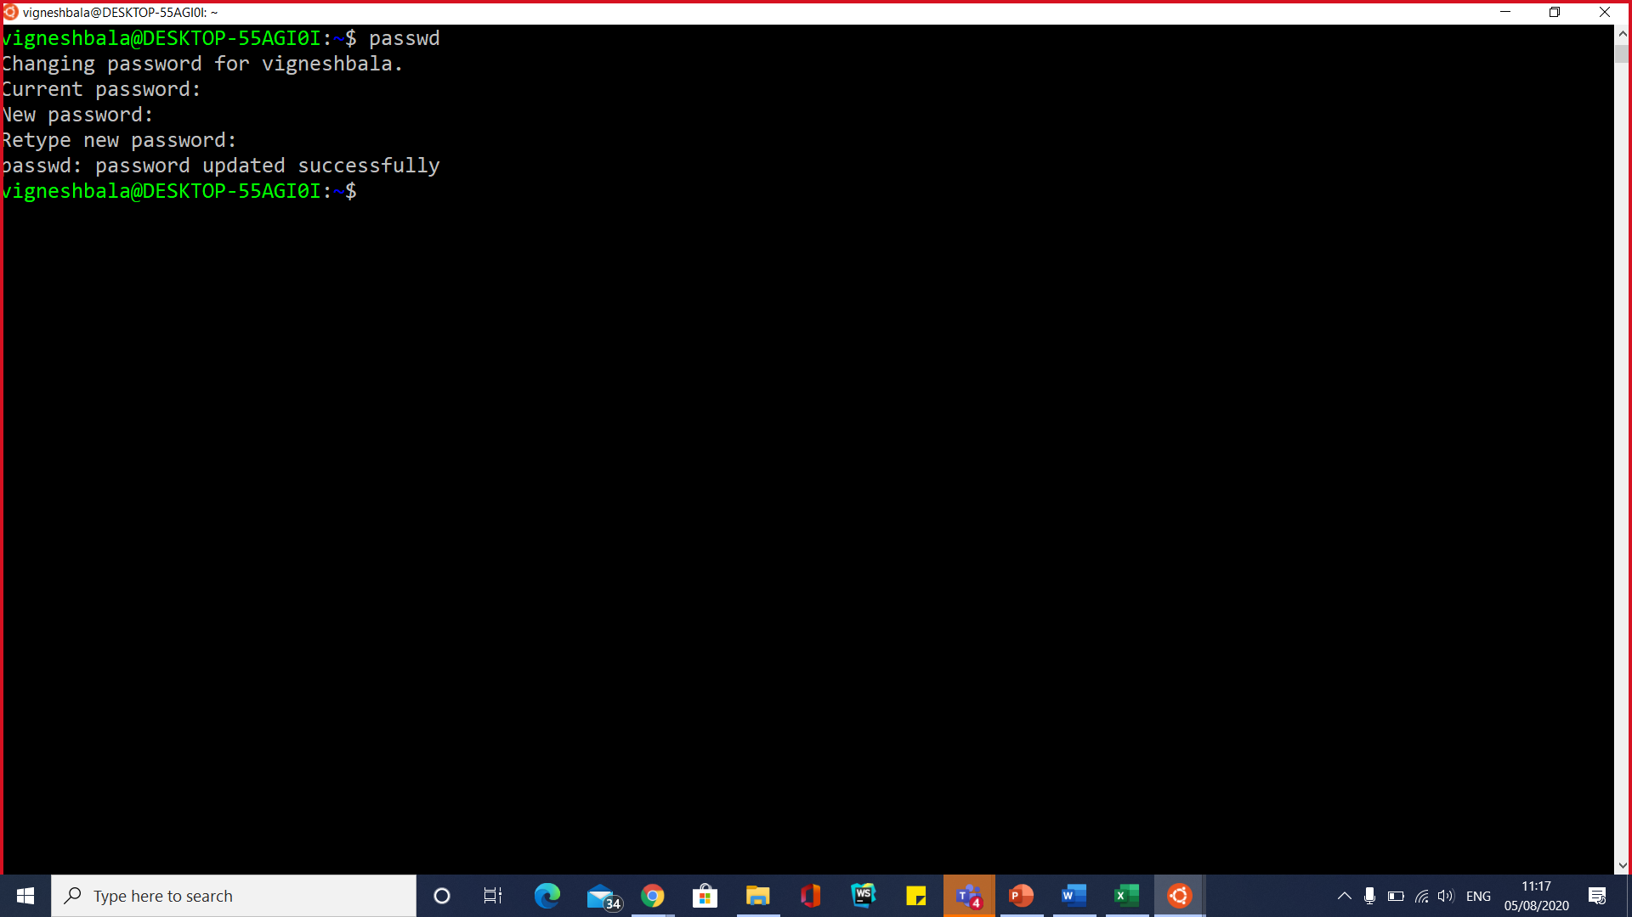
Update Password

Slide 75
Logout
Logging Out
When you finish your work session and wish to leave the UNIX system, type exit (or CTRL-D) to log out. After a few seconds, your UNIX system will display the “login:” prompt:
$ exit
login:
This shows that you have logged out, and that the system is ready for another user to log in using your terminal.

Slide 76
Command Summary

Slide 77
Working with Files and Directories
The UNIX file system provides a powerful and flexible way to organize and manage your information.
Files
A file is the basic structure that stores information on the UNIX System (and on Windows systems, as well).
Conceptually, a computer file is similar to a paper document. Technically a file is a sequence of bytes that is stored somewhere on a storage device, such as a hard drive.
A file can contain any kind of information that can be represented as a sequence of bytes.
Word processing documents, bitmap images, and computer programs are all examples of files.

Slide 78
Filenames
Every file has a title, called a filename.
A filename can be almost any sequence of characters, and up to 255 characters long. (On some older versions of UNIX, two filenames are considered the same if the first 14 characters are identical, so be careful if you use long filenames on these systems.)
You can use any ASCII character in a filename except for the null character (ASCII NUL) or the slash (/), which has a special meaning in the UNIX file system.
The slash acts as a separator between directories and files.

Slide 79
Filenames
Even though UNIX allows you to choose filenames with special characters, it is a good idea to stick with alphanumeric characters (letters and numbers) when naming files.
You may encounter problems when you use or display the names of files containing nonalphanumeric characters. In particular, although the following characters can be used in filenames, it is better to avoid them.
Many of these characters have special meanings in the command shell, which makes them difficult to work with in filenames.

Slide 80
Filenames

Slide 81
Filenames
Capitalization
Windows does not distinguish between uppercase and lowercase letters in filenames.
You could save a file with the name Notes.DOC and find it by searching for notes.doc.
The UNIX file system, however, is case-sensitive, meaning that uppercase and lowercase letters are distinct. In UNIX, NOTES, Notes, and notes would be three different files.
If you save a file with the name Music, you will not find it by searching for music. This also applies to commands in UNIX.
If you are trying to log out with the exit command, typing EXIT will not work.
By the way, this explains why URLs (web addresses) can be case-sensitive, since the first web server was created on a UNIX-based platform, and many web servers still run UNIX.

Slide 82
Filenames
Filename Extensions
In Windows, filenames typically consist of a base name, followed by a period and a short filename extension.
Many Windows programs depend on the extension to determine how to use the file.
For example, a file named solitaire.exe is considered to be a file named solitaire with the extension .exe, where the .exe extension tells Windows that it is an executable program.
If the file extension is altered or deleted, it will be more difficult to work with the file in Windows.

Slide 83
Filenames
Filename Extensions
In UNIX, file extensions are conveniences, rather than a necessary part of the filename.
They can help you remember the content of files, or help you organize your files, but they are usually optional.
In fact, many UNIX filenames do not have an extension.
For example, an executable program would typically have a name like solitaire rather than solitaire.exe.
In addition, filename extensions in UNIX can be longer than three characters.
For example, some people use .backup to indicate a backup copy of a file, so notes.backup would be an extra copy of the file notes.

Slide 84
Filenames
Filename Extensions

Slide 85
Filenames
Filename Extensions
UNIX files can have more than one extension.
For example, the file book.tar.Z is a file that has first been archived using the tar command (which adds the extension .tar ) and then compressed using the compress command (which adds the .Z).
This enables a single script to both decompress the file and untar it, using the filename as input and parsing each of the extensions to perform the appropriate task.
The flexibility of filename conventions in UNIX allow for some variation in filenames.
A program written in Perl could have the filename program.perl, the more frequently used program.pl, or even just the name program.
You can even create your open file extensions.

Slide 86
Directories
Files contain the information you work with.
Directories provide a way to organize your files.
A directory is just a container for as many files as you care to put in it.
If you think of a file as analogous to a document in your office, then a directory is like a file folder.
In fact, directories in UNIX are exactly like folders in Windows.
For example, you may decide to create a directory to hold all of your notes.
You could name it Notes and use it to hold only files that are your notes, keeping them separated from your e-mail, programs, and other files.

Slide 87
Subdirectories
A directory can also contain other directories.
A directory inside another directory is called a subdirectory.
You can create as many subdirectories inside a particular directory as you wish.

Slide 88
Choosing Directory Names
It is a good idea to adopt a convention for naming directories so that they can be easily distinguished from ordinary files.
Some people give directories names that are all uppercase letters, some use directory names that begin with an uppercase letter, and others distinguish directories using the extension .d or .dir.
For example, if you decide to use names beginning with an uppercase letter for directories and avoid naming ordinary files this way, you will know that Notes, Misc, Multimedia, and Programs are all directories, whereas note3, misc.note, mm_5, and progmmA are all ordinary files.

Slide 89
The Hierarchical File Structure
Because directories can contain other directories, which can in turn contain other directories, the UNIX file system is called a hierarchical file system.
Within the UNIX System, there is no limit to the number of files and directories you can create in a directory that you own.
File systems of this type are often called tree-structured file systems, because each directory allows you to branch off into other directories and files.
Tree-structured file systems are usually depicted upside-down, with the root of the tree at the top of the drawing.

Slide 90
The Hierarchical File Structure
Update apt libraries
Sudo add-apt-repository universe
Sudo apt update
Sudo apt-get install tree

Slide 91
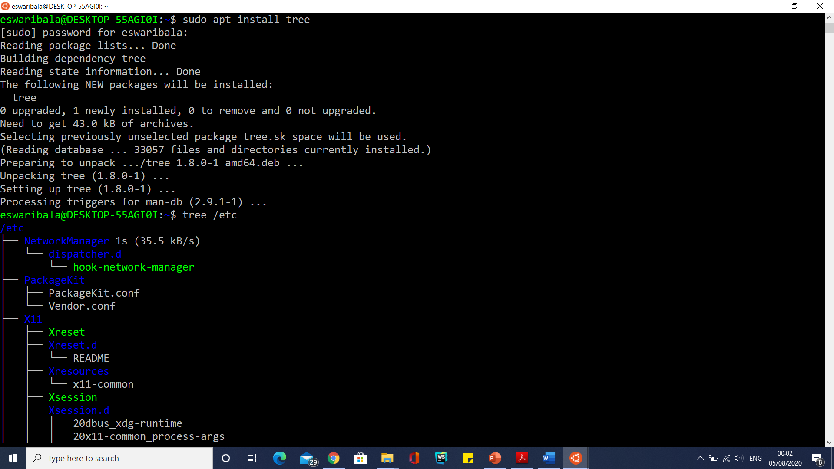
The Hierarchical File Structure

Slide 92
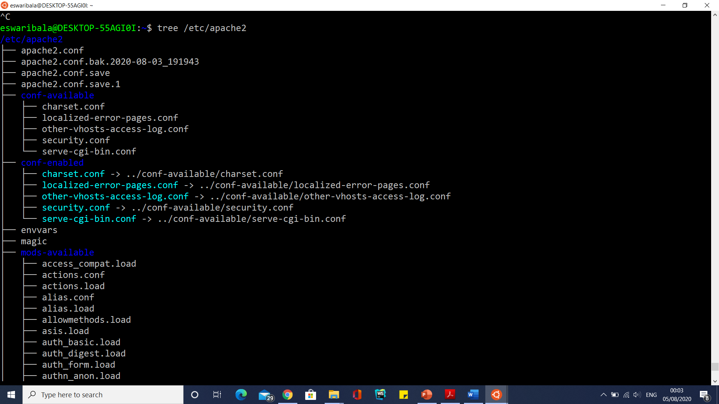
The Hierarchical File Structure

Slide 93
Pathnames
If there are two files with the same name, but in different locations in the file system.
There is a save file in the Email directory, and another file called save in the Work directory.
In order to distinguish files with the same name, the UNIX System allows you to specify filenames by including the location of the file in the directory tree.
This type of name is called a pathname, because it is a listing of the directories you travel through along the path you take to get to the file.
The path through the file system starts at root (/), and the names of directories and files in a pathname are separated by slashes.
For example, the pathname for one of the save files is
/home/raf/Email/save
and the pathname for the other is
/home/raf/Work/save

Slide 94
Pathnames
Pathnames that trace the path from root to a file are called full (or absolute) pathnames.
Specifying a full pathname provides a complete and unambiguous name for a file. In a full pathname, the first slash (/) refers to the root of the file system.
All the other slashes separate the names of directories, until the last slash separates the filename from the name of the directory it’s in.
Using full pathnames can be awkward when there are many levels of directories, as in this filename:
/home/dkraut/Work/cs106x/Proj_1/lib/Source/strings.c

Slide 95
Pathnames
Relative Pathnames
You do not always have to specify the full pathnames when you refer to files.
As a convenient shorthand, you can also specify a path to a file relative to your present directory Such a pathname is called a relative pathname.
Instead of starting with a / for root, the relative pathname starts with the name of a subdirectory For example, suppose you are in your home directory, /home/raf.
The relative path for the save file in the Email subdirectory is Email/save, and the relative path for the other save file is Work/save.

Slide 96
Pathnames
Specifying the Current Directory
A single dot (.) is used as a shortcut to refer to the directory you are currently in.
This directory is known as the current directory.
Specifying the Parent Directory
Two dots (.., pronounced “dot-dot”) refer to the parent directory of the one you are currently in.
The parent directory is the one at the next higher level in the directory tree.
Because the file system is hierarchical, all directories have a parent directory
The dot-dot references can be used many times to refer to things far up in the file system. The following sequence, for example,
../..
refers to the parent of the parent of the current directory.
If you are in Work, then ../.. is the same thing as the home directory, since home is the parent of raf, which is the parent of Work.

Slide 97
Pathnames
Specifying a Home Directory
A tilde (~) can be used to refer to your home directory (Strictly speaking, this is a feature of the shell.
These shortcuts can be combined.
For example, if your home directory is /home/raf, then
~/../liz
refers to the home directory for the user liz.
You can also use a tilde followed by a login name to refer to another user’s home directory For example, the shortcut ~nate refers to the user nate’s home directory

Slide 98
UNIX System File Types
The file is the basic unit of the UNIX System. Within UNIX, there are four different types of files:
ordinary files, directories, symbolic links, and special files.
Ordinary Files
As a user, most of the information that you work with will be stored as an ordinary file.
An ordinary file can contain data, such as text for documents or programs.
Image files and binary executables are also examples of ordinary files.

Slide 99
UNIX System File Types
Links
Sometimes it is useful to have a file that is accessible from several directories, without making separate copies of the file.
For example, suppose you are working with someone else, and you need to share information contained in a single data file that each of you can update.
It would be convenient for each of you to have a copy in your home directory However, you do not want to make separate copies of the file, because it will be hard to keep them in sync.
A link is not a kind of file but instead is a second name for a file. With a link, only one file exists on the disk, but it may appear in two places in the directory structure.
This can allow two users to share the same file.
Any changes that are made to the file will be seen by both users.
This type of link is sometimes called a hard link, to distinguish it from a symbolic link

Slide 100
UNIX System File Types
A hard Link
can't cross the file system boundaries (i.e. A hardlink can only work on the same filesystem),
can't link directories,
has the same inode number and permissions of original file,
permissions will be updated if we change the permissions of source file,
has the actual contents of original file, so that you still can view the contents, even if the original file moved or removed.

Slide 101
UNIX System File Types
A hard Link
The ln command creates a link between files, which enables you to make a single file accessible at two or more locations in the directory system.
The following links the file project.main in dkraut’s home directory with a new file of the same name in the current directory:
$ ln /home/dkraut/project.main project.main

Slide 102
UNIX System File Types
A soft link
can cross the file system,
allows you to link between directories,
has different inode number and file permissions than original file,
permissions will not be updated,
has only the path of the original file, not the contents.

Slide 103
UNIX System File Types
A soft link
Symbolic links are created by using the ln command with the -s (symbolic) option.
The following example shows how you could use ln to link a file in the /var file system to an entry in one of your directories within the /home file system:
$ ln -s /var/X/docs/readme temp/x.readme
This will create a symbolic link called x.readme in the temp directory
The second argument to ln is optional; if you do not specify the name of the new file, it will create a symbolic link with the same name as the target file. So, for example
$ ln -s /usr/bin/firefox/firefox
will create a file called firefox in the current directory that is a symbolic link to /usr/bin/firefox/firefox.
Symbolic links also enable you to link directories.
The command
$ ln -s /home/dkraut/work/cs106x/proj1/lib/Source Project

Slide 104
UNIX System File Types
Listing Directory Contents with Marks
When you use the ls command, you do not know whether a name refers to an ordinary file, a program that you can run, or a directory Running the ls command with the -F option produces a list in which the names are marked with symbols that indicate the kind of file that each name refers to.
Names of directories are listed with / (a slash) following their names. Executable files (those that can be run as programs) are listed with * (an asterisk) following their names.
Symbolic links are listed with @ (an “at” sign) following their names.
For instance, suppose that you run ls with the -F option to list the contents of a directory, producing the following result:
$ ls -F
Email/ notes Projects@
This example shows that the directory contains the ordinary file notes, the directory Email, and a symbolic link Projects.

Slide 105
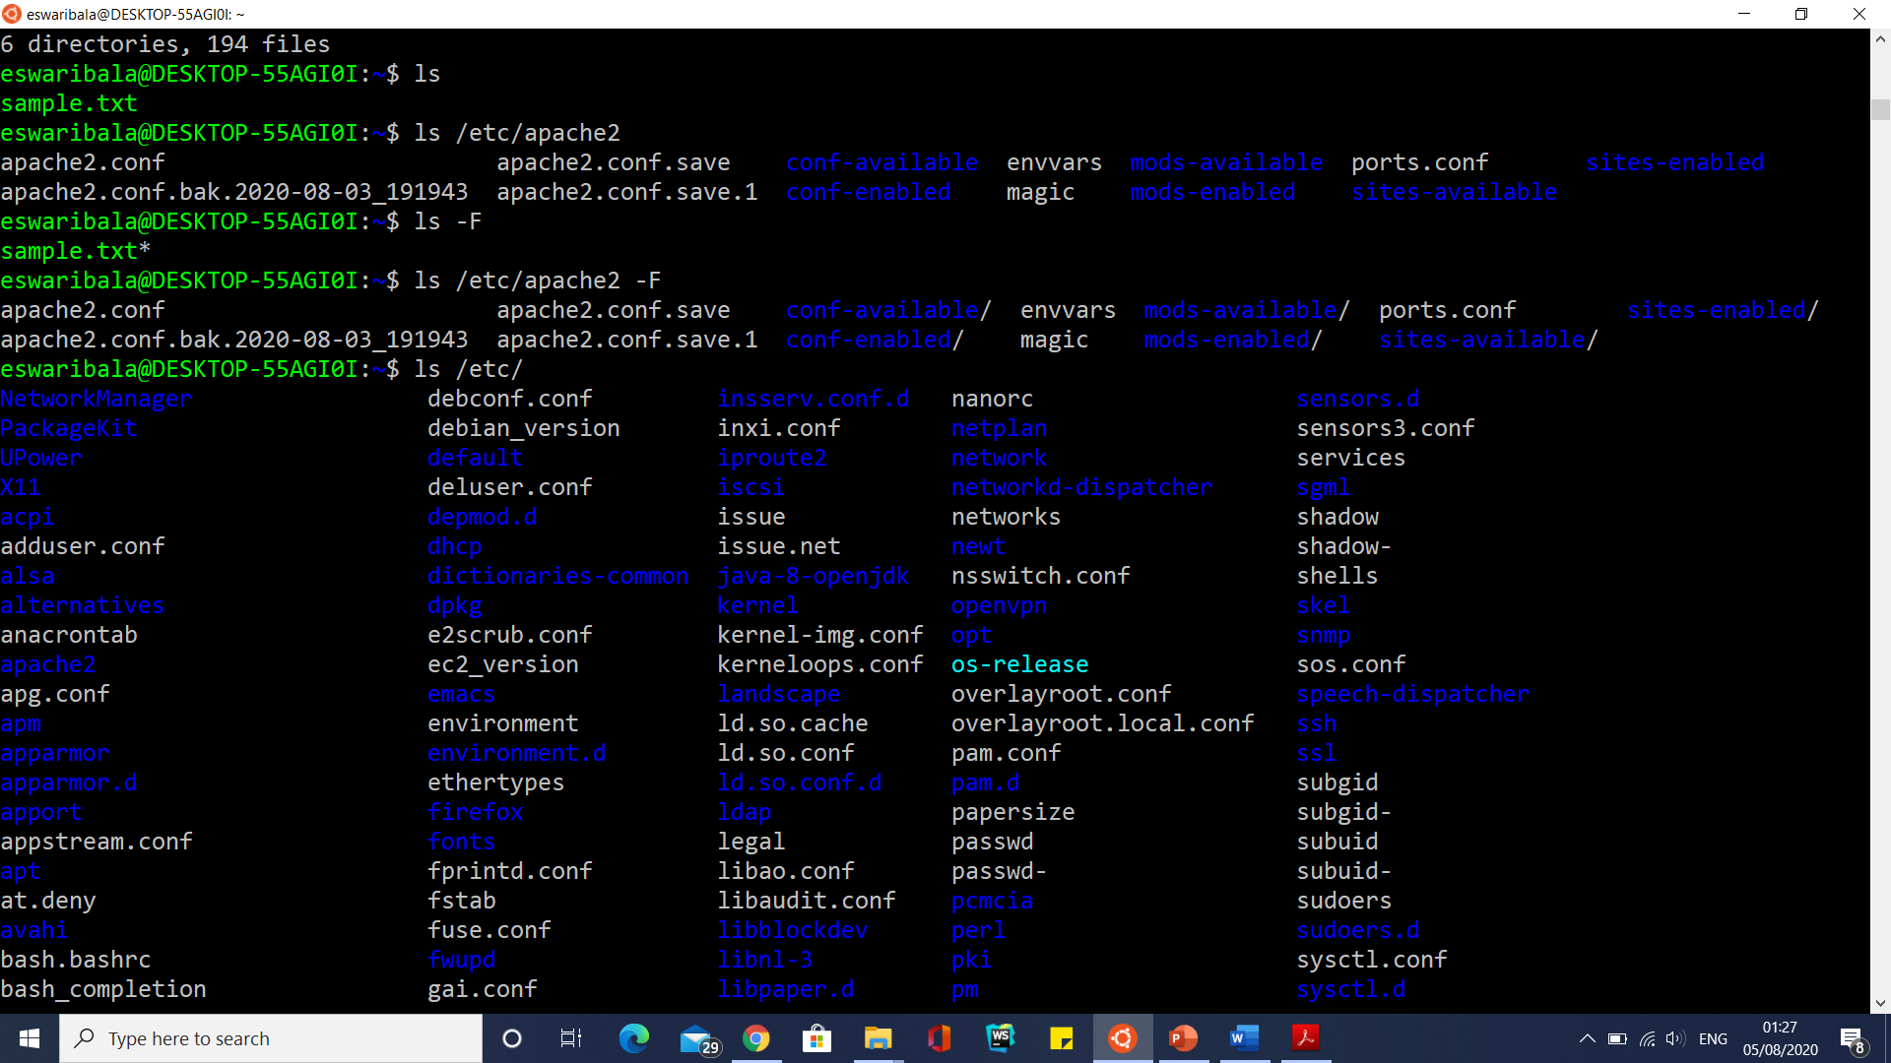
UNIX System File Types

Slide 106
UNIX System File Types
Listing Files in the Current Directory Tree
You can add the -R (recursive) option to the ls command to list all the files in your current directory, along with all the files in each of its subdirectories, and so on.
For example,
$ ls -R

Slide 107
UNIX System File Types
Viewing Files
The simplest and most basic way to view a file is with the cat command. cat (short for concatenate) takes any files you specify and displays them on the screen.
For example, you could use cat to display on your screen the contents of the file review:
$ cat review

Slide 108
UNIX System File Types
Viewing Files with Special Characters
The cat command recognizes eight-bit characters. In earlier versions of UNIX, it only recognized seven-bit characters.
This enhancement permits cat to display characters from extended character sets, such as the kanji characters used to represent Japanese words.
Cat –v sample.txt

Slide 109
UNIX System File Types
Directing the Output of cat
You can send the output of cat to a file as well as to the screen.
For instance,
$ cat physics > physics.backup
In order to add information to the end of a file, do the following:
$ cat notes.august >> notes

Slide 110
UNIX System File Types
Combining Files and Using Wildcards
You can use cat to combine a number of files into one. For example, consider a directory that contains material being used in writing a chapter, as follows:
$ cat section1 section2 section3 > chapter.3
$ cat section* > chapter.3
$ cat *1 *2 > temp

Slide 111
UNIX System File Types
Creating a File
So far, all the examples you have seen involved using cat to copy one or more normal files, either to another file or to your screen. But other possibilities exist.
Just as your screen is the default output for cat and other commands, your keyboard is the default input.
If you do not specify a file to use as input, cat will simply copy everything you type to its output.
This provides a way to create simple files without using an editor.
The command
$ cat > names
Nate nate@engineer.com
Rebecca rlf@library.edu
CTRL-D

Slide 112
UNIX System File Types
Using cat in this way (cat > names) creates the file names if it does not already exist and overwrites (replaces) its contents if it does exist.
You can use cat to add material to a file as well. For example,
$ cat >> names
Dan dkraut@bio.ca.edu
CTRL-D

Slide 113
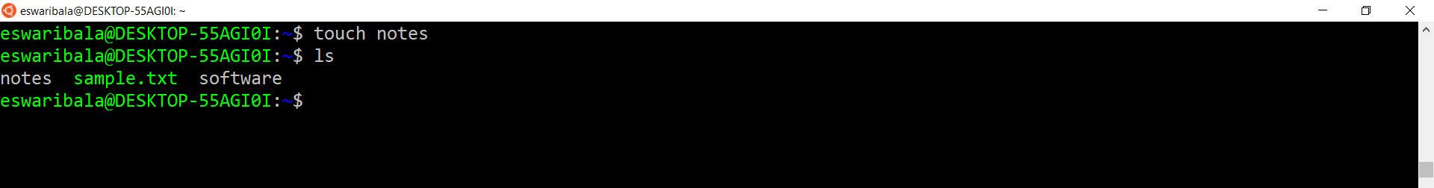
UNIX System File Types
Another command, touch, can also be used to create a file.
$ touch notes

Slide 114
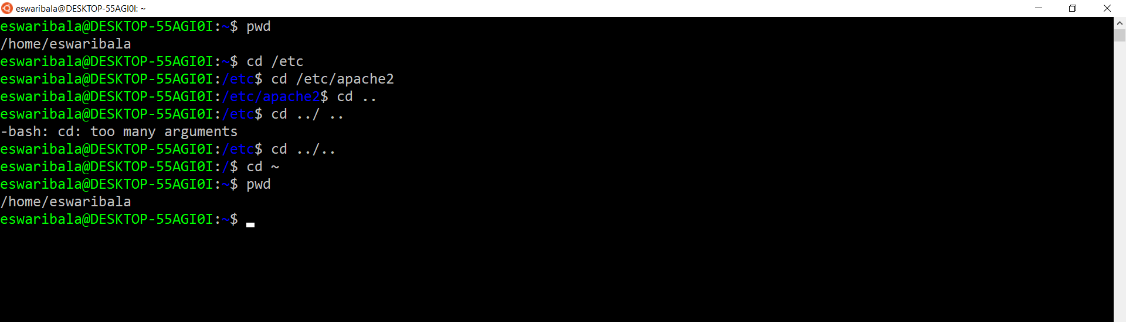
UNIX System File Types
Moving Around in Directories

Slide 115
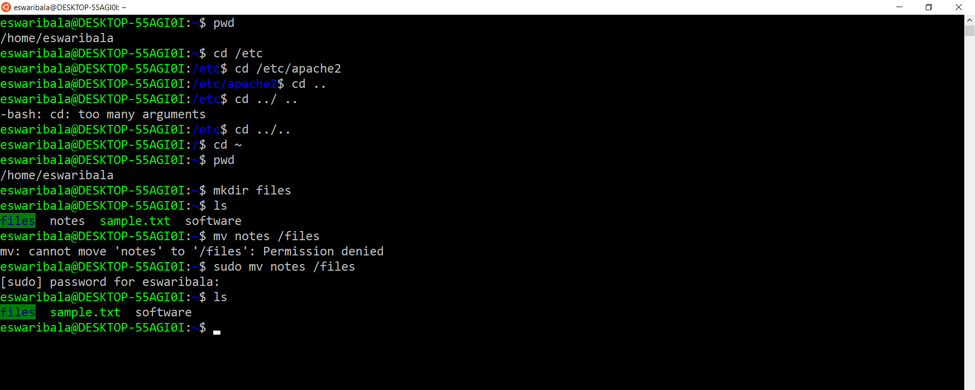
UNIX System File Types
Moving and Renaming Files and Directories
For example, the following command moves three files to the subdirectory called TermPaper:
$ mv section1 section2 section3 TermPaper

Slide 116
UNIX System File Types
To protect mv overwrites the file
The following shows what happens if you try to use mv -i to rename the file totals to data when the data file already exists:
$ mv -i totals data
mv: overwrite data?

Slide 117
UNIX System File Types
Moving Directories
You can use a single mv command to move a directory and all of its files and subdirectories just as you’d use it to move a single file.
For example, if the directory Final contains all of your finished work on a document, you can move it to a directory in which you keep all of the versions of that document, Project, as shown here:
$ ls Project
Drafts
$ mv Final Project
$ ls Project
Drafts Final

Slide 118
UNIX System File Types
Copying Files
The cp command is similar to mv, except that it copies files rather than moving or renaming them.
Cp follows the same model as mv: you name the files to be copied first and then give the destination.
The destination can be a directory, a pathname for a file, or a new file in the current directory.
The following command makes a backup copy of seattle and names the copy seattle.bk:
$ cp seattle seattle.bk
cp -p unix.txt{,.bak.$(date +%F_%H%M%S)}

Slide 119
UNIX System File Types
Copying the Contents of a Directory
If you try to copy a directory, you will get an error message.
A feature of cp (found on most versions of UNIX) is the -r (r ecursive) option that lets you copy an entire directory structure. Suppose you have a directory called Project, and you wish to make a backup copy
The following command creates a new directory, called Project.Backup, and copies all of the files and subdirectories in Project to the new directory:
$ cp -r Project Project.Backup

Slide 120
UNIX System File Types
Removing Files
To get rid of files you no longer want or need, use the rm (remove) command. rm deletes the named files from the file system, as shown in the following example:
$ ls
notes research temp
$ rm temp
$ ls
notes research

Slide 121
UNIX System File Types
Removing Multiple Files
The rm command accepts several arguments and takes several options.
If you specify more than one filename, it removes all of the files you named.
The following command removes the two files left in the directory:
$ rm notes research
$ ls
$
The following will remove all files in the current directory:
$ rm *

Slide 122
UNIX System File Types
Safely Removing Files
Almost every user has accidentally deleted files.
In the preceding example, if you accidentally hit the SPACEBAR between the * and the extension and type
$ rm * .rlf
you will delete all of the files in the current directory As typed, this command says to remove all files (*), and then remove a file named .rlf.

Slide 123
UNIX System File Types
Safely Removing Files
To avoid accidentally removing files, use rm with the -i (interactive) option.
When you use this option, rm prints the name of each file and waits for your response before deleting it.
To go ahead and delete the file, type y. Responding n or hitting ENTER will keep the file rather than deleting it.
For example, in a directory that contains the files notes, research, and temp, the interactive option to rm gives you the following:
$ rm -i *
notes: y
research: <ENTER>
temp: y
Your responses cause rm to delete both notes and temp, but not research.

Slide 124
UNIX System File Types
Restoring Files
When you remove a file using the rm command, it is gone. If you make a mistake, you can only hope that the file is available somewhere on a backup file system (on a tape or disk).
You can call your system administrator and ask to have the file you removed, say /home/you/Work/temp, restored from backup.
If it has been saved, it can be restored for you.
Systems differ widely in how, and how often, they are backed up.
On a heavily supported system, all files are copied to a backup system every day and saved for some number of days, weeks, or months.
On some systems, backups are done less frequently, perhaps weekly On personal workstations, backups occur when you get around to doing them.

Slide 125
UNIX System File Types
Creating a Directory
You can create new directories in your file system with the mkdir (make dir ectory) command. It is used as follows:
$ pwd
Work
$ ls
notes research temp
$ mkdir New
$ ls
notes New research temp

Slide 126
UNIX System File Types
Removing a Directory
There are two ways to remove or delete a directory If the directory is empty (it contains no files or subdirectories), you can use the rmdir (remove dir ectory) command.
If you try to use rmdir on a directory that is not empty, you’ll get an error message.
The following removes the directory New added in the preceding example:
$ rmdir New

Slide 127
UNIX System File Types
Removing a Directory
To remove a directory that is not empty, together with all of the files and subdirectories it contains, use rm with the -r (r ecursive) option, as shown here:
$ rm -r Work
The -r option instructs rm to delete all of the files it finds in Work and then go to each of the subdirectories and delete all of their files, and so forth, concluding by deleting Work itself.
Since rm -r removes all of the contents of a directory, be very careful in using it. You can add the –I option to step through all the files and directories, removing or leaving them one at a time.
$ rm -ir Work
rm: descend into directory 'Work'? y
rm: remove regular empty file 'Work/final'? y
rm: remove regular empty file 'Work/save'? <RETURN>
$ ls Work
save

Slide 128
UNIX System File Types
Getting Information About File Types
Sometimes you just want to know what kind of information a file contains.
For example, you may decide to put all your shell scripts together in one directory You know that several scripts are scattered about in several directories, but you don’t know their names, or you aren’t sure you remember all of them.
Or you may want to print all of the text files in the current directory, whatever their content.
You can use several of the commands already discussed to get limited information about file contents.
For example, ls -l shows you if a file is executable-either a compiled program or a shell script (batch file). But the most complete and most useful command for getting information about the type of information contained in files is file.
file reports the type of information contained in each of the files you give it.
The following shows typical output from using file on all of the files in the current directory:
$ file *

Slide 129
UNIX System File Types
Searching for Files
The command locate searches for a pattern in a database of filenames. For example,
$ locate pippin
searches the database for filenames containing the string “pippin”.
The database contains the full pathname for each file, so this would find files in the directory pippin-photos as well as files such as
0915-pippin.jpg.
The locate command is very fast and easy to use. However, it will only work if the database of filenames is kept up to date.
On many systems, the database is automatically updated once per day

Slide 130
UNIX System File Types
Using find
The find command searches through the contents of one or more directories, including all of their subdirectories.
You have to tell find in which directory to start its search.
The following example
searches user jmf’s directory system for the file new_data and prints the full pathname of any file with that name that it finds:
$ pwd
/home/jmf
$ find . -name new_data -print
/home/jmf/Dir/Logs/new_data
/home/j mf/Cmds/new_data

Slide 131
UNIX System File Types
Using find
To search the entire file system, start in the system’s root directory, represented by the /:
$ find / -name new_data –print
$ find . /tmp/project -name new_data –print
$ find -name "*data" –print
$ find / -name new_data -print > found &
$ find . -name "music" –user eswaribala -mtime +7 -print

Slide 132
UNIX System File Types
List Hidden Files
To see all files in this directory, use ls -a:
$ ls -a
. .. .mailrc .profile Email notes Work

Slide 133
UNIX System File Types
Controlling the Way Is Displays Filenames
You can use the -x option to have names of files displayed horizontally, in as many lines as necessary
For example,
$ ls –x
You also can use the -1 (one) option to have files displayed one line per row (as the old version of ls
did), in alphabetical order:
$ ls -l

Slide 134
UNIX System File Types
Controlling the Way Is Displays Filenames
Combining Options to Is
You can use more than one option to the ls command simultaneously For example, the followingshows the result of using the ls command with the options -F and -a on a home directory:
$ ls –aF
$ ls –Fat
example of what the long format of ls might look like:
$ ls -1

Slide 135
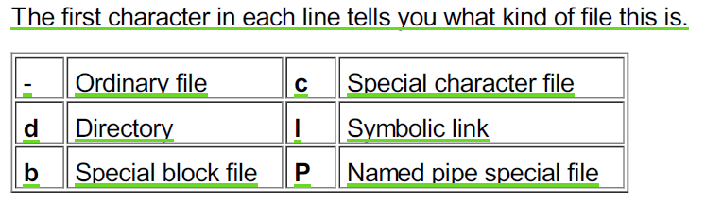
UNIX System File Types
Controlling the Way Is Displays Filenames

Slide 136
UNIX System File Types
Unix Special Characters Or Metacharacters For File Manipulation
Unix Filename Wildcards – Metacharacters
#1) ‘*’ – any number of characters:
This wild-card selects all the files that matches the expression by replacing the asterisk-mark with any set of zero or more characters.
Example1: List all files that start with the name ‘file’. g. file, file1, file2, filenew
$ ls file*
Example2: List all files that end with the name ‘file’. g. file, afile, bfile, newfile
$ ls *file

Slide 137
UNIX System File Types
Unix Special Characters Or Metacharacters For File Manipulation
Unix Filename Wildcards – Metacharacters
#2) ‘?’ – single character:
This wild-card selects all the files that matches the expression by replacing the question-mark with any one character.
Example1: List all files that have one character after ‘file’. g. file1, file2, filea
$ ls file?
Example2: List all files that have two characters before ‘file’. g. dofile, tofile, a1file
$ ls ??file

Slide 138
UNIX System File Types
Unix Special Characters Or Metacharacters For File Manipulation
Unix Filename Wildcards – Metacharacters
#3) ‘[’ range ‘]’ – single character from a range:
This wild-card selects all the files that matches the expression by replacing the marked range with any one character in the range.
Example1: List all files that have a single digit after ‘file’. g. file1, file2
$ ls file[0-9]
Example2: List all files that have anyone letter before ‘file’. g. afile, zfile
$ ls [a-z]file

Slide 139
UNIX System File Types
Unix Special Characters Or Metacharacters For File Manipulation
Unix Filename Wildcards – Metacharacters
# 4) ‘[’ range ‘]*’ – multiple characters from a range:
This wild-card selects all the files that matches the expression by replacing the marked range with one or more characters from the range.
Example1: List all files that have digits after ‘file’. g. file1, file2, file33
$ ls file[0-9]*

Slide 140
UNIX System File Types
Permissions
The UNIX file system is designed to support multiple users.
When many users are sharing one file system, it is important to be able to restrict access to certain files.
The system administrator wants to prevent other users from changing important system files, for example, and many users have private files that they want to restrict others from viewing.
File permissions are designed to address these needs.

Slide 141
UNIX System File Types
Permissions for Files
There are three classes of file permissions, for the three classes of users: the owner (or user) of the file, the group the file belongs to, and all other users of the system.
The first three letters of the permissions field, as seen in the output from ls -l, refer to the owner’s permissions;
the second three letters refer to the permissions for members of the file’s group;
and the last three to the permissions for any other users.

Slide 142
UNIX System File Types
Permissions for Files
In the entry for the file named notes in the ls -l example shown in the preceding section, the first three letters, rwx, show that the owner of the file can read (r) it, write (w) to it, and execute (x) it.
The second group of three characters, r-x, indicates that members of the group can read and execute the file but cannot write to it.
The last three characters, r-x, show that all others can also read and execute the file but not write to it.
If you have read permission for a file, you can view its contents.
Write permission means that you can alter its contents.
Execute permission means that you can run the file as a program.

Slide 143
UNIX System File Types
Special Permissions
There are a few other codes that occasionally appear in permission fields.
For example, the letter s can appear in place of an x in the user’s or group’s permission field.
This s refers to a special kind of execute permission that is relevant primarily for programmers and system administrators.

Slide 144
UNIX System File Types
The chmod Command
In the ls -l example, all of the files and directories have the same permissions set.
Anyone on the system can read or execute any of them, but other users are not allowed to write, or alter, these files.
Normally you don’t want all your files set up this way.
You will often want to restrict other users from being able to view your files, for example.
At times, you may want to allow members of your work group to edit certain files, or even make some files public to anyone on the system.

Slide 145
UNIX System File Types
The chmod Command
The UNIX System allows you to set the permissions of each file you own.
Only the owner of a file or the superuser can alter the file permissions.
You can independently manipulate each of the permissions to allow or prevent reading, writing, or executing by yourself, your group, or all users.

Slide 146
UNIX System File Types
The chmod Command
To alter a file’s permissions, you use the chmod (change mode) command.
You specify the changes you want to make with a sort of code.
First, show which set of permissions you are changing with u for user, g for group, or o for other.
Second, specify how they should be changed with + (to add permission) or − (to subtract permission).
Third, list the permissions to alter: r for read, w for write, or x for execute.
Finally, specify the file or files that the changes refer to.

Slide 147
UNIX System File Types
The chmod Command
$ ls -1 quotations
-rwxr-xr-x 1 nate group1 346 Apr 27 03:32 quotations
$ chmod go-rx quotations
$ ls -1 quotations
-rwx 1 nate group1 346 Apr 27 03:32 quotations
$ chmod ugo+rwx quotations
$ ls -1 quotations
-rwxrwxrwx 1 nate group1 346 Apr 27 03:32 quotations

Slide 148
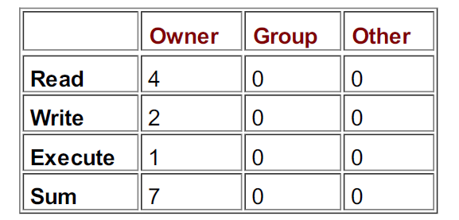
UNIX System File Types
The chmod Command
Setting Absolute Permissions
$ chmod 700 quotations
$ ls -1 quotations
-rwxrwxrwx 1 nate group1 346 Apr 27 03:32 quotations

Slide 149
UNIX System File Types
The chmod Command
$ chmod go-rwx *
$ chmod 700 *
$ chmod -R u+r Email

Slide 150
UNIX System File Types
Using umask to Set Permissions
The chmod command allows you to alter permissions on a file-by-file basis.
The umask command allows you to do this automatically when you create any file or directory.
Everyone has a default umask setting that is either set up either by the system administrator or included in a shell configuration file.

Slide 151
UNIX System File Types
Using umask to Set Permissions
With the umask command, you specify the permissions that will be given to all files created after issuing the command.
This means you will not have to worry about the file permissions for each individual file you create.
Unfortunately, using umask to specify permissions is a little bit complicated.

Slide 152
UNIX System File Types
Using umask to Set Permissions
There are two rules to remember:
umask uses a numeric code for representing absolute permissions just as chmod does.
For example, 777 means read, write, and execute permissions for user, group, and others (rwxrwxrwx).
You specify the permissions you want by telling umask what to subtract from the full permissions value, 777 (rwxrwxrwx).

Slide 153
UNIX System File Types
Using umask to Set Permissions
For example, after you issue the following command, all new files in this session will be given permissions of rwxr-xr-x:
$ umask 022
In this example, we want the new files to have the permission value 755. When we subtract 755 from 777, we get 022.
This is the “mask” we used for the command.

Slide 154
List user accounts
cut -d: -f1 /etc/passwd
ps aux

Slide 155
Create User
sudo adduser mohan

Slide 156
UNIX System File Types
Changing the Owner of a File
Every file has an owner. When you create a file, you are automatically its owner.
The owner usually has broader permissions for manipulating the file than other users.
Sometimes you need to change the owner of a file; for example, if you take over responsibility for a file that previously belonged to another user.
Even if someone else “gives” you a file by moving it to your directory that does not make you the owner.
One way to become the owner of a file is to make a copy of it-when you make a copy, you are the owner of the new file.

Slide 157
UNIX System File Types
Changing the Owner of a File
However, changing ownership by copying only works when the new owner copies the file from the old owner, which requires the new owner to have read permission on the file.
A simpler and more direct way to transfer ownership is to use the chown (change owner) command.
The chown command takes two arguments: the login name of the new owner and the name of the file.
The following makes liz the new owner of the file contact_info:
$ chown liz contact_info
Only the owner of a file (or the superuser) can use chown to change its ownership
chown -R liz Project

Slide 158
List Groups
cut -d: -f1 /etc/group
sudo groupadd unixtraining #create group
sudo usermod -a -G unixtraining mohan #add user to group

Slide 159
UNIX System File Types
Changing the Group of a File
Groups are meant to help sets of users who need to share files more closely than other users on the system.
For example, all the students taking a particular class may belong to the same group, so that they can more easily share files when they collaborate on projects

Slide 160
UNIX System File Types
Changing the Group of a File
Every file belongs to a group.
Sometimes, such as when new groups are set up on a system or when files are copied to a new system, you may want to change the group to which a particular file belongs.
This can be done using the chgrp (change group) command.
The chgrp command takes two arguments, the name of the new group and the name of the file.
The following command changes data_file so that it belongs to the group students:
$ chgrp students data_file

Slide 161
UNIX System File Types
You can use the -R (r ecursive) option of chgrp to change the group to which all the files in a directory belong.
It works just like the -R option of chown.

Slide 162
UNIX System File Types
Viewing Long Files
When you use cat to display a file, it prints the contents on your screen without pausing, so that long files quickly scroll past.
A quick solution, when you only need to view a small part of the file, is to use cat and then hit BREAK when the part you want to read comes on the screen.
This stops the program, but it leaves the output on the screen, so if your timing is good, you may get what you want.

Slide 163
UNIX System File Types
Viewing Long Files
A somewhat better solution is to use the sequence CTRL-S, to make the output pause whenever you get a screen you want to look at, and CTRL-Q to resume scrolling.
This way of suspending output to the screen works for all UNIX commands, not just cat.

Slide 164
UNIX System File Types
Viewing Long Files
The best solution is to use a pager -a program that is designed specifically for viewing files.
UNIX gives you a choice of two pagers, pg and more, which are standard with all versions of UNIX, as well as an enhanced pager called less, available for many versions of UNIX, including Linux.
Less has more features than more and has pretty much replaced it.

Slide 165
UNIX System File Types
Viewing Long Files (more)
To display the file newyork, just enter the command
$ more newyork
To tell more to move ahead by a screen, press the SPACEBAR.
To move ahead one line, press ENTER.
The commands for half-screen motions, d and CTRL-D, are the same as in pg.
To move backward by a screen, use b or CTRL-B.

Slide 166
UNIX System File Types
Viewing Long Files (less)
The less command, an enhanced version of the more command, is a feature-rich pager that can be used to interactively display portions of a file.
It can be used to move either forward or backward in a file.
Since less reads in portions of files, rather than entire files, it is very efficient for large files.
This will display the file newyork with less:
$ less newyork

Slide 167
UNIX System File Types
Viewing Long Files (less)
The less command has many useful options.
For example, the -p option can be used to start less at the first occurrence of the pattern you specify (where the pattern is entered after the -p option)
To display the file sanfrancisco, beginning with the first time the pattern “SFO" appears, you can use
$ less -p SFO sanfrancisco
Among the other options supported by less are -s, which squeezes consecutive blank lines into a single blank line;
-S, which chops off lines longer than the screen (discarding them instead of folding them into the next line); and -U, which displays backspaces and carriage returns as control characters.

Slide 168
UNIX System File Types
Viewing Long Files (less)
Many commands can be used with the less pager to display different parts of a file.
For example, you can scroll forward one window by entering SPACEBAR or f, and you can scroll backward one window by entering b.
You can scroll forward one line by entering e or pressing ENTER, and you can scroll backward one line by entering y.
You can scroll to the next occurrence of the string “pattern” using the command /pattern, and you can scroll to the preceding occurrence of this string using the command ? pattern.

Slide 169
UNIX System File Types
Viewing Long Files (less)
You can find the next and preceding lines that do not contain the string “pattern” using the commands /!pattern and ?!pattern, respectively.
You can use various commands to move the cursor when using less to display files.
For example, you can move one space left using the LEFT ARROW key or ESC-H; you can move one space right using the RIGHT ARROW key or ESC-L.
You can move one word to the left with ESC-B and one word to the right with ESC-W.
You can also do some editing: BACKSPACE deletes the character to the left of the cursor, DELETE deletes the character under the cursor, CTRL-BACKSPACE deletes the word to the left of the cursor, and CTRL-DELETE deletes the word under the cursor.

Slide 170
UNIX System File Types
Viewing the Beginning or End of a File
The head and tail commands are specifically designed for these jobs.
head shows you the beginning of a file, and tail shows you the end.
For example, the command shown here displays the first ten lines of transactions.
$ head transactions
and the following command displays the last ten lines:
$ tail transactions

Slide 171
UNIX System File Types
Viewing the Beginning or End of a File
To display some other number, say the last three lines, you give head or tail a numerical argument.
This command shows only the last three lines:
$ tail -3 transactions
A useful feature of tail is the -f (f ollow) option.
This lets you use tail to check on the progress of a program that writes its output to a file.
Suppose a file transfer program is getting information from a remote system and putting it in the file newdata.
In this example, tail displays the last three lines of newdata, waits (sleeps) for a short time, looks to see if there has been any new input, displays any new lines, and so on:
$ tail -3 -f newdata

Slide 172
UNIX System File Types
Printing Files
The UNIX System includes a collection of programs, called the lp system, for printing files and documents.
You can use it to print everything from simple text files to large documents with complex formats.
It provides a simple, uniform interface to a wide variety of printers.
The lp system is itself large and complex, but fortunately its complexity is well hidden from users.

Slide 173
UNIX System File Types
Printing Files
In fact, three basic commands, lp, lpstat, and cancel, are all you need to know to use this system.
(On Linux, these three basic commands have different names; they are lpr, lpq, and lprm, respectively)

Slide 174
UNIX System File Types
Sending Output to the Printer
The basic command for printing a file is lp (line printer) (or on Linux, lpr). This command prints the file research.nov as follows:
$ lp research.nov
request id is lsr1–142 (1 file)
You can print several files at once by including all of them in the arguments to lp. For instance,
$ lp res*
request id is lsr1–154 (3 files)

Slide 175
UNIX System File Types
Specifying a Printer
The lp command does not ask you which printer to use.
There may be several printers on the system, but one of them will be the system default.
Unless you specify otherwise, this is the printer that lp uses.
To find out which printers are available, you can ask your system administrator

Slide 176
UNIX System File Types
Specifying a Printer
The lp command does not ask you which printer to use.
There may be several printers on the system, but one of them will be the system default.
Unless you specify otherwise, this is the printer that lp uses.
To find out which printers are available, you can ask your system administrator

Slide 177
UNIX System File Types
Specifying a Printer
To specify a particular printer, use the –d (destination) option, followed by the printer’s name.
For example,
$ lp -d laser2 flightinfo
sends flightinfo to the printer named laser2.

Slide 178
UNIX System File Types
Print Spooling
When you print a file on the UNIX System, you do not have to wait until the file is printed (or until it is sent to the printer) before continuing with other work, and you do not have to wait until one print job is finished before sending another.
lp spools its input to the UNIX print system, which means that it tells the print system what file to print and how to print it, and then leaves the work of getting the file through the printer to the system.

Slide 179
UNIX System File Types
Print Spooling
Your job is submitted and spooled, but it is not printed at the precise time you enter the lp command, and lp does not automatically tell you when your job is actually finished.
If you want to be notified when it is printed, use the -m (mail) option.
For example,
$ lp -m -d laser2 flightinfo
sends you mail when your file is successfully printed.

Slide 180
UNIX System File Types
Print Spooling
If you change the file between the time you issue the lp command and the time it actually goes to the printer, it is the changed file that will be printed.
In particular, if you delete the file, or rename it, or move it to another directory the print system will not find it, and it will not be printed.
To avoid this, use the -c (copy) option.
The command
$ lp -c -d laser2 flightinfo
copies flightinfo to a temporary file in the print system and uses that copy as the input to the printer.
Any changes you make to flightinfo after you issue this command will not appear in the printed output.

Slide 181
UNIX System File Types
Using lpstat to Monitor the Print System
The lpstat command (on LINUX this is the lpq command) provides a way to get this and other useful information, such as which printers are currently available on the system and how many other print jobs are scheduled.
One of the most important uses of lpstat is to see if your print jobs are being taken care of or if there is some problem with the system.
The following shows that a job is scheduled for printing but has not yet started printing:
$ lpstat

Slide 182
UNIX System File Types
Canceling Print Jobs
cancel inkjet-133

Slide 183
UNIX System File Types

Slide 184
A list of the commonly used variables in Linux
System Variable | Meaning | To View Variable Value Type
BASH_VERSION | Holds the version of this instance of bash. | echo $BASH_VERSION
HOSTNAME | The name of the your computer. | echo $HOSTNAME
CDPATH | The search path for the cd command. | echo $CDPATH
HISTFILE | The name of the file in which command history is saved. | echo $HISTFILE
HISTFILESIZE | The maximum number of lines contained in the history file. | echo $HISTFILESIZE
HISTSIZE | The number of commands to remember in the command history. The default value is 500. | echo $HISTSIZE
HOME | The home directory of the current user. | echo $HOME

Slide 185
A list of the commonly used variables in Linux
System Variable | Meaning | To View Variable Value Type
FS | The Internal Field Separator that is used for word splitting after expansion and to split lines into words with the read builtin command. The default value is <space><tab><newline>. | echo $IFS
LANG | Used to determine the locale category for any category not specifically selected with a variable starting with LC_. | echo $LANG

Slide 186
A list of the commonly used variables in Linux
System Variable | Meaning | To View Variable Value Type
PATH | The search path for commands. It is a colon-separated list of directories in which the shell looks for commands. | echo $PATH
PS1 | Your prompt settings. | echo $PS1

Slide 187
A list of the commonly used variables in Linux
System Variable | Meaning | To View Variable Value Type
TMOUT | The default timeout for the read builtin command. Also in an interactive shell, the value is interpreted as the number of seconds to wait for input after issuing the command. If not input provided it will logout user. | echo $TMOUT
TERM | Your login terminal type. | echo $TERM export TERM=vt100

Slide 188
A list of the commonly used variables in Linux
System Variable | Meaning | To View Variable Value Type
SHELL | Set path to login shell. | echo $SHELL
DISPLAY | Set X display name | echo $DISPLAY export DISPLAY=:0.1
EDITOR | Set name of default text editor. | export EDITOR=/usr/bin/vim

Slide 189
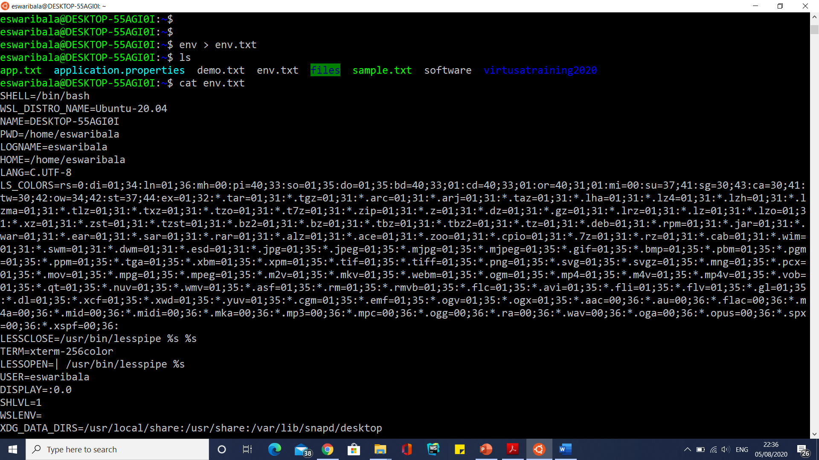
A list of the commonly used variables in Linux

Slide 190
What is SUID and SGID?
There are 3 special permission that are available for executable files and directories. These are :
1. SUID permission
2. SGID permission
3. Sticky bit

Slide 191
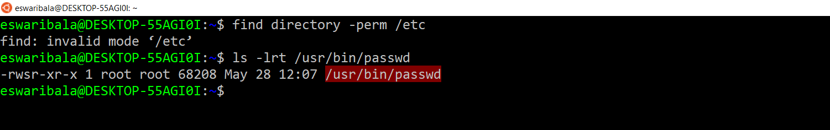
What is SUID and SGID?
Set-user Identification (SUID)
Have you ever thought, how a non-root user can change his own password when he does not have write permission to the /etc/shadow file.
Well to understand the trick check for the permission of /usr/bin/passwd command :
# ls -lrt /usr/bin/passwd

Slide 192
What is SUID and SGID?
Set-user Identification (SUID)
If you check carefully, you would find the S’s in the permission field.
The first s stands for the SUID
– When a command or script with SUID bit set is run, its effective UID becomes that of the owner of the file, rather than of the user who is running it.

Slide 193
What is SUID and SGID?
Set-user Identification (SUID)
How to set SUID on a file?
# chmod 4555 [path_to_file]
If a capital “S” appears in the owner’s execute field, it indicates that the setuid bit is on, and the execute bit “x” for the owner of the file is off or denied.

Slide 194
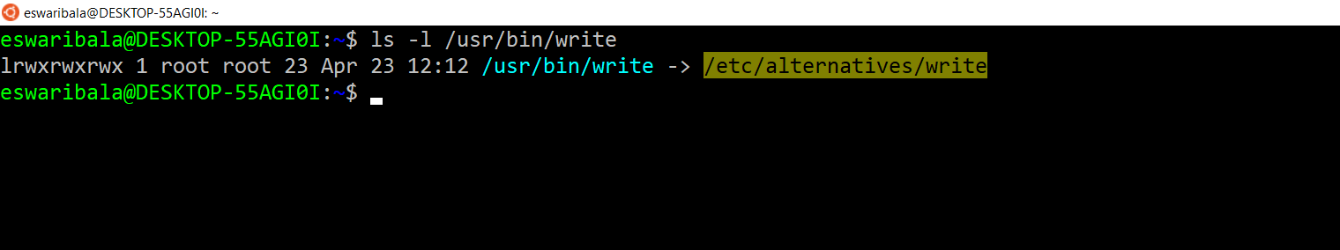
What is SUID and SGID?
Set-group identification (SGID)
SGID permission on executable file
– SGID permission is similar to the SUID permission, only difference is – when the script or command with SGID on is run, it runs as if it were a member of the same group in which the file is a member.
# ls -l /usr/bin/write

Slide 195
What is SUID and SGID?
How to set GUID on a file?
# chmod 2555 [path_to_file]

Slide 196
What is SUID and SGID?
SGID on a directory
– When SGID permission is set on a directory, files created in the directory belong to the group of which the directory is a member.
– For example if a user having write permission in the directory creates a file there, that file is a member of the same group as the directory and not the user’s group.
– This is very useful in creating shared directories.
How to set SGID on a directory
# chmod g+s [path_to_directory]

Slide 197
What is a profile file?
A profile file is a start-up file of an UNIX user, like the autoexec.bat file of DOS.
When a UNIX user tries to login to his account, the operating system executes a lot of system files to set up the user account before returning the prompt to the user.
In addition to the system settings, the user might wish to have some specific settings for his own account.
To achieve this in UNIX, at the end of the login process, the operating system executes a file at the user level, if present. This file is called profile file.
The name of the profile file varies depending on the default shell of the user.
The profile file, if present, should always be in the home directory of the user.

Slide 198
What is a profile file?
The following are the profile files of the commonly used shells:
The specific settings which an unix user usually does is:
Setting of any environment variable
Setting of any alias.(Though it is always recommended to keep the aliases in a separate file).
Setting of PATH variable or any other path variables.
Shell | Profile File
Ksh | .profile
Bourne | .profile
Bash | .bash_profile
Tcsh | .login
Csh | .login
A typical ksh profile file will look as shown below:
#cat $HOME/.profile

Slide 199
Setting the Terminal Type:
$ echo $TERM
echo $SHELL
export TERM=xterm-256color
echo $LS_COLORS
Shell | Command
csh or tcsh | setenv TERM vt100
sh | TERM=vt100; export TERM
ksh, bash, or zsh | export TERM=vt100

Slide 200
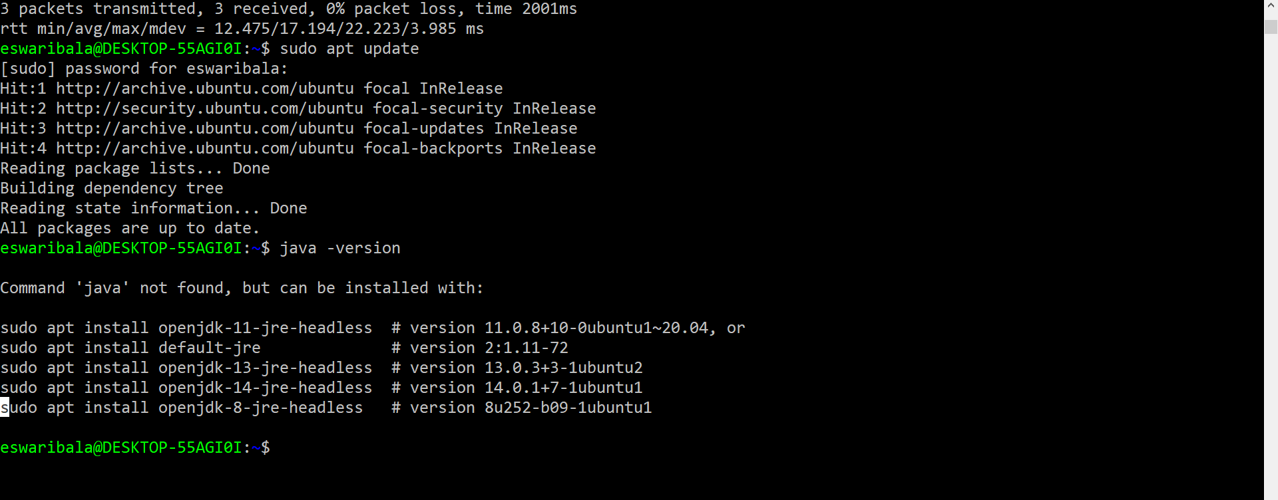
Java Installation
sudo apt update
java -version

Slide 201
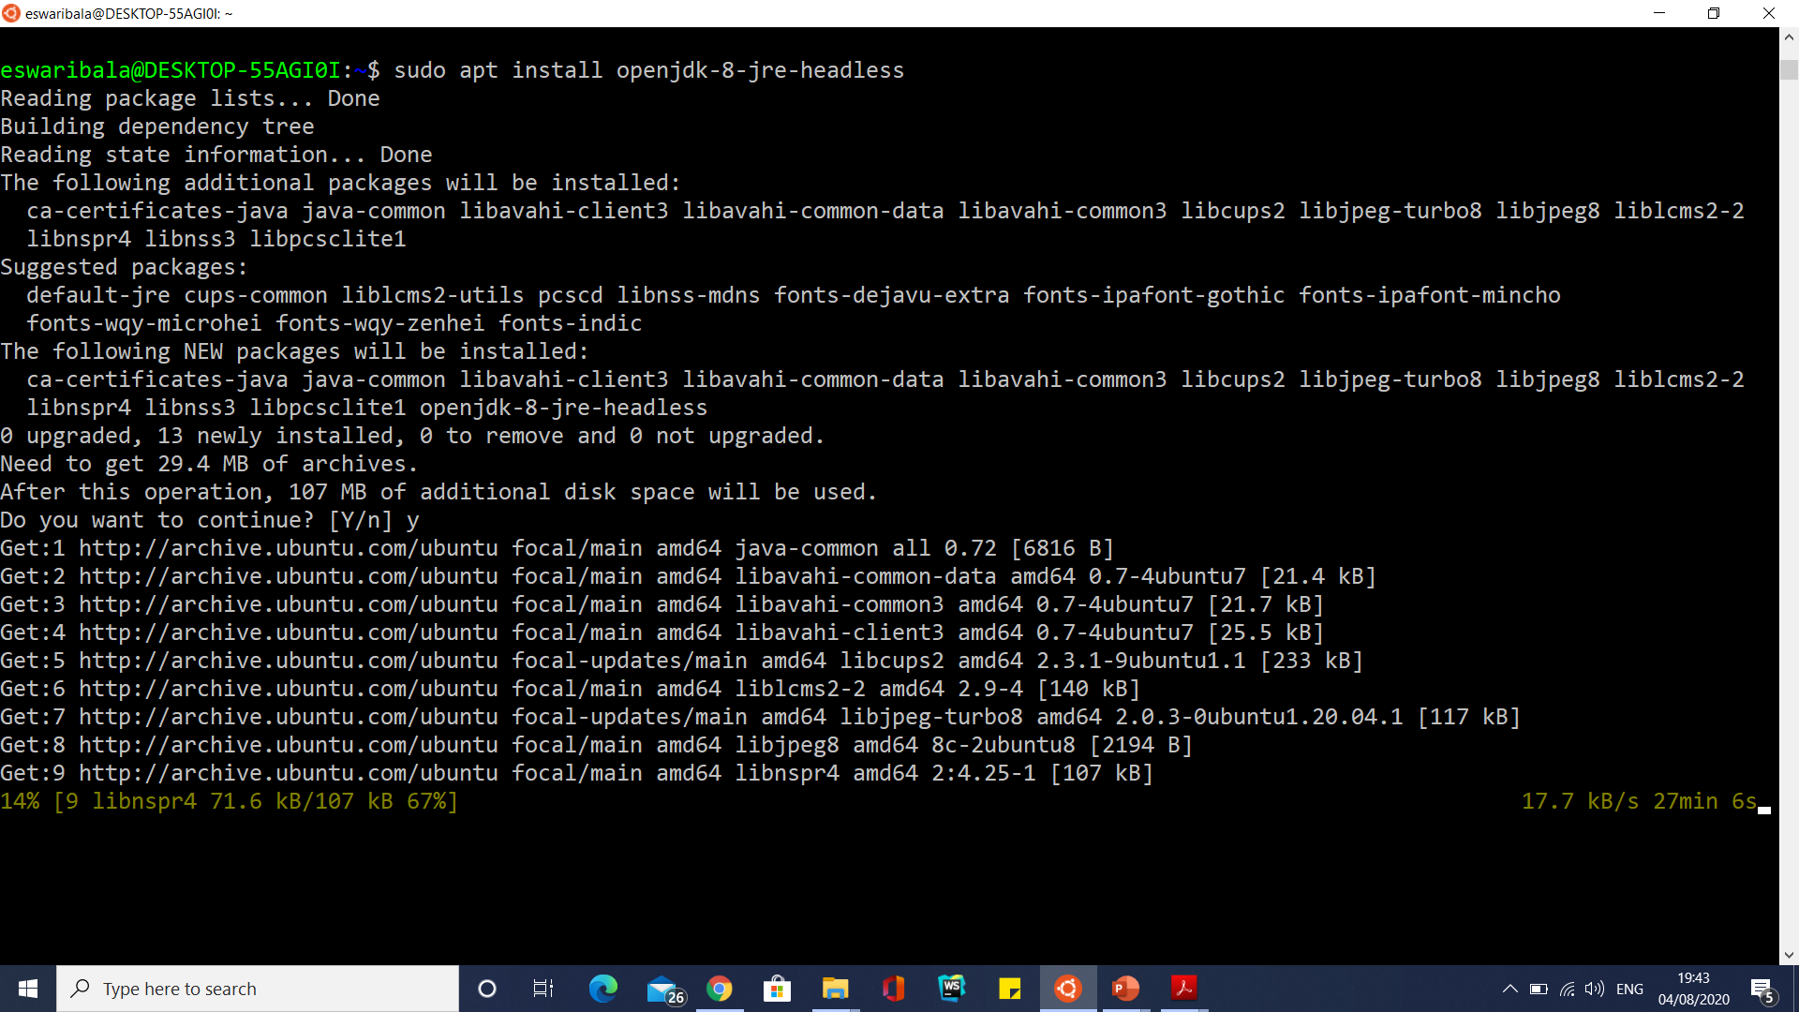
Java Installation
sudo apt install openjdk-8-jre-headless

Slide 202
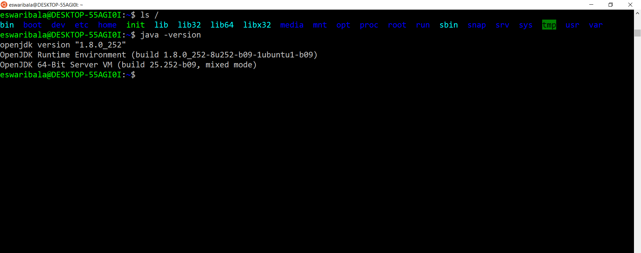
Java Installation
sudo apt install openjdk-8-jre-headless

Slide 203
Java Installation
sudo apt install openjdk-8-jdk-headless

Slide 204
Installing MySQL in Ubuntu|Linux|Windows Subsystem for Linux from Scratch
sudo apt-get remove --purge *mysql*
sudo rm -rf /etc/mysql /var/lib/mysql
sudo apt-get remove --purge *mariadb*
sudo apt-get autoremove
sudo apt-get autoclean
dpkg -l | grep mariadb
dpkg -l | grep mysql

Slide 205
Installing MySQL in Ubuntu|Linux|Windows Subsystem for Linux from Scratch
Now to fix all broken repositories
sudo apt-get install –f
Now Upgrading the Repositories
sudo apt update
sudo apt upgrade
Now, to install MySQL 8, simply type:
sudo apt install mysql-server

Slide 206
Installing MySQL in Ubuntu|Linux|Windows Subsystem for Linux from Scratch
Now to fix all broken repositories
sudo apt-get install –f
Now Upgrading the Repositories
sudo apt update
sudo apt upgrade
Now, to install MySQL 8, simply type:
sudo apt install mysql-server
sudo nano /etc/mysql/mysql.conf.d/mysqld.cnf
(change port)

Slide 207
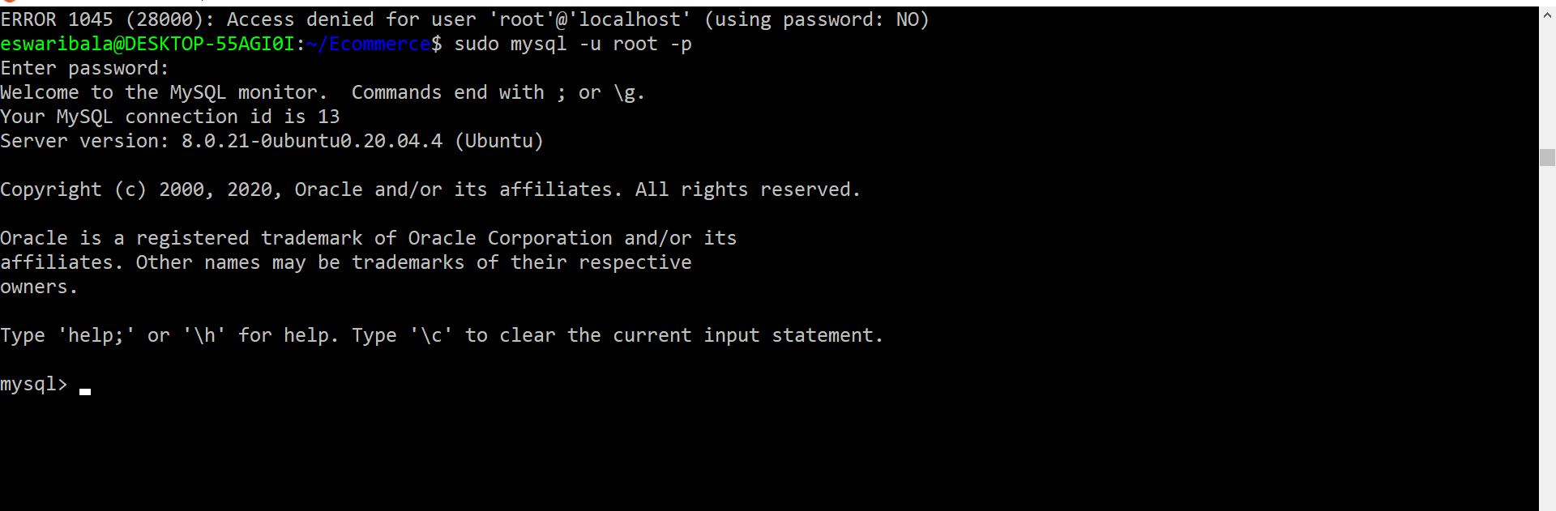
Installing MySQL in Ubuntu|Linux|Windows Subsystem for Linux from Scratch
sudo service mysql start
sudo mysql_secure_installation
mysql -u root -p

Slide 208
Uninstall packages
sudo apt list –installed
sudo apt remove xfce4
sudo apt-get remove --auto-remove ubuntu-gnome-desktop
sudo apt-get purge --auto-remove ubuntu-gnome-desktop

Slide 209
Standard Input and Output
The command gets its input through the channel labeled “standard input.”
That input can come from your keyboard (the default), a file, or a command.
Similarly, the command delivers its output through the channel labeled “standard output.”
The output might go to your screen (the default), a file, or another command.

Slide 210
Standard Input and Output
The command doesn’t need to know which of these sources the input comes from, or where the output goes.
It is the shell that sets up these connections, according to the instructions in your command line.
It does this through the I/O redirection mechanisms, which include pipes and file redirection.

Slide 211
Standard Input and Output
A typical use of the pipe feature is the following command:
$ man find lp
This uses a pipe to send the output from the man command to the lp command, in order to print a hard copy of the manual page for find.
An example of file redirection is the following command:
$ man find > temp
This saves the output from the man command as the file temp

Slide 212
Shell Redirection Output

Slide 213
Using Pipes
The pipe symbol (|) tells the shell to take the standard output of one command and use it as the standard input of another command.
Using pipes to join individual commands together in pipelines is an easy way to use a sequence of simple commands to carry out a complex task.
For example, suppose you want to know if the user named “Ashok” is logged in.
One way to find out would be to use the who command to list all of the users currently logged in, and to look for a line listing “Ashok” in the output.
However, on a large system there could be many users-enough to make it difficult to find a specific name in the list.

Slide 214
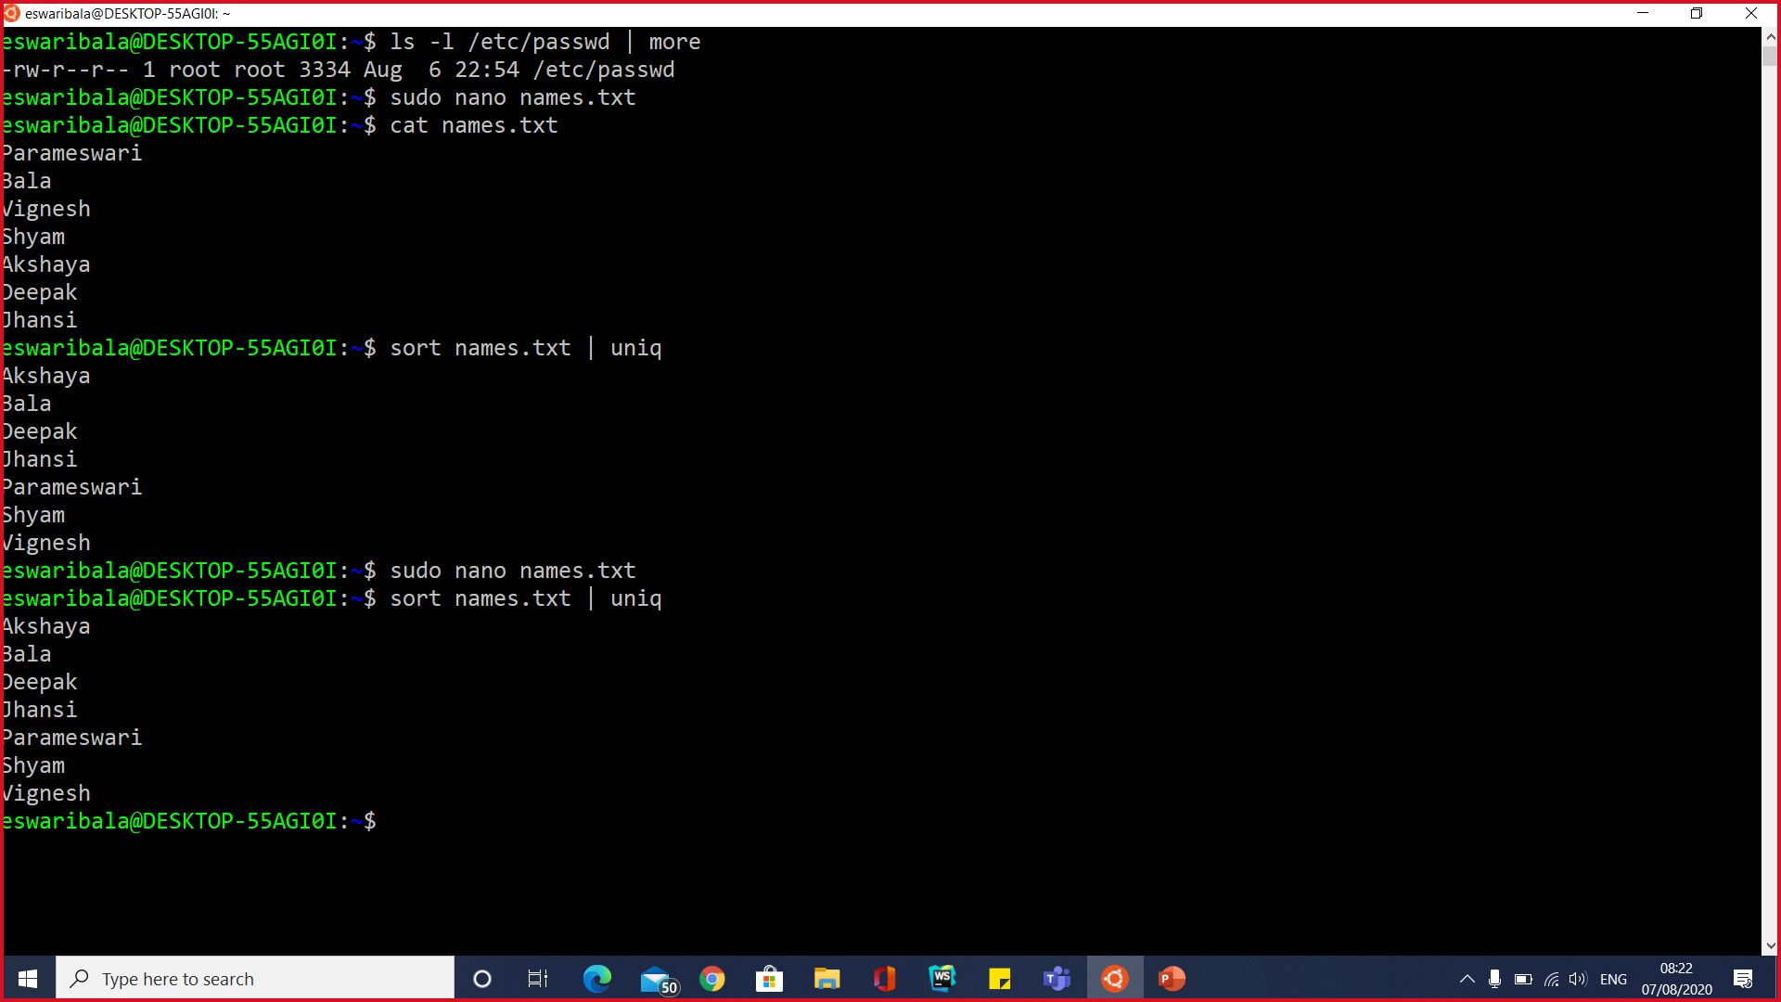
Using Pipes

Slide 215
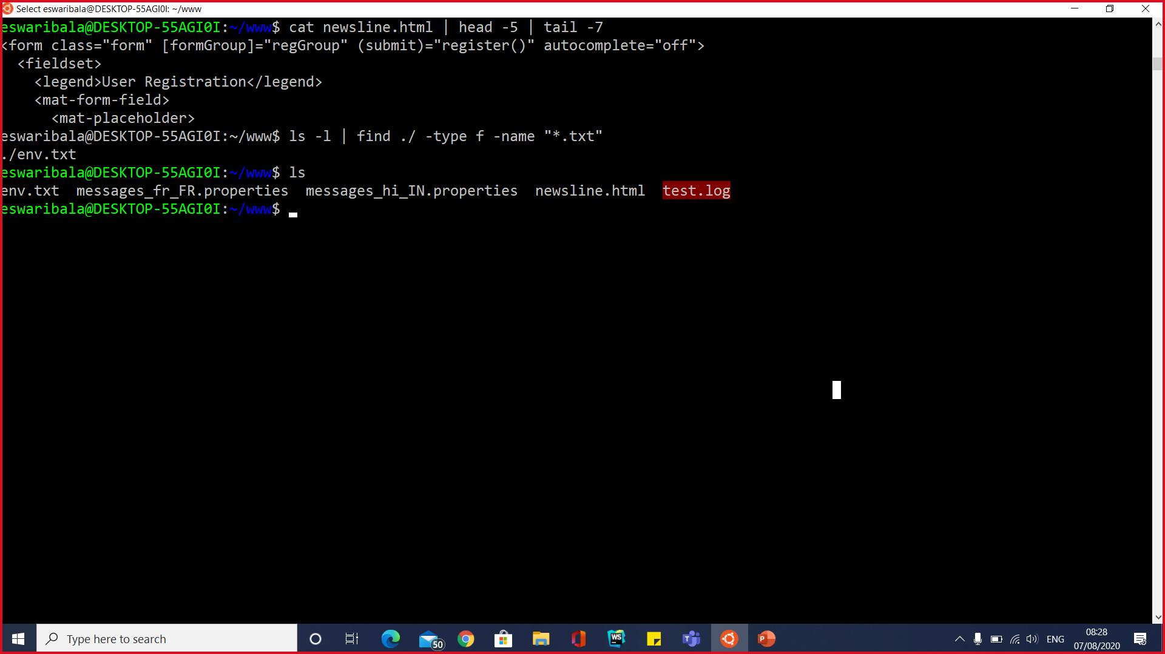
Using Pipes

Slide 216
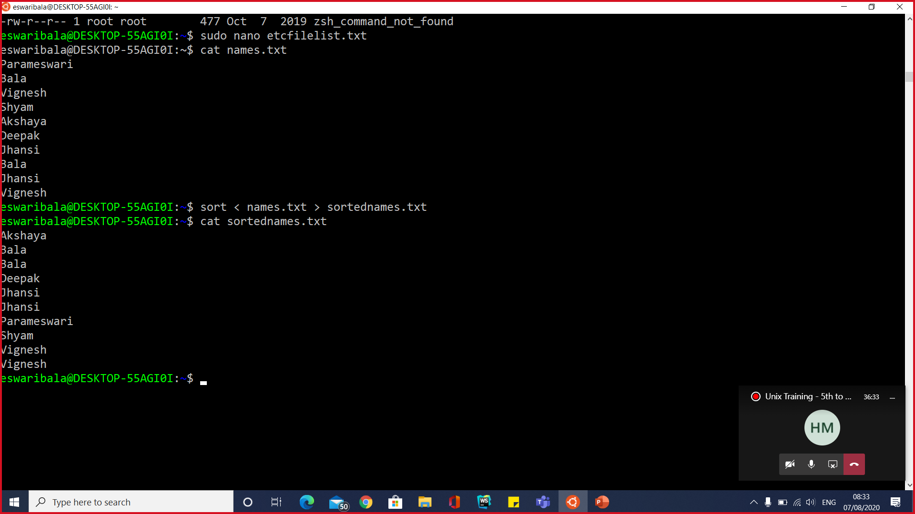
Using redirection

Slide 217
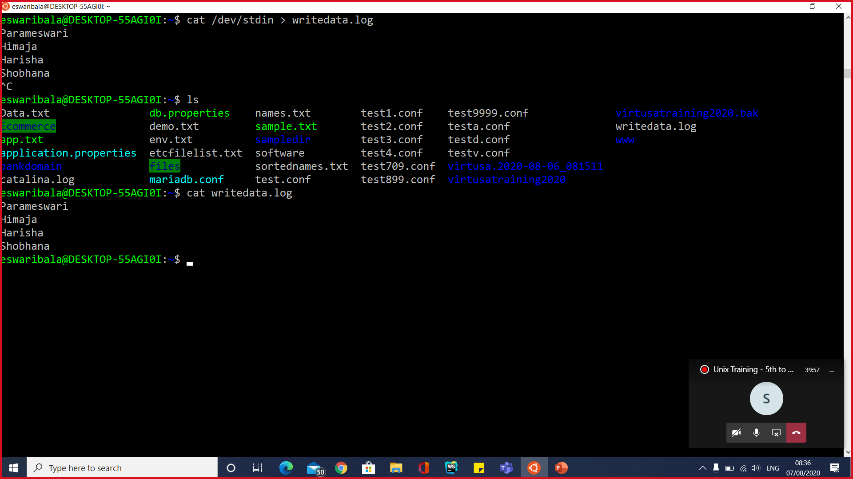
Using redirection

Slide 218
How to use grep command in Unix
The grep utility searches text file.txt for a pattern and prints all lines that contain that pattern.
Syntax: grep [ -options ] limited-regular-expression [filename … ]

Slide 219
How to use grep command in Unix
grep options or grep command options
-c Print only a count of the lines that contain the pattern.
-i Ignore upper/lower case distinction during comparisons.
-l Print only the names of file.txt with matching lines,separated by NEWLINE characters. Does not repeat the names of file.txt when the pattern is found more than once.
-n Precede each line by its line number in the file (first line is 1).
-v Print all lines except those that contain the pattern.
-r It recursively search the pattern in all the file.txt in the current directory and all it’s sub-directory.
-w It searches the exact word

Slide 220
How to use grep command in Unix
To find all uses of the word “spring” (in any case) in the multiples file like a*, and write with line numbers:
grep -i -n spring a*
search ‘application.properties for ‘Trading’ anywhere in a line
grep Trading application.properties

Slide 221
How to use grep command in Unix
grep case insensitive command .
By default grep command is case sensitive.
You can use option grep -i to make it case insensitive.
We can use grep -w option for searching the specific work not sub-string .
The below example searches adpatch.log for word failure in any case
grep -i -w files demo.txt

Slide 222
How to use grep command in Unix
find ‘run time’ or ‘run-time’ in all txt in file.txt
grep run[- ]time *.txt
pipe who to grep, look for appmmgr
cat /etc/passwd | grep mohan
grep recursive option .It search for oracle string in current directory files and all the files in sub directory
grep -r spring *

Slide 223
How to use grep command in Unix
Grep exclude option (grep -v) . We can use grep -v to exclude the search item item. It will not show the lines which has oracle string in it
ps -ef | grep -v eswarib+

Slide 224
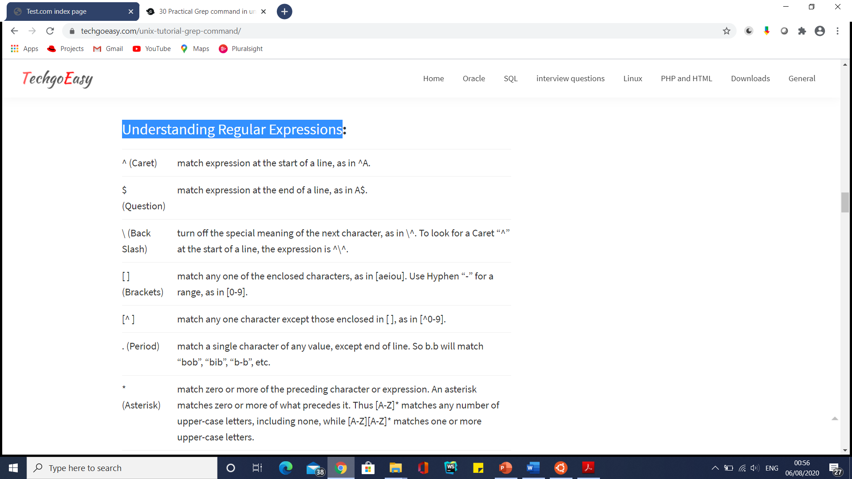
Understanding Regular Expressions

Slide 225
Understanding Regular Expressions
search file.txt for lines with ‘kite’
grep kite file.txt
‘kite’ at the start of a line
grep '^kite' file.txt
‘kite’ at the end of a line
grep 'kite
lines containing only ‘kite’
grep '^kite

Slide 226
Understanding Regular Expressions
lines starting with ‘^s’, “\” escapes the ^
grep '\^s' file.txt
search for ‘kite’ or ‘Kite’
grep '[Kk]ite' file.txt
search for TOM, Tom, TOm or ToM
grep 'T[oO][mM]' file.txt
search for blank lines
grep '^

Slide 227
Understanding Regular Expressions
search for pairs of numeric digits
grep '[0-9][0-9]' file
list your mail
grep '^From: ' /usr/mail/$USER
any line with at least one letter
grep '[a-zA-Z]' 1.txt
anything not a letter or number
grep '[^a-zA-Z0-9]'

Slide 228
Understanding Regular Expressions
line start with “.” and 2 lower case letters} letters
grep '^\.[a-z][a-z]’
If you want to search multiple words in the same grep command ,then use egrep command in UNIX
It search all the three words in the file
egrep -n -v 'Bala|Vignesh' names.txt
It discarded all the lines having any of these three word from the output of ps -ef
cat /etc/passwd | egrep -n -v 'eswaribala|vigneshbala|mohan'

Slide 229
Understanding Regular Expressions
grep with pipe command
pipe command in Linux let u input the output of the one command to the another command.
Example
ps -ef|grep python

Slide 230
Understanding Regular Expressions
Sometimes we just want the grep to show out only the file names which matched the given pattern then we use the -l (lower-case L) option. if multiple files are there. This will simply print all the file names
grep -l -r spring *
Suppose you want to count that how many lines matches the given pattern/string, then use the option -c
cat /etc/passwd | egrep -c -n -v 'eswaribala|vigneshbala|mohan'

Slide 231
Understanding Regular Expressions
When you are searching error using grep on a huge file, it may be useful to see some lines around the match.
Lines before the match
grep -A 10 "TOM" 1.txt
Lines after the match
grep -B 10 "TOM" 1.txt
Lines around the match
grep -C 10 "TOM" 1.txt

Slide 232
Understanding Regular Expressions
When we want to show the line number of the matched pattern with in the file.we can use grep -n
grep -n "ORA-0600" alert.log
Grep exclude directory in recursive search. Some time we want to exclude one directory from grep recursive search
grep -r --exclude-dir=log "TOM"

Slide 233
Using Pipes
A better solution is to use a pipe to redirect the output of who to grep.
The grep command searches through its input and prints the lines that match a target pattern.
$ ls -l | grep application

Slide 234
Using Pipes
Output Redirection to a File
The > redirection operator sends the output of a command to a file.
For example,
$ ls -l > filelist
causes the shell to save the output of ls -l as the file filelist

Slide 235
Using Pipes
Output Redirection to a File
The >> operator appends data to a file without overwriting it.
That means that if the file already exists, the new data will be added on to the end.
In this example,
$ cat notes.jan >> research
the shell redirects the standard output from cat and appends it to the file named research.

Slide 236
Using Pipes
Input Redirection from a File
Just as you can use the greater than (or right arrow) symbol, >, to redirect standard output, you can use the less than (or left arrow) symbol, <, to redirect standard input.
The < symbol tells the shell to interpret the filename that follows it as the standard input to a command.

Slide 237
Using Pipes
You can use the < redirection operator to replace the keyboard with a file as the standard input.
In this case, the mail command will send the contents of that file, instead of waiting for you to enter a message at the keyboard:
$ mail anita@bio.ca.edu < note
The < tells the shell to run mail with the contents of note as its standard input.

Slide 238
Using Pipes
You can redirect input and output at the same time.
The following example uses the sort command to take the information in source, alphabetize it, and put the output in dest:
$ sort < source > dest
The order in which you indicate the input and output files doesn’t matter, so the following example has the same result:
$ sort > dest < source

Slide 239
Using Pipes
Standard Input from the Keyboard
You can also force commands to accept input from the keyboard.
The logical filename /dev/stdin refers to standard input.
When used as an argument to a command, it causes the shell to send the input from the keyboard to the command, in place of a file.

Slide 240
Using Pipes
Standard Input from the Keyboard
For example, the command sort is used to alphabetize the lines in a file.
If you give it the argument /dev/stdin, it will sort the lines you type in from the keyboard:
$ sort /dev/stdin > guestlist

Slide 241
Unix Process Management
A process refers to a program in execution; it’s a running instance of a program.
It is made up of the program instruction, data read from files, other programs or input from a system user.

Slide 242
Unix Process Management
Types of Processes
There are fundamentally two types of processes in Linux:
Foreground processes (also referred to as interactive processes) – these are initialized and controlled through a terminal session.
In other words, there has to be a user connected to the system to start such processes; they haven’t started automatically as part of the system functions/services.
Background processes (also referred to as non-interactive/automatic processes) – are processes not connected to a terminal; they don’t expect any user input.

Slide 243
What is Daemons
These are special types of background processes that start at system startup and keep running forever as a service; they don’t die.
They are started as system tasks (run as services), spontaneously.
However, they can be controlled by a user via the init process.

Slide 244
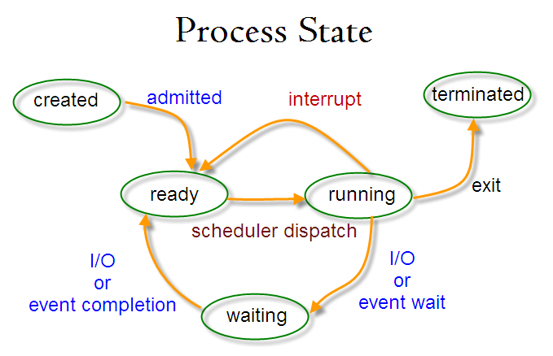
Process States

Slide 245
Creation of a Processes in Linux
A new process is normally created when an existing process makes an exact copy of itself in memory.
The child process will have the same environment as its parent, but only the process ID number is different.
There are two conventional ways used for creating a new process in Linux:
Using The System() Function – this method is relatively simple, however, it’s inefficient and has significantly certain security risks.
Using fork() and exec() Function – this technique is a little advanced but offers greater flexibility, speed, together with security.
Java process Example

Slide 246
How Does Linux Identify Processes?
Because Linux is a multi-user system, meaning different users can be running various programs on the system, each running instance of a program must be identified uniquely by the kernel.
And a program is identified by its process ID (PID) as well as it’s parent processes ID (PPID), therefore processes can further be categorized into:
Parent processes – these are processes that create other processes during run-time.
Child processes – these processes are created by other processes during run-time.

Slide 247
The Init Process
Init process is the mother (parent) of all processes on the system.
it’s the first program that is executed when the Linux system boots up;
it manages all other processes on the system.
It is started by the kernel itself, so in principle it does not have a parent process.
The init process always has process ID of 1. It functions as an adoptive parent for all orphaned processes.
You can use the pidof command to find the ID of a process:

Slide 248
The Init Process
To find the process ID and parent process ID of the current shell, run:
$ echo $$
$ echo $PPID

Slide 249
Starting a Process in Linux
Once you run a command or program (for example ls –l *.txt), it will start a process in the system.
You can start a foreground (interactive) process as follows, it will be connected to the terminal and a user can send input it:

Slide 250
Linux Background Jobs
To start a process in the background (non-interactive), use the & symbol, here, the process doesn’t read input from a user until it’s moved to the foreground.
ls –l *.txt &
You can also send a process to the background by suspending it using [Ctrl + Z], this will send the SIGSTOP signal to the process, thus stopping its operations; it becomes idle:

Slide 251
Linux Background Jobs
To continue running the above-suspended command in the background, use the bg command:
# bg
To send a background process to the foreground, use the fg command together with the job ID like so:
# jobs
# fg %1

Slide 252
States of a Process in Linux
During execution, a process changes from one state to another depending on its environment/circumstances.
In Linux, a process has the following possible states:
Running – here it’s either running (it is the current process in the system) or it’s ready to run (it’s waiting to be assigned to one of the CPUs).
Waiting – in this state, a process is waiting for an event to occur or for a system resource. Additionally, the kernel also differentiates between two types of waiting processes; interruptible waiting processes – can be interrupted by signals and uninterruptible waiting processes – are waiting directly on hardware conditions and cannot be interrupted by any event/signal.

Slide 253
States of a Process in Linux
Stopped – in this state, a process has been stopped, usually by receiving a signal. For instance, a process that is being debugged.
Zombie – here, a process is dead, it has been halted but it’s still has an entry in the process table.

Slide 254
How to View Active Processes in Linux
ps Command
top – System Monitoring Tool
glances – System Monitoring Tool
glances is a relatively new system monitoring tool with advanced features

Slide 255
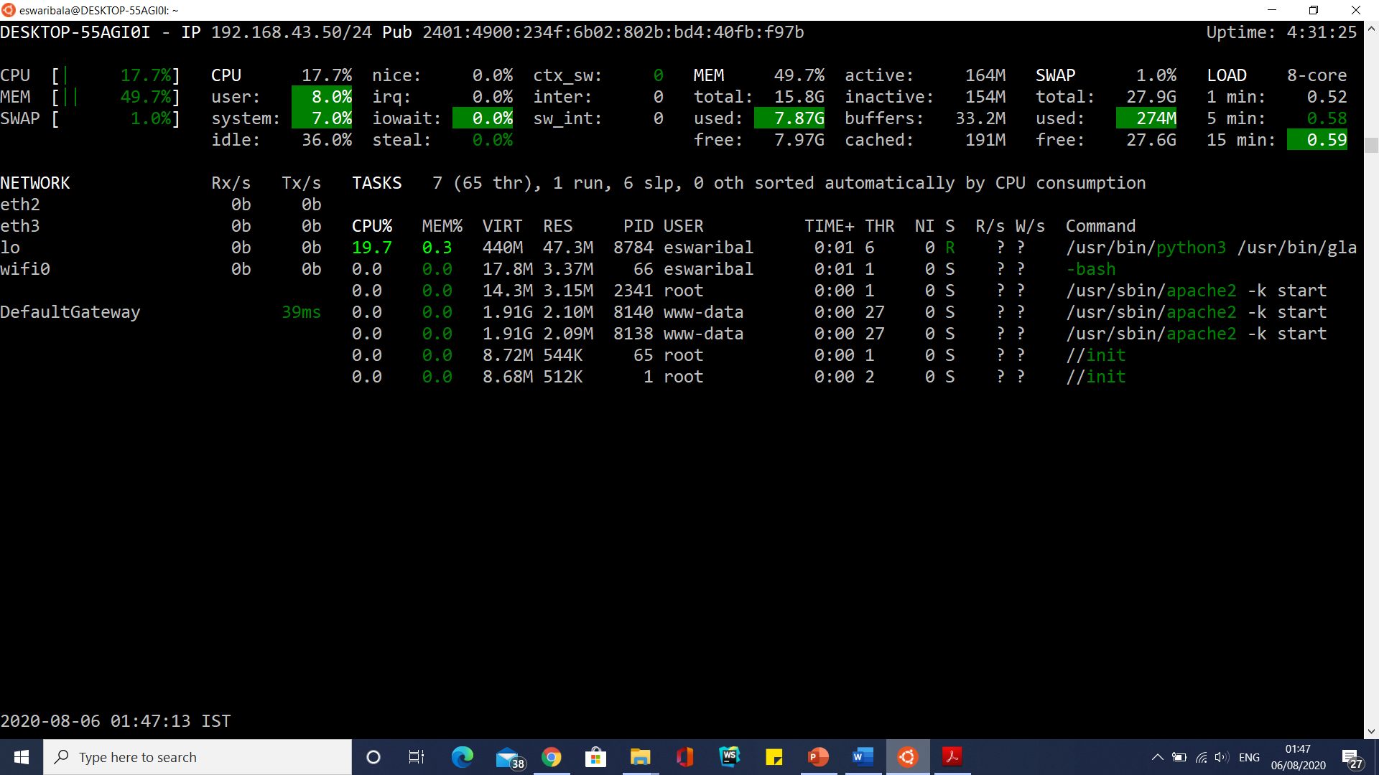
How to View Active Processes in Linux

Slide 256
Sending Signals To Processes
The fundamental way of controlling processes in Linux is by sending signals to them. There are multiple signals that you can send to a process, to view all the signals run:
$ kill -l

Slide 257
PS and PS Variables
ps - report a snapshot of the current processes.
This version of ps accepts several kinds of options:
UNIX options, which may be grouped and must be preceded by a dash.
BSD options, which may be grouped and must not be used with a dash.
GNU long options, which are preceded by two dashes.

Slide 258
PS and PS Variables
To see every process on the system using standard syntax:
ps -e
ps -ef
ps -eF
ps -ely

Slide 259
PS and PS Variables
To see every process on the system using BSD syntax:
ps ax
ps axu
To print a process tree:
ps -ejH
ps axjf
To get info about threads:
ps -eLf
ps axms

Slide 260
PS and PS Variables
To get security info:
ps -eo euser,ruser,suser,fuser,f,comm,label
ps axZ
ps -eM
To see every process running as root (real & effective ID) in user format:
ps -U root -u root u
To see every process with a user-defined format:
ps -eo pid,tid,class,rtprio,ni,pri,psr,pcpu,stat,wchan:14,comm
ps axo stat,euid,ruid,tty,tpgid,sess,pgrp,ppid,pid,pcpu,comm
ps -eopid,tt,user,fname,tmout,f,wchan

Slide 261
PS and PS Variables
Print only the process IDs of syslogd:
ps -C syslogd -o pid=
Print only the name of PID 42:
ps -p 42 -o comm=

Slide 262
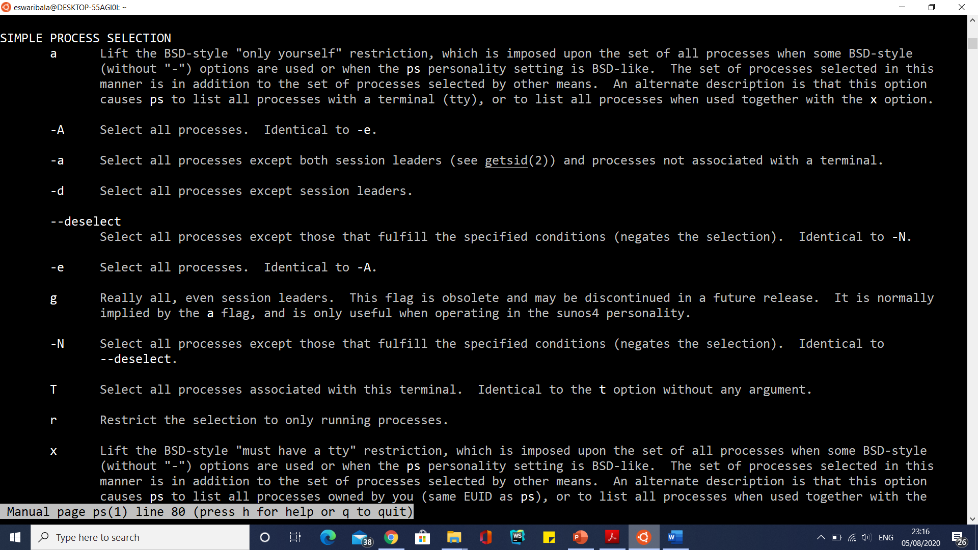
PS and PS Variables
man ps

Slide 263
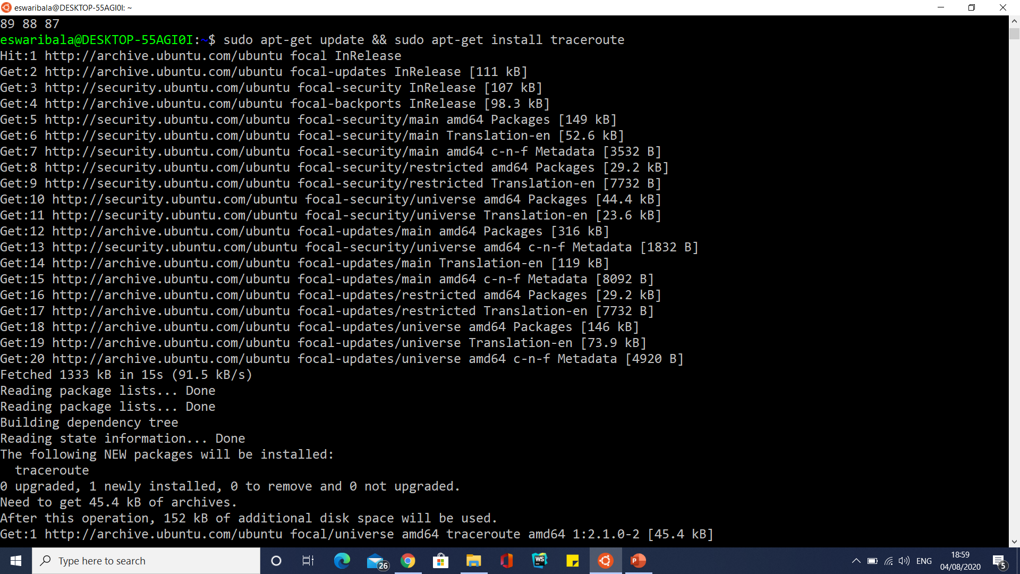
Traceroute Install
sudo apt-get update && sudo apt-get install traceroute

Slide 264
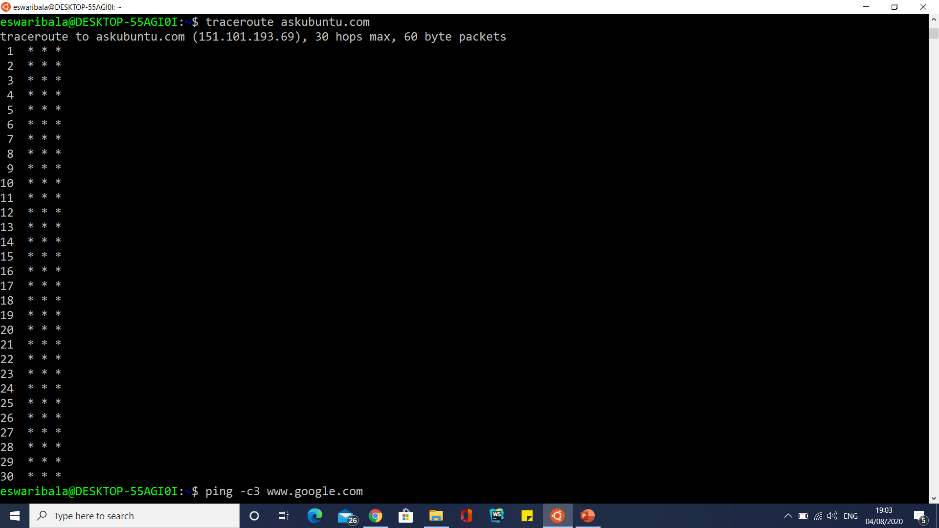
Traceroute Install
traceroute askubuntu.com

Slide 265
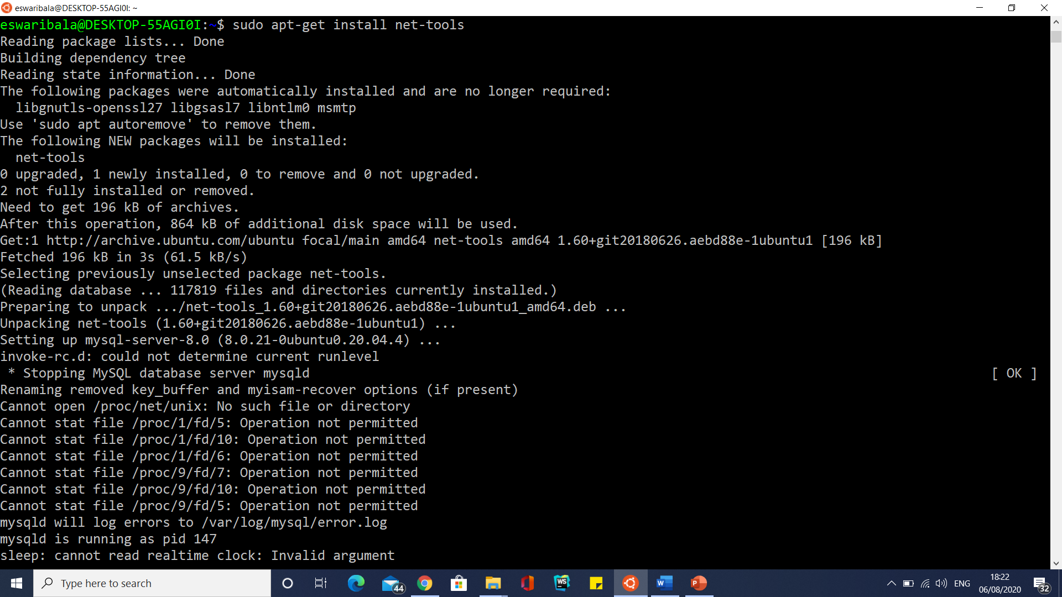
Ifconfig

Slide 266
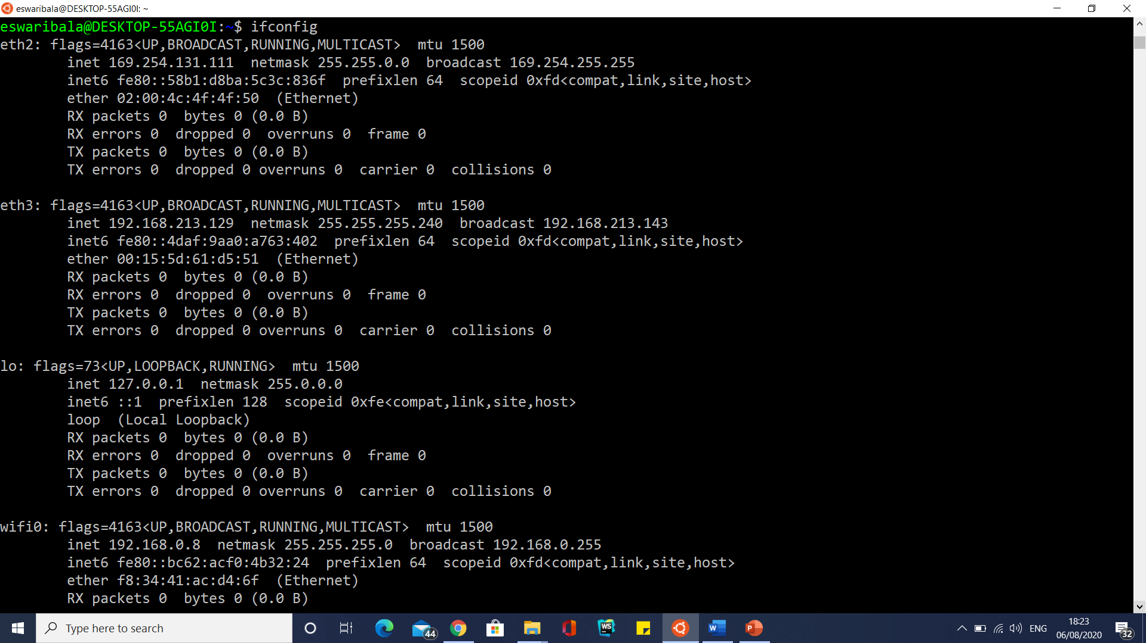
Ifconfig

Slide 267

Ping
ping -c3 www.google.com

Slide 268
ftp utility
FTP (File Transfer Protocol) is a relatively old and most used standard network protocol used for uploading/downloading files between two computers over a network.
However, FTP by its original insecure, because it transmits data together with user credentials (username and password) without encryption.
FTP

Slide 269

ftp utility

Slide 270

ftp utility

Slide 271

ftp utility

Slide 272
ftp utility with remote service
FTP URL: ftp.dlptest.com or ftp://ftp.dlptest.com/
FTP User: dlpuser@dlptest.com
Password: eUj8GeW55SvYaswqUyDSm5v6N

Slide 273

ftp utility with remote service

Slide 274
Vi Editor
Vi Editor
Vi Cheat sheet

Slide 275
Command Shell
The original UNIX System shell, sh, was written by Steve Bourne, and as a result it is known as the Bourne shell.
The C shell, csh, was the first attempt to enhance the original Bourne shell.
The syntax was strongly influenced by the C programming language.
The C shell introduced the concepts of a command history list, job control, and aliases.
However, like sh, it lacks some important features of later shells.
A common complaint about csh is that the new syntax is not compatible with the Bourne shell, and so some scripts may not work properly in csh.

Slide 276
Command Shell
The extended C shell, tcsh, has replaced csh entirely on some versions of UNIX (including Linux).
It retains all the features of csh and adds command-line editing (a very important shell feature) and history completion.
It is one of the more popular shells, although like csh it has been criticized for not being compatible with the Bourne shell.

Slide 277
Command Shell
The Korn shell, ksh, was developed at AT&T Bell Laboratories by David Korn.
Unlike the C shell, the Korn shell has a syntax compatible with sh.
Like tcsh, ksh includes a command history list, job control, aliases, and command-line editing.
The Korn shell was until recently proprietary to AT&T, although it can now be downloaded for free.

Slide 278
Command Shell
The Bourne Again Shell, bash, is part of the GNU project.
It extends ksh further, while remaining compatible with the original Bourne shell syntax, and adds a few features from tcsh as well.
bash is the default shell in Linux and may be the most popular shell today On some systems, the command sh will run bash instead.

Slide 279
Running the Shell
When you log in to the system, a shell program is automatically started for you.
This is your login shell.
The particular shell program that is run when you log in is determined by your entry in the file /etc/passwd.
This file contains information the system needs to know about each user, including name, login ID, and so forth.
The last field of this file contains the name of the program to run as your shell.
A typical entry might look like
$ grep username /etc/passwd

Slide 280

Running the Shell

Slide 281
Changing Your Login Shell
The command to change your login shell is chsh. In this example, the user rlf is changing her shell to
bash:
$ chsh
To find the full pathname for a command or executable, type which followed by the name of the command.
For example,
$ which bash

Slide 282

Changing Your Login Shell

Slide 283
What the Shell Does
After you log in, much of your interaction with the UNIX System takes the form of a dialog with the shell.
The dialog follows this simple sequence repeated over and over:
1. The shell prompts you when it is ready for input, and waits for you to enter a command.
2. You enter a command by typing in a command line.
3. The shell processes your command line to determine what actions to take and carries out the actions required.
4. After the program is finished, the shell prompts you for input, beginning the cycle again.

Slide 284
Shell Programming
Variables
Variables are "words" that hold a value.
The shell enables you to create, assign, and delete variables.
Although the shell manages some variables, it is mostly up to the programmer to manage variables in shell scripts.

Slide 285
Shell Programming
Defining Variables
Variables are defined as follows:
name=value
In this example, name is the name of the variable, and value is the value it should hold.
For example,
FRUIT=peach
defines the variable FRUIT and assigns it the value peach.
Variables of this type are called scalar variables. A scalar variable can hold only one value at a time.

Slide 286
Shell Programming
Defining Variables
Scalar variables are also referred to as name value pairs, because a variable's name and its value can be thought of as a pair.

Slide 287
Shell Programming
Variable Names
The name of a variable can contain only letters ( a to z or A to Z), numbers ( 0 to 9) or the underscore character ( _).
In addition, a variable's name can start only with a letter or an underscore.
The following examples are valid variable names:
_FRUIT
FRUIT_BASKET
TRUST_NO_1
TWO_TIMES_2
but
2_TIMES_2_EQUALS_4
is not a valid variable name

Slide 288
Shell Programming
To make this a valid name, add an underscore at the beginning of its name:
_2_TIMES_2
Variable names, such as 1, 2 or 11, that start with numbers are reserved for use by the shell.
You can use the value stored in these variables, but you cannot set the value yourself.
The reason you cannot use other characters such as !,*, or - is that these characters have a special meaning for the shell.
If you try to make a variable name with one of these special characters it confuses the shell.

Slide 289
Shell Programming
For example, the variable names
FRUIT-BASKET
_2*2
TRUST_NO_1!
are invalid names.
The error message generated by one of these variable name looks something like the following:
$ FRUIT-BASKET=apple
/bin/sh: FRUIT-BASKET=apple: not found.

Slide 290
Shell Programming
Variable Values
The shell enables you to store any value you want in a variable.
For example,
FRUIT=peach
FRUIT=2apples
FRUIT=apple+pear+kiwi
The one thing to be careful about is using values that have spaces. For example,
$ FRUIT=apple orange plum.
results in the following error message:
sh: orange: not found.

Slide 291
Shell Programming
In order to use spaces you need to quote the value.
For example, both of the following are valid assignments:
$ FRUIT="apple orange plum"
$ FRUIT='apple orange plum'

Slide 292
Shell Programming
Accessing Values
To access the value stored in a variable, prefix its name with the dollar sign ( $).
For example, the command
$ echo $FRUIT
peach
prints out the value stored in the variable FRUIT, in this case peach.
If you do not use the dollar sign ( $) to access the value of a variable, the name of the variable is printed instead of its value.
For example,
$ echo FRUIT
FRUIT

Slide 293

Shell Programming

Slide 294

Shell Programming

Slide 295

Shell Programming

Slide 296
Shell Programming
Array Variables
The Bourne shell, sh, supports only scalar variables, which are the type of variables you have seen so far.
The Korn shell, ksh, extends this to include array variables.
Version 2.0 and later of the Bourne Again shell, bash, also support array variables.

Slide 297
Shell Programming
Array Variables
The Bourne shell, sh, supports only scalar variables, which are the type of variables you have seen so far.
The Korn shell, ksh, extends this to include array variables.
Version 2.0 and later of the Bourne Again shell, bash, also support array variables.

Slide 298
Shell Programming
Array Variables
The simplest method of creating an array variable is to assign a value to one of its indices.
This is expressed as follows:
name[index]=value
Here name is the name of the array, index is the index of the item in the array that you want to set, and value is the value you want to set for that item.
As an example, the following commands
$ FRUIT[0]=apple
$ FRUIT[1]=banana
$ FRUIT[2]=orange

Slide 299
Shell Programming
Array Variables
set the values of the first three items in the array named FRUIT.
You could do the same thing with scalar variables as follows:
$ FRUIT_0=apple
$ FRUIT_1=banana
$ FRUIT_2=orange

Slide 300
Shell Programming
Array Variables
If an array variable with the same name as a scalar variable is defined, the value of the scalar variable becomes the value of the element of the array at index 0.
For example, if the following commands are executed
$ FRUIT=apple
$ FRUIT[1]=peach
the element FRUIT has the value apple.
At this point any accesses to the scalar variable FRUIT are treated like an access to the array item FRUIT[0].
The second form of array initialization is used to set multiple elements at once. In ksh, this is done as follows:
set -A name value1 value2 ... valuen
In bash, the multiple elements are set as follows:
myarray=([0]=derri [3]=gene [2]=mike [1]=terry)

Slide 301
Shell Programming
Array Variables
Here, name is the name of the array and the values, 1 to n, are the values of the items to be set.
When setting multiple elements at once, both ksh and bash use consecutive array indices beginning at 0.
For example the ksh command
$ set -A band derri terry mike gene
or the bash command
$ band =([0]=derri [3]=gene [2]=mike [1]=terry)
is equivalent to the following commands:
$ band[0]=derri
$ band[1]=terry

Slide 302
Shell Programming
Accessing Array Values
After you have set any array variable, you access it as follows:
${name[index]}
Here name is the name of the array, and index is the index that interests us.
For example, if the array FRUIT was initialized as given previously, the command
$ echo ${FRUIT[2]}
produces the following output:
orange
You can access all the items in an array in one of the following ways:
${name[*]}
${name[@]}

Slide 303
Shell Programming
Accessing Array Values
Here name is the name of the array you are interested in. If the FRUIT array is initialized as given previously, the command
$ echo ${FRUIT[*]}
produces the following output:
apple banana orange
If any of the array items hold values with spaces, this form of array access will not work and will need to use the second form.
The second form quotes all the array entries so that embedded spaces are preserved.
For example, define the following array item:
FRUIT[3]="passion fruit"

Slide 304
Shell Programming
Accessing Array Values
Assuming that FRUIT is defined as given previously, accessing the entire array using the following command
$ echo ${FRUIT[*]}
results in five items, not four:
apple banana orange passion fruit
Commands accessing FRUIT using this form of array access get five values, with passion and fruit treated as separate items.

Slide 305
Shell Programming
Accessing Array Values
To get only four items, you have to use the following form:
$ echo ${FRUIT[@]}
The output from this command looks similar to the previous commands:
apple banana orange passion fruit
but the commands see only four items because the shell quotes the last item as passion fruit.

Slide 306

Shell Programming

Slide 307

Shell Programming

Slide 308

Shell Programming

Slide 309

Shell Programming
Read-only Variables
The shell provides a way to mark variables as read-only by using the readonly command.
After a variable is marked read-only, its value cannot be changed.
Consider the following commands:
$ FRUIT=kiwi
$ readonly FRUIT
$ echo $FRUIT
kiwi
$ FRUIT=cantaloupe
The last command results in an error message:
/bin/sh: FRUIT: This variable is read only.

Slide 310
Shell Programming
Unsetting Variables
Unsetting a variable tells the shell to remove the variable from the list of variables that it tracks.
This is like asking the shell to forget a piece of information because it is no longer required.
Both scalar and array variables are unset using the unset command:
unset name
Here name is the name of the variable to unset.
For example,
unset FRUIT
unsets the variable FRUIT.
You cannot use the unset command to unset variables that are marked readonly.

Slide 311

Special Variables

Slide 312

Special Variables

Slide 313

Special Variables

Slide 314
Shell Programming
When a shell is running, three main types of variables are present:
Local Variables
Environment Variables
Shell Variables

Slide 315
Shell Programming
A local variable is a variable that is present within the current instance of the shell.
It is not available to programs that are started by the shell.
The variables that you looked at previously have all been local variables.

Slide 316
Shell Programming
An environment variable is a variable that is available to any child process of the shell.
Some programs need environment variables in order to function correctly.
Usually a shell script defines only those environment variables that are needed by the programs that it runs..

Slide 317
Shell Programming
A shell variable is a special variable that is set by the shell and is required by the shell in order to function correctly.
Some of these variables are environment variables whereas others are local variables.

Slide 318
Shell Programming
A shell variable is a special variable that is set by the shell and is required by the shell in order to function correctly.
Some of these variables are environment variables whereas others are local variables.

Slide 319
Shell Variables

Slide 320
Command and Arithmetic Substitution
Command substitution enables you to capture the output of a command and substitute it in another command, whereas arithmetic substitution enables you to perform simple integer mathematics using the shell.

Slide 321
Shell Programming
Command Substitution
Command substitution is the mechanism by which the shell performs a given set of commands and then substitutes their output in the place of the commands.
Command substitution is performed when a command is given as ´command´
Here command, can be a simple command, a pipeline, or a list.

Slide 322
Shell Programming
Command Substitution
Command substitution is generally used to assign the output of a command to a variable. Each of the
following examples demonstrate command substitution:
DATE=´date´
USERS=´who | wc -l´
UP=´date ; uptime´

Slide 323

Shell Programming
Command Substitution

Slide 324
Shell Programming
Arithmetic Substitution
In ksh and bash, the shell enables integer arithmetic to be performed.
This avoids having to run an extra program such as expr or bc to do math in a shell script.
This feature is not available in sh.
Arithmetic substitution is performed when the following form of command is given:
$((expression))
Expressions are evaluated according to standard mathematical conventions.

Slide 325

Shell Programming
Arithmetic Substitution

Slide 326

Shell Programming
Arithmetic Substitution

Slide 327
Creating a Script File
To place shell commands in a text file, first you’ll need to use a text editor to create a file, then enter the commands into the file.
When creating a shell script file, you must specify the shell you are using in the first line of the file.
The format for this is:
#!/bin/bash

Slide 328
Creating a Script File
After indicating the shell, commands are entered onto each line of the file, followed by a carriage return.
As mentioned, comments can be added by using the pound sign.
An example looks like this:
#!/bin/bash
# This script displays the date and who’s logged on
date
who

Slide 329
Creating a Script File
days=10
guest="Kavitha"
echo "$guest checked in $days days ago"
days=5
guest=“Kumar"
echo "$guest checked in $days days ago“
var1=100
var2=45
var3=$[$var1 / $var2]
echo The final result is $var3

Slide 330
Creating a Script File

Slide 331
Creating a Script File

Slide 332
Exiting the Script
Every command that runs in the shell uses an exit status to indicate to the shell that it’s done processing.
The exit status is an integer value between 0 and 255 that’s passed by the command to the shell when the command finishes running.
You can capture this value and use it in your scripts.

Slide 333
Exiting the Script
Checking the exit status
Linux provides the $? special variable that holds the exit status value from the last command that executed.
You must view or use the $? variable immediately after the command you want to check.
It changes values to the exit status of the last command executed by the shell:
$ date
Sat Sep 29 10:01:30 EDT 2007
$ echo $?

Slide 334
Exiting the Script
Checking the exit status

Slide 335

Exiting the Script
Checking the exit status

Slide 336
Using Structured Commands
Working with the if-then Statement
The most basic type of structured command is the if-then statement.
The if-then statement has the following format:
if command
then
commands
fi

Slide 337
Using Structured Commands
The if-then-else Statement
The if-then-else statement provides another group of commands in the statement:
if command
then
commands
else
commands
fi

Slide 338
Using Structured Commands
Nesting ifs
The elif continues an else section with another if-then statement:
if command1
then
command set 1
elif command2
then
command set 2
elif command3
then
command set 3
elif command4
then
command set 4
fi

Slide 339
Advanced if-then Features
Using double parentheses
The double parentheses command allows you to incorporate advanced mathematical formulas in your comparisons.
The test command only allows for simple arithmetic operations in the comparison.
The double parentheses command provides more mathematical symbols that programmers from other languages are used to using.
The format of the double parentheses command is:
(( expression ))
The expression term can be any mathematical assignment or comparison expression.

Slide 340

Using Structured Commands

Slide 341
Using Structured Commands

Slide 342
Using Structured Commands

Slide 343
Using Structured Commands

Slide 344
Advanced if-then Features
There are two relatively recent additions to the bash shell that provide advanced features that you can use in if-then statements:
Double parentheses for mathematical expressions
Double square brackets for advanced string handling functions

Slide 345
The case Command
The case command checks multiple values of a single variable in a list-oriented format:
case variable in
pattern1 | pattern2) commands1;;
pattern3) commands2;;
*) default commands;;
esac

Slide 346
The for Command
The bash shell provides the for command to allow you to create a loop that iterates through a series of values.
Each iteration performs a defined set of commands using one of the values in the series.
The basic format of the bash shell for command is:
for var in list
do
commands
done

Slide 347
The while Command
Basic while format
The format of the while command is:
while test command
do
other commands
done

Slide 348
The until Command
The until command works exactly the opposite way from the while command.
The until command requires that you to specify a test command that normally produces a non-zero exit status.
As long as the exit status of the test command is non-zero, the bash shell executes the commands listed in the loop.
Once the test command returns a zero exit status, the loop stops.
As you would expect, the format of the until command is:
until test commands
do
other commands
done

Slide 349
The break command
The break command is a simple way to escape out of a loop in progress.
You can use the break command to exit out of any type of loop, including while and until loops.

Slide 350
Command Line Parameters
The most basic method of passing data to your shell script is by using command line parameters.
Command line parameters allow you to add data values to the command line when you execute the script:
$ ./addem 10 30

Slide 351
Reading parameters
The bash shell assigns special variables, called positional parameters, to all of the parameters entered in a command line.
This even includes the name of the program the shell executes.
The positional parameter variables are standard numbers, with $0 being the name of the program, $1 being the first parameter, $2 being the second parameter, and so on, up to $9 for the ninth parameter.

Slide 352

Reading parameters

Slide 353
Counting parameters
Instead of testing each parameter, you can just count how many parameters were entered on the command line.
The bash shell provides a special variable for this purpose.
The special $# variable contains the number of command line parameters included when the script was run.
You can use this special variable anywhere in the script, just as a normal variable:

Slide 354
Grabbing all the data
The $* and $@ variables provide one-stop shopping for all of your parameters.
Both of these variables include all of the command line parameters within a single variable.
The $* variable takes all of the parameters supplied on the command line as a single word.
The word contains each of the values as they appear on the command line.
Basically, instead of treating the parameters as multiple objects, the $* variable treats them all as one parameter.

Slide 355
Grabbing all the data
The $@ variable on the other hand, takes all of the parameters supplied on the command line as separate words in the same string.
It allows you to iterate through the value, separating out each parameter supplied.
This is most often accomplished using the for command.

Slide 356
Timing out
There’s a danger when using the read command.
It’s quite possible that your script will get stuck waiting for the script user to enter data.
If the script must go on regardless of if there was any data entered, you can use the -t option specify a timer.
The -t option specifies the number of seconds for the read command to wait for input.
When the timer expires, the read command returns a non-zero exit status:

Slide 357
Select Loop
Basic 'select' Loop
In select loop, we have the similar syntax as that of for loop. As mentioned above, select loop accepts a sequence to iterate through it and present it as a numbered menu.
For this, we use the in keywordas shown in below syntax.
Syntax:
select variableName in choice1 choice2 ... choiceN
do
-- Block of Commands --
done

Slide 358
continue Statement
The continue statement in a loop, when certain condition becomes true, skips all the subsequent statements, coming after it, and continues with the next iteration of the loop.
So, when a continue statement is reached, further portion of code is skipped from execution and next iteration is started.
Syntax:
while [ condition ]
do
-- Some Commands --
if [ condition ]
then
continue
fi
-- More commands --
done

Slide 359
Basic Script Functions
Functions are blocks of script code that you assign a name to, then reuse anywhere in your code.
Anytime you need to use that block of code in your script, all you need to do is use the function name you assigned it (referred to as calling the function).

Slide 360
Basic Script Functions
Creating a function
There are two formats you can use to create functions in bash shell scripts.
The first format uses the keyword function, along with the function name you assign to the block of code:
function name {
commands
}

Slide 361
Basic Script Functions
Creating a function
The commands are one or more bash shell commands that make up your function.
When you call the function, the bash shell executes each of the commands in the order they appear in the function, just as in a normal script.

Slide 362
Basic Script Functions
Creating a function
The second format for defining a function in a bash shell script more closely follows how functions
are defined in other programming languages:
name() {
commands
}
The empty parentheses after the function name indicate that you’re defining a function.
The same naming rules apply in this format as in the original shell script function format.

Slide 363
Basic Script Functions
Returning a Value
The bash shell uses the return command to exit a function with a specific exit status.
The return command allows you to specify a single integer value to define the function exit status, providing an easy way for you to programmatically set the exit status of your function:

Slide 364
Basic Script Functions
Handling variables in a function
One thing that causes problems for shell script programmers is the scope of a variable.
The scope is where the variable is visible.
Variables defined in functions can have a different scope than regular variables.
That is, they can be hidden from the rest of the script.

Slide 365
Basic Script Functions
Handling variables in a function
Functions use two types of variables:
Global
Local

Slide 366
Basic Script Functions
Global variables
Global variables are variables that are valid anywhere within the shell script.
If you define a global variable in the main section of a script, you can retrieve its value inside a function.
Likewise, if you define a global variable inside a function, you can retrieve its value in the main section of the script.

Slide 367
Basic Script Functions
Local variables
Instead of using global variables in functions, any variables that the function uses internally can be declared as local variables.
To do that, just use the local keyword in front of the variable declaration:
local temp
You can also use the local keyword in an assignment statement while assigning a value to the variable:
local temp=$[ $value + 5 ]

Slide 368
Basic Script Functions
Local variables
The local keyword ensures that the variable is limited to only within the function.
If a variable with the same name appears outside the function in the script, the shell keeps the two variable values separate.

Slide 369
Basic Script Functions
Array Variables and Functions
Passing multiple values to function using array and returning the array from function.

Slide 370
Basic Script Functions
Creating a Library
The bash shell allows you to create a library file for your functions, then reference that single library file in as many scripts as you need to.
The first step in the process is to create a common library file that contains the functions you need in your scripts.

Slide 371
Basic Script Functions
Using Functions on the Command Line
You can use script functions to create some pretty complex operations.
Sometimes it would be nice to be able to use these functions directly on the command line interface prompt.
Just as you can use a script function as a command in a shell script, you can also use a script function as a command in the command line interface.
This is a nice feature, since once you define the function in the shell, you can use it from any directory on the system;
You don’t have to worry about a script being in your PATH environment variable

Slide 372

Basic Script Functions
Using Functions on the Command Line
function bonus { echo `expr $1*0.05+$2*0.10|bc`; }

Slide 373

Basic Script Functions
Using Functions on the Command Line
function doubleit { read -p "Enter value: " value; echo $[
$ value * 2 ]; }

Slide 374
Basic Script Functions
Create the menu functions
Adding Color (Refer colodename.sh)

Slide 375
Basic Script Functions
Create the menu functions
Adding Color

Slide 376
Reading from a file
Read command can be used to read data stored in a file on the Linux system.
Each call to the read command reads a single line of text from the file.
When there are no more lines left in the file, the read command will exit with a non-zero exit status.

Slide 377
Understanding Input and Output

Slide 378
Understanding Input and Output
Permanent redirections
If you have lots of data that you’re redirecting in your script, it can get tedious having to redirect every echo statement.
Instead, you can tell the shell to redirect a specific file descriptor for the duration of the script by using the exec command

Slide 379
Understanding Input and Output
Redirecting Input in Scripts
You can use the same technique used to redirect STDOUT and STDERR in your scripts to redirect STDIN from the keyboard.
The exec command allows you to redirect STDIN to a file on the Linux system:
exec 0< testfile
This command informs the shell that it should retrieve input from the file testfile instead of STDIN.
Refer filereading example

Slide 380
Creating Your Own Redirection
Creating output file descriptors you assign a file descriptor for output by using the exec command.
Just as with the standard file descriptors, once you assign an alternative file descriptor to a file location, that redirection stays permanent until you reassign it.
The other six file descriptors are numbered from three through eight and are available for you to use as either input or output redirection.
Refer fileopenclose example

Slide 381
Closing file descriptors
If you create new input or output file descriptors, the shell automatically closes them when the script exits.
There are situations though when you need to manually close a file descriptor before the end of the script.
To close a file descriptor, redirect it to the special symbol &-
Once you close the file descriptor, you can’t write any data to it in your script or the shell produces an error message.

Slide 382
AWK Editor
awk -F: '{print $1}' /etc/passwd
#run multiple commands
echo "Hello Tom" | awk '{$2="Adam"; print $0}’
Create file.csv
awk 1 file #print file
awk 'NR>1' file.csv #remove header
awk 'NR>1 && NR < 4' file.csv #print in range
awk '1' RS='' file.csv #remove blank lines

Slide 383
Built in Variables
NR: It is used to show the current count of the lines. The awk command performs action once for each line. These lines are said as records.
NF: It is used to count the number of fields within the current database.
FS: It is used to create a field separator character to divide fields into the input lines.
OFS: It is used to store the output field separator. It separates the output fields.
ORS: It is used to store the output record separator. It separates the output records. It prints the content of the ORS command automatically.

Slide 384
AWK Editor
awk '{ print $1, $3}' FS=, OFS=, file.csv # few cols
awk '{ SUM+=$1 } END { print SUM }' FS=, OFS=, file.csv #arithemetic operation
awk '/./ { COUNT+=1 } END { print COUNT }' file.csv #count empty lines
awk '/ CS/ {print} ' student.txt #only from CS

Slide 385
AWK Editor
To display the line number in output, use the NR variable with the Awk command as follows:
awk '{print NR,$0}' student.txt
To display the last field of the file, execute the NF variable with the Awk command as follows:
awk '{print $NF}' student.txt
To separate the output by a '-' symbol or (:) semicolon, specify it with ORS command as follows:
awk 'BEGIN { ORS ="-"} {print $0}' student.txt

Slide 386
AWK Editor
To print the numbers from 1 to 8, execute below command:
awk 'BEGIN { for(i=1;i<=8;i++) print "square of", i, "is",i*i; }’

Slide 387

AWK Editor

Slide 388

AWK Editor

Slide 389

Grep Options

Slide 390

Grep Options

Slide 391
Grep Options
Enter the following command to search a file for a specific character pattern:
grep 'bare metal' example_file2.txt
grep commands are case-sensitive. Use the -i option to display both uppercase and lowercase results:
grep -i 'bare metal' example_file2.txt
You can use grep to print all lines that do not match a specific pattern. To invert the search, append -v to the grep command:
grep -v 'bare metal' example_file2.txt

Slide 392
Grep Options
grep 'server' example_file1.txt example_file2.txt example_file3.txt #multiple file search
To search all files in the current directory, use an asterisk (*) instead of a filename at the end of a grep command.
In this example, the search pattern is ransomware:
grep 'ransomware' *

Slide 393
Grep Options
Use the asterisk (*) wildcard to limit searches to files with certain extensions:
grep 'ransomware' *.txt
Find Whole Words Only (Exact match)
grep allows you to search and print the results for whole words only. To search for the word server in all files in the current directory, append -w to the grep command:
grep -w server *

Slide 394
Grep Options
To recursively search all files, including subdirectories, add the -r operator to the grep command:
grep -r phoenix *
Show Lines That Exactly Match a Search String
The grep command prints entire lines when it finds a match in a file. Add the -x option to print lines that completely match the search string:
grep -x 'Spoofing' example_file1.txt

Slide 395
Grep Options
grep can count how many lines contain a pattern in one or more files. Use the -c operator to count the number of matching lines:
grep -c server *
Show Only the Matched Part of the Line
Use the -o option to show only part of the line that matches the search pattern rather than the entire line:
grep -o 'server' example_file2.txt

Slide 396
Grep Options
grep '^[a-zA-Z]' example_file1.txt
cat example_file2.txt | grep 'server'

Slide 397
Logging Messages
Sometimes it’s beneficial to send output both to the monitor and to a file for logging.
Instead of having to redirect output twice, you can use the special tee command.
The tee command is like a T-connector for pipes.
It sends data from STDIN to two destinations at the same time. One destination is STDOUT.
The other destination is a filename specified on the tee command line:
tee filename
Since tee redirects data from STDIN, you can use it with the pipe command to redirect output from any command:

Slide 398
Text Manipulation
The sed editor
The sed editor is called a stream editor, as opposed to a normal interactive text editor.
In an interactive text editor, such as vim, you interactively use keyboard commands to insert, delete, or replace text in the data.
A stream editor edits a stream of data based on a set of rules you supply ahead of time, before the editor processes the data.

Slide 399
Text Manipulation
The sed editor
The sed editor can manipulate data in a data stream based on commands you either enter into the command line or store in a command text file.
It reads one line of data at a time from the input, matches that data with the supplied editor commands, changes data in the stream as specified in the commands, then outputs the new data to STDOUT.
After the stream editor matches all of the commands against a line of data, it reads the next line of data and repeats the process.
After the stream editor processes all of the lines of data in the stream, it terminates

Slide 400
Text Manipulation
The sed editor
Since the commands are applied sequentially line by line, the sed editor only has to make one pass through the data stream to make the edits.
This makes the sed editor much faster than an interactive editor, allowing you to quickly make changes to data in a file on the fly.
The format for using the sed command is:
sed options script file
The options parameters allow you to customize the behavior of the sed command

Slide 401
Text Manipulation
The sed editor

Slide 402
Text Manipulation
The sed editor
How to add a header line say "Employee, EmpId" to this file using sed?
'1i' means to include the following before reading the first line and hence we got the header in the file.
sed '1i Employee, EmpId' empfile

Slide 403
Text Manipulation
The sed editor
How to add a line '-------' after the header line or the 1st line?
sed -i '1a ---------------' empfile
'1i' is similar to '1a' except that 'i' tells to include the content before reading the line, 'a' tells to include the content after reading the line.
sed -i '$a ---------------' empfile (trailing)

Slide 404
Text Manipulation
The sed editor
How to add a record after a particular record?
sed -i '/Hilesh/a Bharti, 1002' empfile
How to add a record before a particular record?
sed -i '/Harshal/i Aparna, 1003' empFile

Slide 405
Text Manipulation
The sed editor
To add something to the beginning of a every line in a file, say to add a word Fruit:
$ sed 's/^/Fruit: /’ fruits
Similarly, to add something to the end of the file:
$ sed 's/$/ Fruit/’ fruits
To replace or substitute a particular character, say to replace 'a' with 'A'.
$ sed 's/a/A/’ fruits

Slide 406
Text Manipulation
The sed editor
To replace or substitute all occurrences of 'a' with 'A'
$ sed 's/a/A/g’ fruits
Now, say to replace all occurrences from 2nd occurrence onwards:
$ sed 's/a/A/2g’ fruits
Say, you want to replace 'a' only in a specific line say 3rd line, not in the entire file:
$ sed '3s/a/A/g’ fruits

Slide 407
Text Manipulation
The sed editor
To replace or substitute 'a' on a range of lines, say from 1st to 3rd line:
$ sed '1,3s/a/A/g’ fruits
To replace the entire line with something. For example, to replace 'apple' with 'apple is a Fruit'.
$ sed 's/.*/& is a Fruit/’ fruits

Slide 408
Text Manipulation
The sed editor
Using sed, we can also do multiple substitution. For example, say to replace all 'a' to 'A', and 'p' to 'P':
$ sed 's/a/A/g; s/p/P/g’ fruits

Slide 409
Text Manipulation
The sed editor
Read the file2 after every line of file1.
$ sed ‘r fruitnew’ fruits
we can also try to read a file contents on finding a pattern:
$ sed '/banana/r fruitnew’ fruits

Slide 410
Text Manipulation
The sed editor
Write the contents from the 3rd line onwards to a different file:
$ sudo sed -n '3,$w fruitnew’ fruits

Slide 411
Text Manipulation
The sed editor
Viewing a range of lines of a document
sed -n '5,10p' /home/eswaribala/EmployeeData.txt
Viewing the entire file except a given range
sed '20,35d' /home/eswaribala/EmployeeData.txt
Viewing non-consecutive lines and ranges
sed -n -e '5,7p' -e '10,13p' /home/eswaribala/EmployeeData.txt

Slide 412
Text Manipulation
The sed editor
Replacing words or characters (basic substitution)
To replace every instance of the word old name with new name in EmployeeData.txt, do:
sed 's/Martina/Madhu/g' /home/eswaribala/EmployeeData.txt
Additionally, you may want to consider using gi instead of g in order to ignore character case:
# sed 's/version/story/gi' myfile.txt

Slide 413
Text Manipulation
The sed editor
ip route show
To replace multiple blank spaces with a single space, we will use the output of ip route show and a pipeline:
ip route show | sed 's/ */ /g’
Replacing words or characters inside a range If you’re interested in replacing words only within a line range (30 through 40, for example), you can do:
# sed ‘5,10 s/Martina/Madhu/g' /home/eswaribala/EmployeeData.txt

Slide 414
Text Manipulation
The sed editor
Using regular expressions
To remove empty lines or those beginning with # from the Apache configuration file, do:
sed '/^#\|^$\| *#/d' apache2.conf
The caret sign followed by the number sign (^#) indicates the beginning of a line, whereas ^$ represents blank lines.
The vertical bars indicate boolean operations, whereas the backward slash is used to escape the vertical bars.

Slide 415
Text Manipulation
The sed editor
Using regular expressions
To replace a word beginning with uppercase or lowercase with another word, we can also use sed. To illustrate, let’s replace the word zip or Zip with rar in myfile.txt:
# sed 's/[Zz]ip/rar/g' myfile.txt
Viewing lines containing with a given pattern
In this case, the pattern to search for is nMadhu at the beginning of each line:
sed -n '/^LogFormat / p' apache2.conf

Slide 416
Text Manipulation
Inserting spaces in files
With sed, we can also insert spaces (blank lines) for each non-empty line in a file. To insert one blank line every other line in LICENSE, a plain text file, do:
# sed G myfile.txt
To insert two blank lines, do:
# sed 'G;G' myfile.txt

Slide 417
Text Manipulation
Performing two or more substitutions at once
You can combine two or more substitutions one single sed command.
Let’s replace the words that and line in myfile.txt with This and verse, respectively.
Note how this can be done by using an ordinary sed substitution command followed by a semicolon and a second substitution command:
# sed -i 's/that/this/gi;s/line/verse/gi' myfile.txt

Slide 418
gawk Editor
While the sed editor is a handy tool for modifying text files on the fly, it has its limitations.
Often you need a more advanced tool for manipulating data in a file, one that provides a more programming-like environment allowing you to modify and reorganize data in a file.
This is where gawk comes in.
The gawk program is the GNU version of the original awk program in Unix.
The awk program takes stream editing one step further than the sed editor by providing a programming language instead of just editor commands.

Slide 419
gawk Editor
Within the programming language you can:
Define variables to store data.
Use arithmetic and string operators to operate on data.
Use structured programming concepts, such as if-then statements and loops, to add logic to your data processing.
Generate formatted reports by extracting data elements within the data file and repositioning them in another order or format.

Slide 420
gawk Editor
The gawk program’s report-generating abilities are often used for extracting data elements from large bulky text files and formatting them into a readable report.
The perfect example of this is formatting log files.
Trying to pore through lines of errors in a log file can be difficult.
The gawk program allows you to filter just the data elements you want to view from the log file, then format them in a manner that makes reading the important data easier.

Slide 421
gawk Editor
The gawk command format
The basic format of the gawk program is:
gawk options program file
The command line options provide an easy way to customize features in the gawk program.
We’ll be looking more closely at these as we explore using gawk.
The power of gawk is in the program script.
You can write scripts to read the data within a line of text, then manipulate and display the data to create any type of output report.

Slide 422
gawk Editor
To define an awk script, use braces surrounded by single quotation marks like this:
$ awk '{print "Welcome to awk Text Manipulator"}’
If you type anything, it returns the same welcome string we provide.
To terminate the program, press The Ctrl+D.
Looks tricky, don’t panic, the best is yet to come.

Slide 423
gawk Editor
Built-in Variables #
Awk has a number of built-in variables that contain useful information and allows you to control how the program is processed.
Below are some of the most common built-in Variables:
NF - The number of fields in the record.
NR - The number of the current record.
FILENAME - The name of the input file that is currently processed.
FS - Field separator.
RS - Record separator.
OFS - Output field separator.
ORS - Output record separator.

Slide 424
gawk Editor
Built-in Variables #
To print the file name and the number of lines (records):
awk 'END { print "File", FILENAME, "contains", NR, "lines." }' teams.txt.

Slide 425
gawk Editor
Built-in Variables #
Changing the Field and Record Separator
The default value of the field separator is any number of space or tab characters. It can be changed by setting in the FS variable.
For example, to set the field separator to . you would use:
awk 'BEGIN { FS = "." } { print $1 }' teams.txt
Or
awk -F "." '{ print $1 }' teams.txt

Slide 426
gawk Editor
Built-in Variables #
Here is an example showing how to change the record separator to .:
awk 'BEGIN { RS = "." } { print $1 }' teams.txt

Slide 427
gawk Editor
Using Variables
With awk, you can process text files. Awk assigns some variables for each data field found:
$0 for the whole line.
$1 for the first field.
$2 for the second field.
$n for the nth field.
The whitespace character like space or tab is the default separator between fields in awk.

Slide 428
gawk Editor
Using Variables
awk '{print $1}' empfile
echo "Hello Param" | awk '{$2=“Eswari"; print $0}’
awk '{print $1,$2,$NF}' dennis_ritchie.txt
$NF prints last field
awk '{ print $1, $3, $5 }' teams.txt
awk '{ print "The first field:", $1}' teams.txt
awk 'BEGIN { print "First line\nSecond line\nThird line" }'

Slide 429
gawk Editor
Using Variables
awk '{ printf "%3d. %s\n", NR, $0 }' teams.txt
awk '{ sum += $3 } END { printf "%d\n", sum }' teams.txt
awk 'BEGIN { i = 1; while (i < 6) { print "Square of", i, "is", i*i; ++i } }’
awk -v seed=$RANDOM 'BEGIN{i=1;srand(seed);while(i<100){print rand()*10000,i++}}'

Slide 430
gawk Editor
Prog.awk
BEGIN {
i = 1
while (i < 6) {
print "Square of", i, "is", i*i;
++i
}
}

Slide 431
gawk Editor
Run the program by passing the file name to the awk interpreter:
awk -f prog.awk
chmod +x prog.awk
./prog.awk

Slide 432
gawk Editor
Using Shell Variables in Awk Programs
num=51
awk -v n="$num" 'BEGIN {print n}'

Slide 433
gawk Editor
Adding Output Field Separators
date
date | awk '{print $2,$3,$6}’
date | awk 'OFS="/" {print$2,$3,$6}’
date | awk 'OFS="-" {print$2,$3,$6}'

Slide 434
gawk Editor
Awk Patterns
awk '{ print $3 }' teams.txt
awk '/0.5/ { print $1 }' teams.txt
awk '/^[0-9][0-9]/ { print $1 }' teams.txt
To print the first field of each record whose second field contains “ia” you would type:
awk '$2 ~ /ia/ { print $1 }' teams.txt

Slide 435
gawk Editor
Awk Patterns
To match fields that do not contain a given pattern use the !~ operator:
awk '$2 !~ /ia/ { print $1 }' teams.txt
The following command prints the first field of all records whose third field is greater than 50:
awk '$3 > 50 { print $1 }' teams.txt

Slide 436
gawk Editor
Awk Patterns
Range patterns
To print the first field of all records starting from the record including “Raptors” until the record including “Celtics”:
awk '/Raptors/,/Celtics/ { print $1 }' teams.txt

Slide 437
gawk Editor
Special expression patterns
The BEGIN and END Rules
A BEGIN rule is executed once before any text processing starts.
In fact, it’s executed before awk even reads any text.
An END rule is executed after all processing has completed.
You can have multiple BEGIN and END rules, and they’ll execute in order.

Slide 438
gawk Editor
The BEGIN and END Rules
The BEGIN pattern is generally used to set variables and the END pattern to process data from the records such as calculation.
To print “Start Processing.”, then print the third field of each record and finally “End Processing.":
awk 'BEGIN { print "Start Processing." }; { print $3 }; END { print "End Processing." }' teams.txt

Slide 439
gawk Editor
The BEGIN and END Rules
Combining patterns #
Awk allows you to combine two or more patterns using the logical AND operator (&&) and logical OR operator (||).
Here is an example that uses the && operator to print the first field of those record whose third field is greater than 50 and the fourth field is less than 30:
awk '$3 > 50 && $4 < 30 { print $1 }' teams.txt

Slide 440
gawk Editor

Slide 441
gawk Editor
-F: It uses FS for the input field separator (the value of the FS predefined variable).
gawk -F: '{print $1}' /etc/passwd

Slide 442
The Unix File System
The Unix file system is a methodology for logically organizing and storing large quantities of data such that the system is easy to manage.
A file can be informally defined as a collection of (typically related) data, which can be logically viewed as a stream of bytes (i.e. characters).
A file is the smallest unit of storage in the Unix file system.

Slide 443
The Unix File System
By contrast, a file system consists of files, relationships to other files, as well as the attributes of each file.
File attributes are information relating to the file, but do not include the data contained within a file.
File attributes for a generic operating system might include (but are not limited to):
a file type (i.e. what kind of data is in the file)
a file name (which may or may not include an extension)
a physical file size
a file owner
file protection/privacy capability
file time stamp (time and date created/modified)

Slide 444
The Unix File System
Additionally, file systems provide tools which allow the manipulation of files, provide a logical organization as well as provide services which map the logical organization of files to physical devices.
From the beginners perspective, the Unix file system is essentially composed of files and directories.
Directories are special files that may contain other files.

Slide 445
The Unix File System
The Unix file system has a hierarchical (or tree-like) structure with its highest level directory called root (denoted by /, pronounced slash).
Immediately below the root level directory are several subdirectories, most of which contain system files.
Below this can exist system files, application files, and/or user data files.
Similar to the concept of the process parent-child relationship, all files on a Unix system are related to one another.
That is, files also have a parent-child existence.
Thus, all files (except one) share a common parental link, the top-most file (i.e. /) being the exception.

Slide 446
The Unix File System
Below is a diagram (slice) of a "typical" Unix file system.
The top-most directory is / (slash), with the directories directly beneath being system directories.
Note that as Unix implementaions and vendors vary, so will this file system hierarchy.
However, the organization of most file systems is similar.

Slide 447

The Unix File System

Slide 448
The Unix File System
bin - short for binaries, this is the directory where many commonly used executable commands reside
dev - contains device specific files
etc - contains system configuration files
home - contains user directories and files
lib - contains all library files
mnt - contains device files related to mounted devices
proc - contains files related to system processes
root - the root users' home directory (note this is different than /)

Slide 449
The Unix File System
sbin - system binary files reside here. If there is no sbin directory on your system, these files most likely reside in etc
tmp - storage for temporary files which are periodically removed from the filesystem
usr - also contains executable commands

Slide 450
The Unix File System
du COMMAND
du command (short for disk usage) is useful command which is used to find disk usage for files & directories.
du command when used with various options provides results in many formats.
1- To find out summary of disk usage for a directory with all its sub-directories
$ sudo du /home

Slide 451
The Unix File System
2- Disk usage with file/directory sizes in human readable format I.e. in kb, mb etc
$ du -h /home
3- Total disk size of a directory
$ du -s /home

Slide 452
The Unix File System
df COMMAND
df command (short for disk filesystem) is used to show disk utilization for a Linux system.
Some examples are shared below.
1- To display information of device name, total blocks, total disk space, used disk space, available disk space and mount points on a file system.
$ df

Slide 453
The Unix File System
df COMMAND
2- Information in human readable format
$ df –h
Display information of a particular partition
$ df -hT /etc

Slide 454
The Unix File System
On Linux and UNIX operating systems, you can use the mount command to attach (mount) file systems and removable devices such as USB flash drives at a particular mount point in the directory tree.
The umount command detaches (unmounts) the mounted file system from the directory tree.

Slide 455
The Unix File System
How to List Mounted File Systems #
When used without any argument, the mount command will display all currently attached file systems:
$mount
device_name on directory type filesystem_type (options)

Slide 456
The Unix File System
How to List Mounted File Systems #
To display only certain file systems use the -t option.
For example, to print only the ext4 partitions you would use:
mount -t ext4
For example, to mount the /dev/sdb1 file system to the /mnt/media directory you would use:
sudo mount /dev/sdb1 /mnt/media

Slide 457
The Unix File System
Mounting USB Drive
On most modern Linux distribution like Ubuntu, USB drives will auto mount when you insert it, but sometimes you may need to manually mount the drive.
To manually mount a USB device, perform the following steps:

Slide 458
The Unix File System
Mounting USB Drive
Create the mount point:
sudo mkdir -p /media/usb
Assuming that the USB drive uses the /dev/sdd1 device you can mount it to /media/usb directory by typing:
sudo mount -t tmpfs /dev/sdd1 /media/usb
ls /media

Slide 459
The Unix File System
Mounting USB Drive
To find the device and filesystem type, you can use any of the following commands:
fdisk -l
ls -l /dev/disk/by-id/usb*
dmesg
lsblk

Slide 460
The Unix File System
Mounting ISO Files #
You can mount an ISO file using the loop device which is a special pseudo-device that makes a file accessible as a block device.
Start by creating the mount point, it can be any location you want:
sudo mkdir /media/iso
Mount the ISO file to the mount point by typing the following command:
sudo mount /path/to/image.iso /media/iso -o loop

Slide 461
The Unix File System
Unmounting a File System
To detach a mounted file system, use the umount command followed by either the directory where it has been mounted (mount point) or the device name:
umount DIRECTORY
umount DEVICE_NAME
sudo umount /media/usb
If the file system is in use the umount command will fail to detach the file system.
In those situations, you can use the fuser command to find out which processes are accessing the file system:
fuser -m DIRECTORY

Slide 462
The Unix File System
Lazy unmount
Use the -l (--lazy) option to unmount a busy file system as soon as it is not busy anymore.
umount -l DIRECTORY
Force unmount
Use the -f (--force) option to force an unmount. This option is usually used to unmount an unreachable NFS system.
umount -f DIRECTORY

Slide 463
User and Group Quota
On Linux, you can setup disk quota using one of the following methods:
File system base disk quota allocation
User or group based disk quota allocation

Slide 464
User and Group Quota
On the user or group based quota, following are three important factors to consider:
Hard limit – For example, if you specify 2GB as hard limit, user will not be able to create new files after 2GB
Soft limit – For example, if you specify 1GB as soft limit, user will get a warning message “disk quota exceeded”, once they reach 1GB limit. But, they’ll still be able to create new files until they reach the hard limit
Grace Period – For example, if you specify 10 days as a grace period, after user reach their hard limit, they would be allowed additional 10 days to create new files. In that time period, they should try to get back to the quota limit.

Slide 465
User and Group Quota
Enable quota check on filesystem
First, you should specify which filesystem are allowed for quota check.
Modify the /etc/fstab, and add the keyword usrquota and grpquota to the corresponding filesystem that you would like to monitor.
The following example indicates that both user and group quota check is enabled on /home filesystem
$ cat /etc/fstab
LABEL=cloudimg-rootfs / ext4 defaults 0 0

Slide 466
User and Group Quota
Initial quota check on Linux filesystem using quotacheck
Once you’ve enabled disk quota check on the filesystem, collect all quota information initially as shown below.
$ repquota /dev/sda3
quotacheck: Scanning /dev/sda3 [/home] done
quotacheck: Checked 5182 directories and 31566 files
quotacheck: Old file not found.
quotacheck: Old file not found.

Slide 467
Creating groups and adding users
sudo groupadd editorial
sudo usermod -a -G editorial olivia
The -a option tells usermod we are appending and the -G option tells usermod we are appending to the group name that follows the option.
grep editorial /etc/group
Below command will change the group group_old to group_new using -n option.
groupmod -n group_new group_old

Slide 468
Creating groups and adding users
Giving groups permissions to directories
Let’s say you have the directory /READERS and you need to allow all members of the readers group access to that directory. First, change the group of the folder with the command:
sudo chown -R :readers /READERS
Next, remove write permission from the group with the command:
sudo chmod -R g-w /READERS

Slide 469
Creating groups and adding users
Now we remove the others x bit from the /READERS directory (to prevent any user not in the readers group from accessing any file within) with the command:
sudo chmod -R o-x /READERS

Slide 470
Creating groups and adding users
Let’s say you have the directory /EDITORS and you need to give members of the editors group read and write permission to its contents. To do that, the following command would be necessary:
sudo chown -R :editors /EDITORS
sudo chmod -R g+w /EDITORS
sudo chmod -R o-x /EDITORS

Slide 471
Creating groups and adding users
To delete a group named staff, enter:
sudo groupdel staff

Slide 472
Command Line Tools to Monitor Linux Performance
Top – Linux Process Monitoring
Glances
VmStat – Virtual Memory Statistics
Lsof – List Open Files
Tcpdump – Network Packet Analyzer
tcpdump –i -eth0
netstat -a | more
Htop – Linux Process Monitoring

Slide 473
Command Line Tools to Monitor Linux Performance
iotop – Monitor Linux Disk I/O
Iostat – Input/Output Statistics
sudo apt install sysstat
iostat
iptraf– Real Time IP LAN Monitoring
sudo apt install iptraf
Iptraf-ng
Psacct or Acct – Monitor User Activity
Monit – Linux Process and Services Monitoring
NetHogs – Monitor Per Process Network Bandwidth
iftop – Network Bandwidth Monitoring
Monitorix – System and Network Monitoring

Slide 474
Command Line Tools to Monitor Linux Performance
Arpwatch – Ethernet Activity Monitor
. Suricata – Network Security Monitoring
VnStat PHP – Monitoring Network Bandwidth
Nagios – Network/Server Monitoring
Nmon: Monitor Linux Performance
Collectl: All-in-One Performance Monitoring Tool

Slide 475
Linux Logs
Linux logs provide a timeline of events for the Linux operating system, applications, and system, and are a valuable troubleshooting tool when you encounter issues.
Essentially, analyzing log files is the first thing an administrator needs to do when an issue is discovered.

Slide 476
Linux Logs
For desktop app-specific issues, log files are written to different locations.
For example, Chrome writes crash reports to ‘~/.chrome/Crash Reports’).
Where a desktop application writes logs depends on the developer, and if the app allows for custom log configuration.

Slide 477
Linux Logs
Files are stored in plain-text and can be found in the /var/log directory and subdirectory.
There are Linux logs for everything: system, kernel, package managers, boot processes, Xorg, Apache, MySQL.

Slide 478
How to View Linux Logs
Linux logs can be viewed with the command cd/var/log, then by typing the command ls to see the logs stored under this directory.
One of the most important logs to view is the syslog, which logs everything but auth-related messages.
Issue the command var/log/syslog to view everything under the syslog, but zooming in on a specific issue will take a while, since this file tends to be long.
You can use Shift+G to get to the end of the file, denoted by “END.”

Slide 479
How to View Linux Logs
You can also view logs via dmesg, which prints the kernel ring buffer.
It prints everything and sends you to the end of the file.
From there, you can use the command dmesg | less to scroll through the output.
If you want to view log entries for the user facility, you need to issue the command dmesg –facility=user.

Slide 480
How to View Linux Logs
Lastly, you can use the tail command to view log files.
It is one of the handiest tools you can use, since it only shows the last part of the logs, where the problem usually lies.
For this, use the command tail /var/log/syslog or tail -f /var/log/syslog.
tail will continue watching the log file, and print out the next line written to the file, allowing you to follow what is written to syslog as it happens

Slide 481
How to View Linux Logs
Most Important Linux Logs
Most directories can be grouped into one of four categories:
Application Logs
Event Logs
Service Logs
System Logs

Slide 482
How to View Linux Logs
/var/log/syslog or /var/log/messages: general messages, as well as system-related information.
Essentially, this log stores all activity data across the global system.
Note that activity for Redhat-based systems, such as CentOS or Rhel, are stored in messages, while Ubuntu and other Debian-based systems are stored in Syslog.

Slide 483
How to View Linux Logs
syslog is a protocol for tracking and logging system messages in Linux.
Applications use syslog to export all their error and status messages to the files in the /var/log directory.
syslog uses the client-server model; a client transmits a text message to the server (receiver).
The server is commonly called syslogd, syslog daemon, or syslog server. syslog uses the User Datagram Protocol (UDP) port 514 for communication.
The messages are sent in cleartext, although an SSL wrapper can be used to provide encryption.
Each message sent to the syslog server has two labels associated with it that make the message easier to handle.

Slide 484
How to View Linux Logs
The first label describes the function (facility) of the application that generated it.
For example, mail servers typically log using the mail facility.
The second label specifies the severity level. After these two labels, the action in specified.
The action is usually a filename in the /var/log directory tree, in which the messages will be stored:

Slide 485
How to View Linux Logs
/var/log/auth.log or /var/log/secure: store authentication logs, including both successful and failed logins and authentication methods.
Again, the system type dictates where authentication logs are stored; Debian/Ubuntu information is stored in /var/log/auth.log, while Redhat/CentrOS is stored in /var/log/secure.

Slide 486
How to View Linux Logs
/var/log/boot.log
/var/log/maillog or var/log/mail.log
/var/log/kern
/var/log/dmesg
/var/log/faillog
/var/log/cron
/var/log/yum.log
/var/log/httpd/
/var/log/mysqld.log or /var/log/mysql.log

Slide 487
How To Manage Logfiles with Logrotate on Ubuntu
Logrotate is a system utility that manages the automatic rotation and compression of log files.
If log files were not rotated, compressed, and periodically pruned, they could eventually consume all available disk space on a system.
Logrotate is installed by default on Ubuntu, and is set up to handle the log rotation needs of all installed packages, including rsyslog, the default system log processor.

Slide 488
How To Manage Logfiles with Logrotate on Ubuntu
Logrotate is available on many other Linux distributions as well, but the default configuration may be quite different.
logrotate –version
cat /etc/logrotate.d/apt

Slide 489
Signals and Trap
Signals are software interrupts sent to a program to indicate that an important event has occurred.
The events can vary from user requests to illegal memory access errors.
Some signals, such as the interrupt signal, indicate that a user has asked the program to do something that is not in the usual flow of control.

Slide 490
Signals and Trap
Signal Name | Signal Number | Description
SIGHUP | 1 | Hang up detected on controlling terminal or death of controlling process
SIGINT | 2 | Issued if the user sends an interrupt signal (Ctrl + C)
SIGQUIT | 3 | Issued if the user sends a quit signal (Ctrl + D)
SIGFPE | 8 | Issued if an illegal mathematical operation is attempted
SIGKILL | 9 | If a process gets this signal it must quit immediately and will not perform any clean-up operations
SIGALRM | 14 | Alarm clock signal (used for timers)
SIGTERM | 15 | Software termination signal (sent by kill by default)

Slide 491

Signals and Trap
List of Signals
There is an easy way to list down all the signals supported by your system.
Just issue the kill -l command and it would display all the supported signals.

Slide 492
Signals and Trap
Sending Signals
There are several methods of delivering signals to a program or script.
One of the most common is for a user to type CONTROL-C or the INTERRUPT key while a script is executing.
When you press the Ctrl+C key, a SIGINT is sent to the script and as per defined default action script terminates.
The other common method for delivering signals is to use the kill command, the syntax of which is as follows −
$ kill -signal pid

Slide 493
Signals and Trap
Here signal is either the number or name of the signal to deliver and pid is the process ID that the signal should be sent to.
For Example −
$ kill -1 1001
The above command sends the HUP or hang-up signal to the program that is running with process ID 1001.
To send a kill signal to the same process, use the following command −
$ kill -9 1001
This kills the process running with process ID 1001.

Slide 494
Trapping Signals
When you press the Ctrl+C or Break key at your terminal during execution of a shell program, normally that program is immediately terminated, and your command prompt returns.
This may not always be desirable.
For instance, you may end up leaving a bunch of temporary files that won't get cleaned up.
Trapping these signals is quite easy, and the trap command has the following syntax −
$ trap commands signals

Slide 495
Trapping Signals
Here command can be any valid Unix command, or even a user-defined function, and signal can be a list of any number of signals you want to trap.
There are two common uses for trap in shell scripts −
Clean up temporary files
Ignore signals

Slide 496
Trapping Signals
Trap command without any option and arg
Run the following command from the terminal to display the list of all commands associated with each condition. If any `trap` command is not set before then the following command will not display any information.
$ trap
Trap command with -l option
Run the following command from the terminal to display the list of all signal names with number.
$ trap –l
The output of the above command will show the list of 64 signals with numbers.

Slide 497
Questions

Slide 498
Module Summary
Unix Architecture
Directories and Files
File Management
Editors
Shell Scripting
Utilities

